Slide 1

SNS COLLEGE OF TECHNOLOGY
An Autonomous Institution Coimbatore-35
DEPARTMENT OF INFORMATION TECHNOLOGY
23ITT304 Information Coding Technique
Unit I
Information Theory
Mutual Information
P.Thilagarani AP/IT

Slide 2

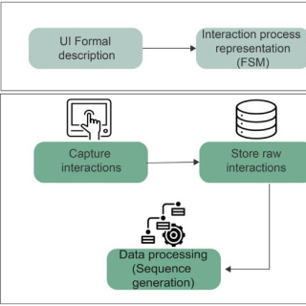
Mutual Information
Understanding Information Sharing in Data Systems
10.01.2026 INFORMATION CODING TECHNIQUE | Mutual Information | P.Thilagarani | SNSCT 2/11

Slide 3


Recap & Icebreaker
Let’s Refresh!
What is entropy in information theory?
How do we measure uncertainty in a message?
Quick Activity
Think of a 3-word message you’d send using only emojis. Could someone decode it accurately? Why or why not?
This touches on how much information is shared between sender and receiver — the heart of mutual information.
10.01.2026 INFORMATION CODING TECHNIQUE | Mutual Information | P.Thilagarani | SNSCT 3/11

Slide 4
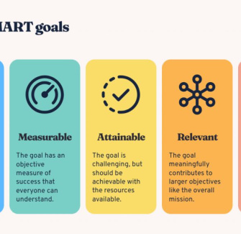
Session Objectives
By the end of this session, you will be able to:
Define mutual information and its mathematical foundation
Explain how it quantifies shared information between variables
Apply mutual information in coding, machine learning, and communication systems
Analyze real-world scenarios using the Design Thinking approach
Reflect on interdisciplinary applications using the T-Shaped Model
10.01.2026 INFORMATION CODING TECHNIQUE | Mutual Information | P.Thilagarani | SNSCT 4/11

Slide 5
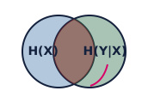
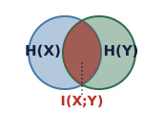
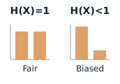
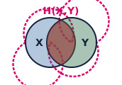
Mutual Information: Core Concepts
Conditional Entropy
Uncertainty in Y given knowledge of X — reduces randomness.
Mutual Info
Quantifies how much knowing one variable reduces uncertainty about another.
Entropy
Measures random variable uncertainty. Higher entropy = more unpredictability.
Joint Entropy
Captures total uncertainty when two variables are considered together.
10.01.2026 INFORMATION CODING TECHNIQUE | Mutual Information | P.Thilagarani | SNSCT 5/11

Slide 6
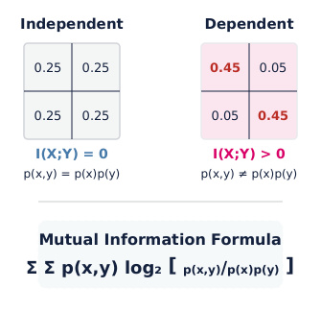
The Math Behind It
Mutual Information Formula
I(X;Y) = Σ Σ p(x,y) log₂ [p(x,y)/(p(x)p(y))]
I(X;Y): Mutual information
p(x,y): Joint probability
p(x), p(y): Marginal probabilities
Interpretation
I(X;Y) = 0: X, Y independent
I(X;Y) > 0: Information shared
Maximum when one variable perfectly predicts the other
Symmetric: I(X;Y) = I(Y;X)
10.01.2026 INFORMATION CODING TECHNIQUE | Mutual Information | P.Thilagarani | SNSCT 6/11

Slide 7

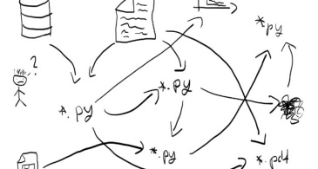
Design Thinking: Persona & Problem
Meet Priya
Data engineer at a telecom startup. Noisy user logs. Wants to predict churn, struggles with signal vs. noise.
Core Challenge: Priya needs to identify variables (login frequency, call duration) truly linked to customer churn, as traditional correlation misses non-linear patterns.
10.01.2026 INFORMATION CODING TECHNIQUE | Mutual Information | P.Thilagarani | SNSCT 7/11

Slide 8

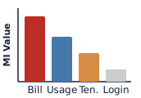

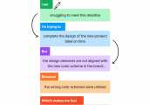
Design Thinking Approach
Define
Frame the problem: 'Find variables with high mutual information with churn.'
Prototype
Apply I(X;Y) to telecom dataset: compare login patterns vs. billing complaints.
Empathize
Understand Priya’s need to reduce false alarms and focus on actionable insights.
Ideate
Use mutual information instead of correlation to capture non-linear dependencies.
10.01.2026 INFORMATION CODING TECHNIQUE | Mutual Information | P.Thilagarani | SNSCT 8/11

Slide 9
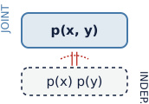
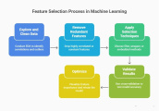


T-Shaped Model: Depth & Breadth
ML Applications
Used in feature selection — pick features that share max info with target label.
Future Scope
Quantum information theory uses mutual info to study entanglement and communication limits.
Vertical Depth
I(X;Y) is KL divergence between joint and product distributions.
Neuroscience
Measures how neuron firing patterns encode sensory stimuli.
10.01.2026 INFORMATION CODING TECHNIQUE | Mutual Information | P.Thilagarani | SNSCT 9/11

Slide 10
Summary & Reflection
Key Takeaways
Mutual information quantifies shared information, capturing non-linear relationships beyond correlation. It's based on entropy and used in data science, communications, and neuroscience. Design thinking helped solve Priya's challenge.
Peer Sharing
Share a real-life scenario where mutual information could reveal hidden patterns.
Quick Assessment
Why is mutual information preferred over correlation in feature selection?
10.01.2026 INFORMATION CODING TECHNIQUE | Mutual Information | P.Thilagarani | SNSCT 10/11

Slide 11
Thank you
10.01.2026 INFORMATION CODING TECHNIQUE | Mutual Information | P.Thilagarani | SNSCT 11/11

