Slide 1
SNS COLLEGE OF TECHNOLOGY
Coimbatore-35
An Autonomous Institution
Department of AIML
23AMO304-Introduction To Business Intelligence
ROLAP Architecture
Dynamic Multidimensional Analysis via Relational Systems
Dr. Angel Latha Mary S
SNS College of Technology | Coimbatore

Slide 2
Part 1
The Fundamentals of Relational OLAP

Slide 3


What is ROLAP?
Definition
Relational Online Analytical Processing (ROLAP) is an approach that performs multidimensional analysis directly on top of traditional relational databases.
Core Concept: Multidimensional view, Relational storage. It bridges the gap between massive datasets and complex reporting needs.
Unlike MOLAP, which uses proprietary cubes, ROLAP utilizes relational tables to answer analytical queries, generating SQL on the fly.

Slide 4

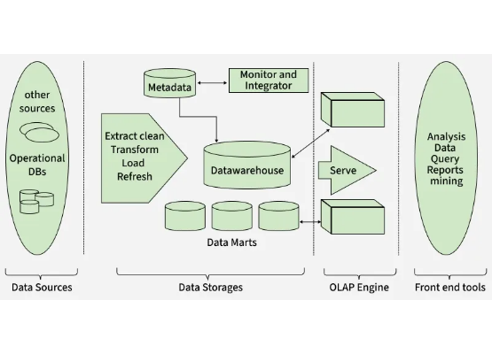
The Three-Tier Architecture
Database Server: The relational back-end (RDBMS) where fact and dimension tables are stored.
ROLAP Server: The middleware that translates OLAP operations into SQL statements.
Front-End Tools: Client applications used for reporting, visualization, and ad-hoc analysis.

Slide 5
Part 2
Technical Mechanics & Data Modeling

Slide 6
Data Structures in ROLAP
Star & Snowflake Schemas
ROLAP relies on structured relational models to optimize query generation. These models allow for clear separation between transactional measures and descriptive attributes.
Star Schema: Simple, centralized fact table connected to dimensions.
Snowflake: Normalized dimensions for reduced redundancy.

Slide 7






The ROLAP Query Cycle
SQL Generation
Dynamic Aggregation
Aggregation Nav
The server receives multidimensional requests (Slice/Dice) and generates optimized SQL JOINs and aggregates.
Logic that determines whether to use pre-calculated summary tables or query raw detail data.
Calculations are performed at runtime by the database engine, ensuring access to the latest data.

Slide 8
Performance Matrix
Feature | ROLAP | MOLAP | HOLAP
Storage | Relational (Tables) | Multidimensional (Cubes) | Mixed/Hybrid
Scalability | High (Petabytes) | Low/Medium | Medium/High
Query Speed | Moderate/Slow | Fast (Pre-calculated) | Optimized
Data Freshness | Real-time access | Needs processing | Semi-processed

Slide 9
Strategic Benefits
Massive Scalability: Leverages the power of modern RDBMS to handle data volumes that would break traditional cubes.
Security & Admin: Inherits the robust security, authentication, and backup protocols of the underlying relational database.
Near Real-Time: No lengthy "cube building" phase; users can query the warehouse as soon as data is loaded.
Flexibility: Easily handles changes in data structure without needing a total rebuild.

Slide 10
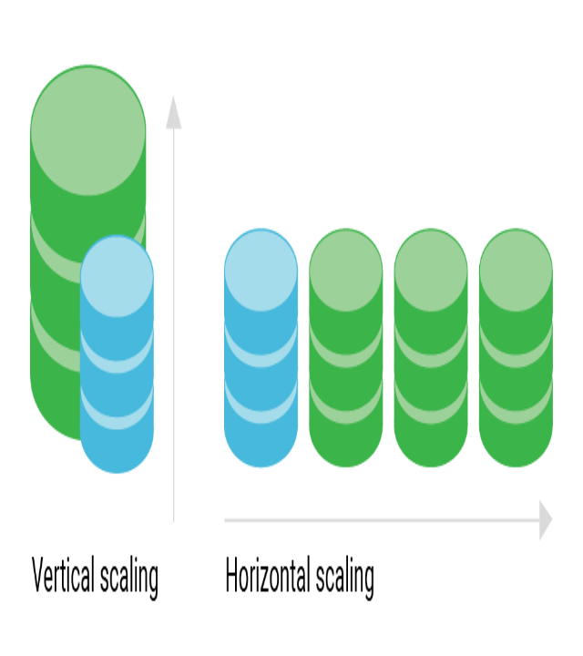
Business Use Cases
ROLAP is the industry standard for Big Data Analytical Reporting. Organizations use it when:
1. Data exceeds the capacity of standard OLAP cubes.
2. Detailed "drill-down" to the lowest transaction level is required.
3. Frequent data updates necessitate near real-time reporting availability.

Slide 11







Puzzle 1: Tier Matcher
Match the Tier to its primary function:
(Answer: 1-B, 2-C, 3-A)

Slide 12



Puzzle 2: True or False?
Scenario: Your company needs to analyze 50TB of daily transaction data with real-time updates.
Statement: "ROLAP is a better choice than MOLAP for this specific scenario."
Why? Because ROLAP excels at high data volumes and real-time accessibility without pre-calculation delays.

