Slide 1


Error Correction: The Power of Minimum Distance
Ensuring Data Integrity in Information Coding

Slide 2


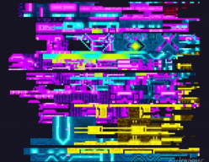
Icebreaker: The 'Pass the Message' Glitch
Think about a time you received a distorted text message or a corrupted file. Why does digital noise happen, and how does the receiving device 'guess' the original message?

Slide 3
Icebreaker: The 'Pass the Message' Glitch
✅​
You might have said...
Signals can be corrupted by electromagnetic interference.
Devices use mathematical buffers called redundancy.
Error correction codes allow the system to realize a bit has flipped from 0 to 1.

Slide 4

Define & Empathize: The Data Engineer's Dilemma
The Persona: Aarav, Network Engineer
Aarav manages high-speed satellite links in rural India. High atmospheric noise causes frequent 'bit flips' (0 becoming 1).
The Challenge
Aarav needs to design a system where the receiver can not only detect that an error occurred but also correct it automatically without re-sending the data. This requires understanding the geometric 'distance' between valid codewords.

Slide 5
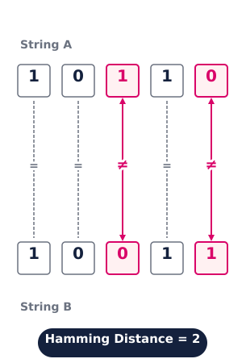
Ideate: Hamming Distance Fundamentals
What is Hamming Distance?
It is the number of positions at which the corresponding symbols of two equal-length strings are different.
The Concept of 'Minimum Distance' (d-min)
In a set of valid codewords (a Code), the Minimum Distance is the smallest Hamming distance between any two distinct codewords.
If d-min is large, codewords are distinct enough that noise won't easily turn one valid word into another.

Slide 6
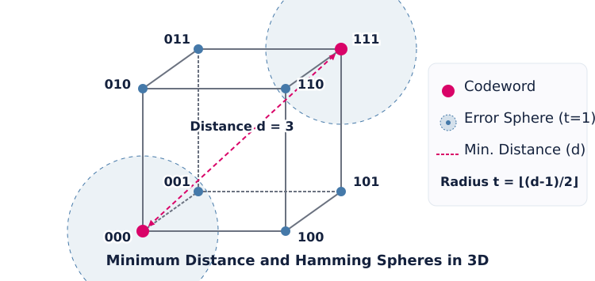
Prototype: Visualizing Error Spheres

Slide 7


Technical Depth: The d-min Rules
1
2
Error Detection
To detect 's' errors, you need a minimum distance of d-min ≥ s + 1.
Error Correction
To correct 't' errors, you need d-min ≥ 2t + 1. This ensures the corrupted word is still 'closer' to the original than any other.

Slide 8


Test: Group Problem Solving
Scenario: The 3-Bit Code
Your code consists of two words: {000, 111}.
What is the Hamming distance between them?
If a receiver gets 101, which codeword was likely sent?
Calculate the maximum number of errors this code can detect and correct.

Slide 9
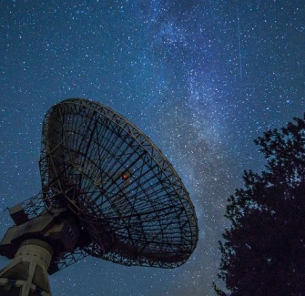
Horizontal Breadth: Real-World Scope
Applications
Deep Space Communication: NASA uses high d-min codes to talk to Voyager probes.
QR Codes: The reason a torn or coffee-stained QR code still works is because of Reed-Solomon codes and minimum distance.
Cloud Storage: RAID systems use these principles to recover data from failed hard drives.

Slide 10



Summary & Key Takeaways
The Golden Rule
Increase redundancy to increase d-min, which increases reliability but slows throughput.
Data Integrity
Minimum distance is the safety margin between valid data points.
Future Scope
Quantum Error Correction uses similar logic to protect qubits from decoherence.

Slide 11

Final Assessment
Question 1:
If a code has a minimum distance of 5, what is the maximum number of errors it can reliably correct?
Question 2:
What happens to the 'efficiency' of a code as you increase the minimum distance?
Question 3:
True or False: Hamming distance can be calculated between strings of different lengths.
Answers on the next slide...

Slide 12
Final Assessment
✅​
Answer 1:
2 errors (using the formula d-min >= 2t + 1; 5 >= 2t +1 implies t=2).
Answer 2:
Efficiency typical decreases because you must add more redundant/parity bits.
Answer 3:
False. Hamming distance is only defined for strings of equal length.

