Slide 1

SNS COLLEGE OF TECHNOLOGY
An Autonomous Institution Coimbatore-35
DEPARTMENT OF INFORMATION TECHNOLOGY
23ITT304 Information Coding Technique
Unit II
Source Coding
Arithmetic Coding
Thilagarani P
P.Thilagarani AP/IT

Slide 2


Arithmetic Coding
A Smart Way to Code Data
02.03.2026 INFORMATION CODING TECHNIQUE | Arithmetic Coding | P.Thilagarani | SNSCT 3/15

Slide 3

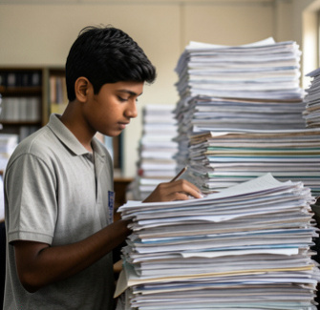
Let's Meet Anil
Our Persona
Anil is a student.
He has a big file.
He wants to send it to his friend.
But the file is too big!
He needs to make it smaller.
02.03.2026 INFORMATION CODING TECHNIQUE | Arithmetic Coding | P.Thilagarani | SNSCT 3/15

Slide 4
The Problem
What is wrong?
The file is huge.
It takes too long to send.
It uses too much space.
What do we need?
We need to shrink the file.
We need to keep all the data.
We need a smart code.
02.03.2026 INFORMATION CODING TECHNIQUE | Arithmetic Coding | P.Thilagarani | SNSCT 3/15

Slide 5

The Big Idea
What is Arithmetic Coding?
It is a way to squash data.
We use a number line.
We pick a small range.
That small range is our code!
02.03.2026 INFORMATION CODING TECHNIQUE | Arithmetic Coding | P.Thilagarani | SNSCT 3/15

Slide 6
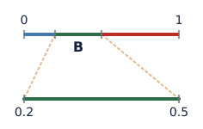
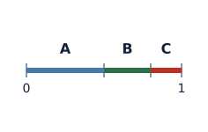
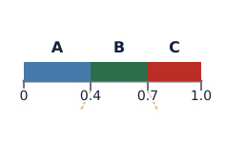
How It Works
Step 3
We zoom in on the part we need.
Step 1
We start with a line from 0 to 1.
Step 2
We split the line for each letter.
02.03.2026 INFORMATION CODING TECHNIQUE | Arithmetic Coding | P.Thilagarani | SNSCT 3/15

Slide 7
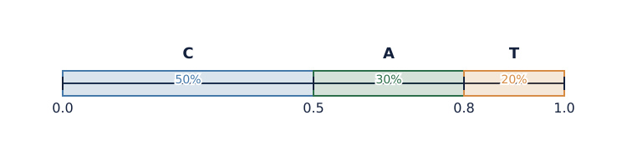
Let's Try an Example
Message: "CAT"
C, A, T. We look at the chance for each letter.
The Result
Find "CAT" spot, pick number. That's the code.
02.03.2026 INFORMATION CODING TECHNIQUE | Arithmetic Coding | P.Thilagarani | SNSCT 3/15

Slide 8

True or False ✅​ ❌​
Arithmetic coding uses one big number for the whole message.
👍​
👎​
Answers on the next slide...
TRUE
FALSE
02.03.2026 INFORMATION CODING TECHNIQUE | Arithmetic Coding | P.Thilagarani | SNSCT 3/15

Slide 9
True or False ✅​ ❌​
✅​
Arithmetic coding uses one big number for the whole message.
👍​
TRUE
Yes! It uses one single number to represent the whole message.
02.03.2026 INFORMATION CODING TECHNIQUE | Arithmetic Coding | P.Thilagarani | SNSCT 3/15

Slide 10
Where Do We Use This?
Deep Dive
JPEG Images: Helps photos load fast.
Video: Makes files small.
Math: Uses fractions and ranges.
Big Picture
Saves space on phones.
Makes internet faster.
Helps in data science jobs.
02.03.2026 INFORMATION CODING TECHNIQUE | Arithmetic Coding | P.Thilagarani | SNSCT 3/15

Slide 11


Your Turn
Think of a short word like "BAT".
Draw a line.
Split it into three parts.
Which part would you zoom into first?
02.03.2026 INFORMATION CODING TECHNIQUE | Arithmetic Coding | P.Thilagarani | SNSCT 3/15

Slide 12
Thank You
02.03.2026 INFORMATION CODING TECHNIQUE | Arithmetic Coding | P.Thilagarani | SNSCT 3/15

Slide 13

Final Quiz
Question 1:
What do we use to code the message?
Answers on the next slide...
Question 2:
Does arithmetic coding make files bigger?
Question 3:
Can we use this for photos?

Slide 14
Final Quiz
✅​
Answer 1:
A number line
Answer 2:
No, it makes them smaller
Answer 3:
Yes

