Slide 1

SNS COLLEGE OF TECHNOLOGY
An Autonomous Institution Coimbatore-35
DEPARTMENT OF INFORMATION TECHNOLOGY
23ITT304 Information Coding Technique
Unit I
Information Theory
Channel Models
P.Thilagarani AP/IT

Slide 2

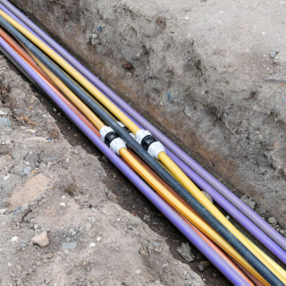
Channel Models
Understanding Information Transmission in Coding Systems
10.01.2026 INFORMATION CODING TECHNIQUE |Channel Models | P.Thilagarani | SNSCT 10/11

Slide 3


Recap & Icebreaker
Quick Recap
• What is information coding?
• How do digital messages travel from sender to receiver?
Think-Pair-Share
Imagine you're sending an urgent text message, but only half arrives. What might have gone wrong in the transmission?
Discuss with a partner: Could the environment, device, or network affect the message?
10.01.2026 INFORMATION CODING TECHNIQUE |Channel Models | P.Thilagarani | SNSCT 10/11

Slide 4
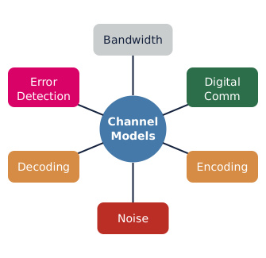
Session Objectives
By the end of this session, you will be able to:
• Explain what a channel model is in information theory.
• Identify types of communication channels and common distortions.
• Apply design thinking to diagnose transmission issues.
• Connect channel models to real-world tech (5G, Wi-Fi, satellite).
10.01.2026 INFORMATION CODING TECHNIQUE |Channel Models | P.Thilagarani | SNSCT 10/11

Slide 5

Design Thinking Approach
1
Empathize
User frustration: slow messages, failed loads. Consider rural, mobile, video call contexts.
2
Define
Info degrades over transmission channels due to noise, interference, and bandwidth limits.
3
Ideate
Brainstorm: encoding, error correction, boosting, adaptive modulation.
4
Prototype
Simulate noisy channel: binary message, bit flips, test recovery.
10.01.2026 INFORMATION CODING TECHNIQUE |Channel Models | P.Thilagarani | SNSCT 10/11

Slide 6
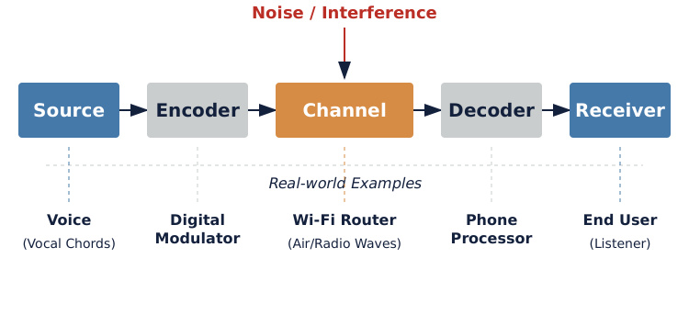
The Communication Channel Model
10.01.2026 INFORMATION CODING TECHNIQUE |Channel Models | P.Thilagarani | SNSCT 10/11

Slide 7
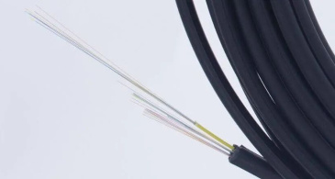
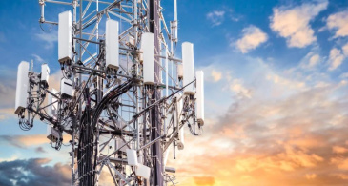
Types of Channels
Wired Channels
Physical media (fiber optics, copper cables). High bandwidth, low interference, limited mobility.
Wireless Channels
Radio waves, microwaves, satellite links. Prone to noise, fading, congestion, but enable mobile access.
10.01.2026 INFORMATION CODING TECHNIQUE |Channel Models | P.Thilagarani | SNSCT 10/11

Slide 8
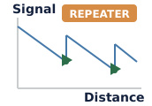
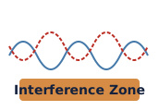
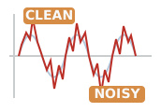

Common Channel Distortions
Attenuation
Signal weakens over distance; requires repeaters or amplifiers in long-distance transmission.
Interference
Signals overlap from multiple sources; common in crowded wireless spectrums.
Noise
Random signal disturbances from environment/electronics can flip bits in digital transmission.
Delay
Time lag in transmission; critical in real-time applications like video conferencing.
10.01.2026 INFORMATION CODING TECHNIQUE |Channel Models | P.Thilagarani | SNSCT 10/11

Slide 9
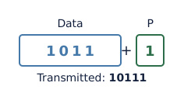
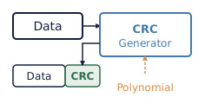
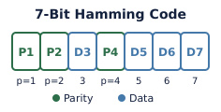
Error Control Techniques
Parity Check
Adds a single bit to detect odd-numbered bit errors in small data units.
CRC
Cyclic Redundancy Check uses polynomial division for robust error detection in networks.
Hamming Code
Detects and corrects single-bit errors using redundant bits placed at power-of-two positions.
10.01.2026 INFORMATION CODING TECHNIQUE |Channel Models | P.Thilagarani | SNSCT 10/11

Slide 10
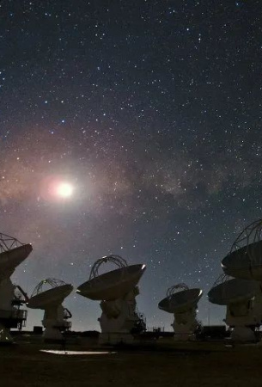
Summary & Key Takeaways
Channel models explain information travel & degradation. Wired vs. wireless channels offer speed, reliability, and mobility trade-offs. Noise, attenuation, delay, and interference are key challenges. Error detection/correction ensures data integrity. Design thinking aids resilient communication systems. Applications: telecom, satellite, IoT, and future 6G.
10.01.2026 INFORMATION CODING TECHNIQUE |Channel Models | P.Thilagarani | SNSCT 10/11

Slide 11
10.01.2026 INFORMATION CODING TECHNIQUE |Channel Models | P.Thilagarani | SNSCT 10/11

