Slide 1

SNS COLLEGE OF TECHNOLOGY
An Autonomous Institution Coimbatore-45
DEPARTMENT OF INFORMATION TECHNOLOGY
23ITT304 Information Coding Technique
Unit IV
MASTERING CYCLIC CODES
P.Thilagarani AP/IT
LINEAR BLOCK CODES AND CYCLIC CODES

Slide 2


MASTERING CYCLIC CODES
Efficiency and Error Correction in Modern Communication
12.05.2026 23ITT304-INFORMATION CODING TECHNIQUES |MASTERING CYCLIC CODES | P.Thilagarani | SNSCT 2/14

Slide 3


SETTING THE STAGE: RECAP & WARM-UP
STARTER
What do we remember?
Last session, we explored Linear Block Codes. We learned how to use parity bits to detect errors.
Quick Challenge: If you translate a digital message and shift its bits to the right, is it still a valid part of the code? In most systems, no—but today we discover the exception.
12.05.2026 23ITT304-INFORMATION CODING TECHNIQUES |MASTERING CYCLIC CODES | P.Thilagarani | SNSCT 3/14

Slide 4

DESIGN THINKING: THE PROBLEM
EMPATHIZE & DEFINE
Meet Raj, a Network Engineer
Raj works for a telecom provider in Bangalore. He faces a challenge: standard block codes require complex hardware for high-speed encoding.
The Pain Point: High latency in error correction because of massive generator matrices (G). We need a code that is memory efficient and mathematically simple to implement.
12.05.2026 23ITT304-INFORMATION CODING TECHNIQUES |MASTERING CYCLIC CODES | P.Thilagarani | SNSCT 4/14

Slide 5

IDEATE: THE POWER OF ALGEBRA
The Solution
What if we treat binary sequences as polynomials?
By treating the code (1011) as x³ + x + 1, we can use polynomial division. If a code is cyclic, any cyclic shift of a codeword is also a codeword. This allows us to use Shift Registers instead of huge lookup tables.
🔑
Key point
A linear code C is cyclic if for every codeword (c₀, c₁, ..., cₙ₋₁), the shifted version (cₙ₋₁, c₀, ..., cₙ₋₂) is also in C.
12.05.2026 23ITT304-INFORMATION CODING TECHNIQUES |MASTERING CYCLIC CODES | P.Thilagarani | SNSCT 5/14

Slide 6
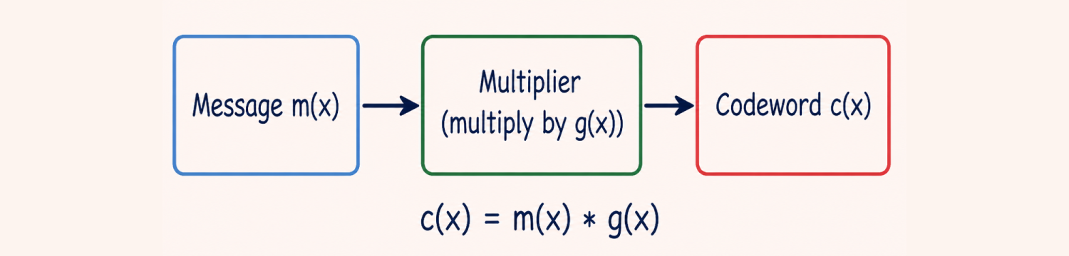
PROTOTYPE: GENERATOR POLYNOMIALS
Every (n, k) cyclic code is uniquely defined by a Generator Polynomial g(x) of degree (n-k).
🔍
Example
To find a codeword for m(x), we multiply it by the fixed g(x). All valid codewords are multiples of this generator polynomial.
12.05.2026 23ITT304-INFORMATION CODING TECHNIQUES |MASTERING CYCLIC CODES | P.Thilagarani | SNSCT 6/14

Slide 7
QUICK KNOWLEDGE CHECK
Answers on the next slide...
In a cyclic code of length n=7, if (1011000) is a valid codeword, which of the following must also be a valid codeword?
1.
0001101 (Reverse order)
2.
0101100 (Single cyclic shift)
3.
1111111 (All ones)
4.
0000000 (The zero vector is always there, but not because of the cyclic property)
12.05.2026 23ITT304-INFORMATION CODING TECHNIQUES |MASTERING CYCLIC CODES | P.Thilagarani | SNSCT 7/14

Slide 8
QUICK KNOWLEDGE CHECK
✅​
In a cyclic code of length n=7, if (1011000) is a valid codeword, which of the following must also be a valid codeword?
1.
0001101 (Reverse order)
2.
0101100 (Single cyclic shift)
👍​
3.
1111111 (All ones)
4.
0000000 (The zero vector is always there, but not because of the cyclic property)
12.05.2026 23ITT304-INFORMATION CODING TECHNIQUES |MASTERING CYCLIC CODES | P.Thilagarani | SNSCT 8/14

Slide 9
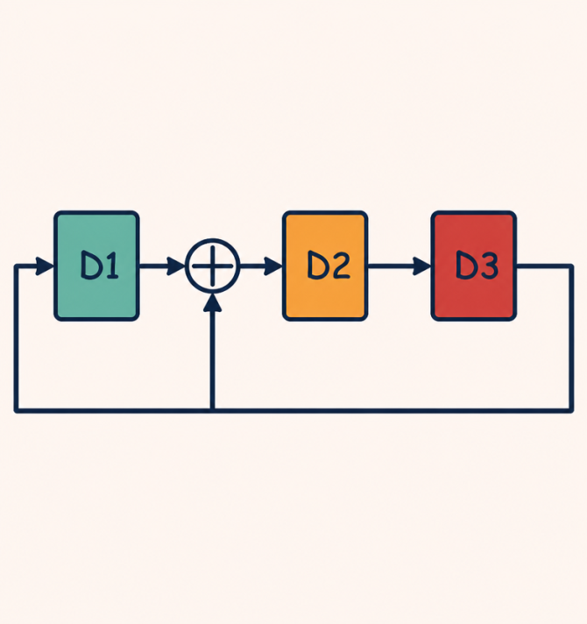
VERTICAL DEPTH: HARDWARE MASTERY
TECHNICAL DETAIL
Implementing cyclic codes in silicon is done using Linear Feedback Shift Registers (LFSRs).
Efficiency: Only requires XOR gates and Flip-Flops.
Cyclic Redundancy Check (CRC): This is the most famous application of cyclic codes, used in Ethernet and USB.
12.05.2026 23ITT304-INFORMATION CODING TECHNIQUES |MASTERING CYCLIC CODES | P.Thilagarani | SNSCT 9/14

Slide 10

HORIZONTAL BREADTH: REAL-WORLD IMPACT
Interdisciplinary Links
Storage: Hard drives and CDs use Reed-Solomon codes (a type of cyclic code).
Deep Space: Error correction for satellite imagery.
Future Scope
5G/6G Networks: Advanced cyclic-based polar codes for ultra-reliable communication.
Quantum Computing: Designing quantum-resistant cyclic codes.
12.05.2026 23ITT304-INFORMATION CODING TECHNIQUES |MASTERING CYCLIC CODES | P.Thilagarani | SNSCT 10/14

Slide 11
SUMMARY: CYCLIC CODES MIND MAP
12.05.2026 23ITT304-INFORMATION CODING TECHNIQUES |MASTERING CYCLIC CODES | P.Thilagarani | SNSCT 11/14

Slide 12


CONCLUSION & REFLECTION
If Raj's company switches from standard Block Codes to Cyclic Codes for their new IoT devices, what is the biggest trade-off they might face? Think about mathematical constraints vs. hardware speed.
12.05.2026 23ITT304-INFORMATION CODING TECHNIQUES |MASTERING CYCLIC CODES | P.Thilagarani | SNSCT 12/14

Slide 13
CONCLUSION & REFLECTION
✅​
You might have said...
Hardware complexity decreases significantly using LFSRs.
Encoding and decoding speeds increase.
Block length 'n' must match polynomial properties.
Error correction may be restricted in high-noise environments.
12.05.2026 23ITT304-INFORMATION CODING TECHNIQUES |MASTERING CYCLIC CODES | P.Thilagarani | SNSCT 13/14

Slide 14
Thank You
12.05.2026 23ITT304-INFORMATION CODING TECHNIQUES |MASTERING CYCLIC CODES | P.Thilagarani | SNSCT 14/14

