Slide 1

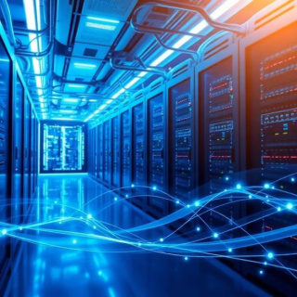
Reliable Communication: Error Detection & Correction
Ensuring Data Integrity in Noisy Channels

Slide 2


Recap & Icebreaker
Question 1:
In a binary system, what happens to a bit if it is corrupted by noise?
Question 2:
What is the simplest way to check if data changed during transmission?
Question 3:
Why can't we just resend data every single time as a fix?
Answers on the next slide...

Slide 3
Recap & Icebreaker
✅​
Answer 1:
It flips (0 becomes 1, or 1 becomes 0).
Answer 2:
Adding a parity bit.
Answer 3:
It wastes bandwidth and increases latency significantly.

Slide 4

Design Thinking: The Persona & Problem
Empathize: Meet Arjun
Arjun is a lead engineer for a UPI payment gateway in Bangalore. He deals with millions of transactions where a single bit flip could mean the difference between ₹1,000 and ₹9,000.
Define: The Challenge
Digital channels are inherently noisy. Cosmic rays, thermal noise, and interference cause Single Bit Errors or Burst Errors. How do we maintain 99.99% integrity without slowing down the network?

Slide 5
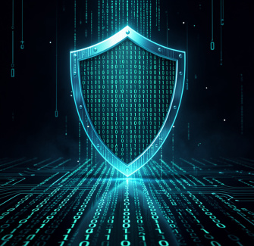
Ideate: Strategies for Integrity
Detection vs. Correction
Detection: Only identifies that an error occurred (e.g., CRC). It requires a retransmission request (ARQ).
Correction: Identifies AND fixes the error at the receiver (e.g., Hamming Code). This is essential for one-way links like satellite comms.
Redundancy is Key
We add extra bits (redundant bits) that follow a mathematical relationship with the data bits.

Slide 6
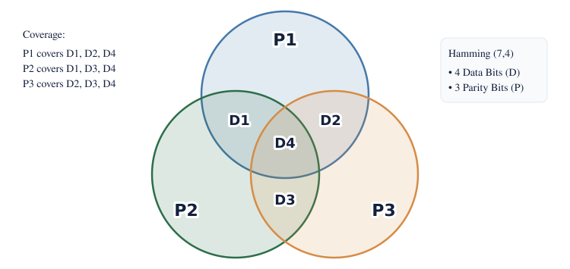
Prototype: Hamming Code (7,4)

Slide 7
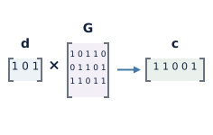
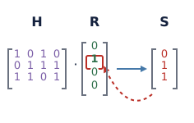
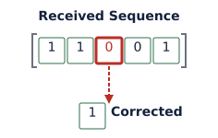
Technical Depth: How it Works
1
2
3
Generator Matrix
Data is multiplied by a matrix to create a codeword with built-in redundancy.
Syndrome Testing
The receiver checks if the received bits satisfy the parity equations.
Error Location
A non-zero syndrome points precisely to the bit position that flipped.

Slide 8

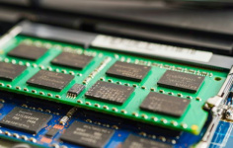

Horizontal Breadth: Applications
Deep Space
NASA uses Reed-Solomon codes to get clear photos from Voyager probes billions of miles away.
ECC Memory
Server RAM uses error correction to prevent crashes caused by solar radiation.
Storage (QR)
QR codes use Reed-Solomon so they can still be scanned even if 30% of the code is smudged.

Slide 9


Active Learning: The Human Parity Check
Group Activity: Role Play
Divide into groups of 3 (Sender, Channel, Receiver).
Sender: Write a 4-bit message and calculate parity.
Channel: Decide whether to flip one bit or not.
Receiver: Verify parity. Can you identify the error?

Slide 10
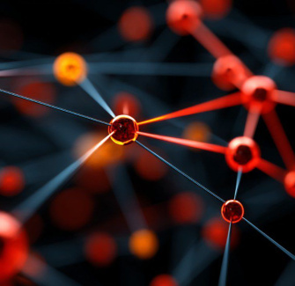
Summary & Key Takeaways
The Mind Map
Objective: Maintain data integrity under noise.
Detection: Checksum, CRC (Cyclic Redundancy Check).
Correction: Hamming Code, Reed-Solomon, Convolutional Codes.
Trade-off: More correction capability requires more redundant bits, reducing the effective data rate.
Reflection
Consider how your smartphone handles a FaceTime call over weak Wi-Fi—that jitter you see is error correction struggling in real-time.

Slide 11
Final Assessment
Answers on the next slide...
If a system uses Forward Error Correction (FEC), what is the primary advantage?
1.
It uses less bandwidth than detection-only systems.
2.
The receiver can fix errors without asking the sender to retransmit.
3.
It eliminates the need for any redundant bits.
4.
It prevents noise from entering the channel entirely.

Slide 12
Final Assessment
✅​
If a system uses Forward Error Correction (FEC), what is the primary advantage?
1.
It uses less bandwidth than detection-only systems.
2.
The receiver can fix errors without asking the sender to retransmit.
👍​
3.
It eliminates the need for any redundant bits.
4.
It prevents noise from entering the channel entirely.

