Slide 1

SNS COLLEGE OF TECHNOLOGY
An Autonomous Institution Coimbatore-35
DEPARTMENT OF INFORMATION TECHNOLOGY
23ITT304 Information Coding Technique
Unit I
Information Theory
Channel Capacity
P.Thilagarani AP/IT

Slide 2


Channel Capacity
Understanding the Limits of Data Transmission
01.02.2026 INFORMATION CODING TECHNIQUE |Channel Capacity| P.Thilagarani | SNSCT 2/12

Slide 3


Recap & Icebreaker
Think Back: Information Theory Basics
• What is entropy in information theory?
• How does noise affect communication?
Quick Icebreaker:
Imagine texting your friend, but every 3rd word gets scrambled. How would you ensure your message still gets through clearly?
Share one strategy you’d use.
01.02.2026 INFORMATION CODING TECHNIQUE |Channel Capacity| P.Thilagarani | SNSCT 3/12

Slide 4
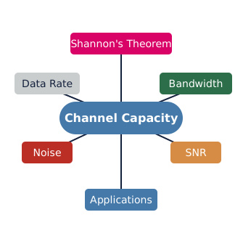
Session Objectives
By the end of this session, you will be able to:
• Define channel capacity and explain its significance in data communication.
• Apply Shannon’s Theorem to calculate maximum data rates.
• Analyze real-world trade-offs between bandwidth, noise, and transmission speed.
• Connect theory to modern applications like 5G, satellite, and Wi-Fi networks.
01.02.2026 INFORMATION CODING TECHNIQUE |Channel Capacity| P.Thilagarani | SNSCT 4/12

Slide 5

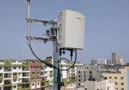
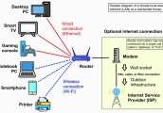
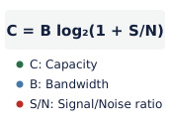
Design Thinking: The Problem
Empathize
Users need fast, reliable internet. Latency and dropped signals hinder communication.
Define
Physical channels limit data transfer speed due to inherent constraints.
Ideate
Speed up without more bandwidth? Reduce errors without slowing down? Coding, modulation, noise.
Prototype
Shannon's formula: model max throughput, simulate noise impact on data rate.
01.02.2026 INFORMATION CODING TECHNIQUE |Channel Capacity| P.Thilagarani | SNSCT 5/12

Slide 6
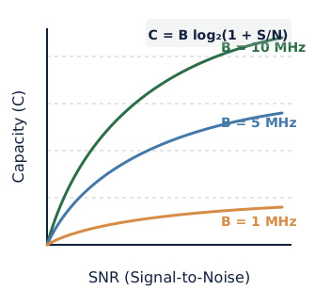
Vertical Depth: Shannon's Theorem
Channel Capacity
Channel capacity (C) is the max data rate over a communication channel with arbitrarily low error.
Shannon-Hartley Law:
C = B log₂(1 + S/N)
• C: Capacity (bits/s)
• B: Bandwidth (Hz)
• S/N: Signal-to-Noise Ratio
Key Insight:
Even with noise, there’s a limit beyond which no coding scheme can reliably transmit faster.
01.02.2026 INFORMATION CODING TECHNIQUE |Channel Capacity| P.Thilagarani | SNSCT 6/12

Slide 7
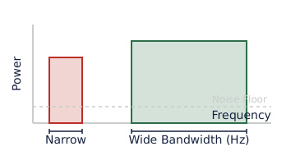
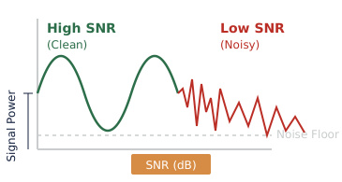
Technical Deep Dive
Bandwidth (B): Physical frequency limit. Higher B = more data lanes. 5G uses mmWave for wider B.
Signal-to-Noise (S/N): Ratio of signal power to noise. Measured in decibels (dB): SNR(dB) = 10 log₁₀(S/N). Low SNR means more errors.
01.02.2026 INFORMATION CODING TECHNIQUE |Channel Capacity| P.Thilagarani | SNSCT 7/12

Slide 8

Horizontal Breadth: Real-World Links
5G Networks
Engineers boost capacity with massive MIMO, mmWave for B and S/N.
1
Satellite Comms
High latency and low S/N require powerful error-correcting codes to approach channel limits.
2
Wi-Fi 6
OFDMA & beamforming boost spectral efficiency in constrained bandwidth.
3
4
Future AI
AI adapts to channel conditions, nearing theoretical capacity.
01.02.2026 INFORMATION CODING TECHNIQUE |Channel Capacity| P.Thilagarani | SNSCT 8/12

Slide 9
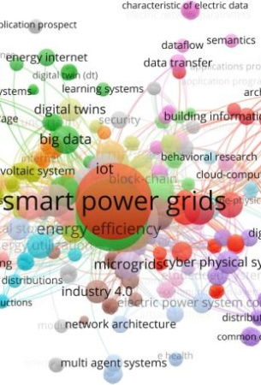
Summary & Mind Map
Channel capacity is a communication system's theoretical speed limit, defined by Shannon's Theorem: C = B log₂(1 + S/N). This formula highlights trade-offs between bandwidth, power, and noise.
Real-world systems use coding and modulation to approach this limit. Applications span telecom, IoT, space, and AI-driven networks. Future systems will intelligently optimize these parameters.
01.02.2026 INFORMATION CODING TECHNIQUE |Channel Capacity| P.Thilagarani | SNSCT 9/12

Slide 10


Discuss! 🤷‍♀️​ 💁‍♂️​ 💬​
Balancing the Limits in Real Networks
Imagine you're designing a network for a remote village with limited power and high interference. How would you balance bandwidth, signal strength, and error correction to maximize usable data rate?
After discussing with a peer, reflect: One thing I now understand about channel limits is...
01.02.2026 INFORMATION CODING TECHNIQUE |Channel Capacity| P.Thilagarani | SNSCT 10/12

Slide 11
Discuss! 🤷‍♀️​ 💁‍♂️​ 💬​
✅​
You might have said...
I would use strong error correction codes to reduce the effect of noise, even if it means sending slightly less data per second.
Increasing bandwidth as much as possible would help since power is limited, but I’d have to make sure the equipment can handle wider channels.
Maximizing signal strength within the power limits and carefully choosing modulation could help make the most of existing conditions.
01.02.2026 INFORMATION CODING TECHNIQUE |Channel Capacity| P.Thilagarani | SNSCT 11/12

Slide 12
Thank You
01.02.2026 INFORMATION CODING TECHNIQUE |Channel Capacity| P.Thilagarani | SNSCT 12/12

