Slide 1

SNS COLLEGE OF TECHNOLOGY
An Autonomous Institution Coimbatore-45
DEPARTMENT OF INFORMATION TECHNOLOGY
23ITT304 Information Coding Technique
Unit IV
INFORMATION CODING: PROPERTIES
P.Thilagarani AP/IT
LINEAR BLOCK CODES AND CYCLIC CODES

Slide 2


INFORMATION CODING: PROPERTIES
Efficiency and Reliability in Data Systems
17.05.2026 23ITT304-INFORMATION CODING TECHNIQUES |PROPERTIES | P.Thilagarani | SNSCT 2/14

Slide 3

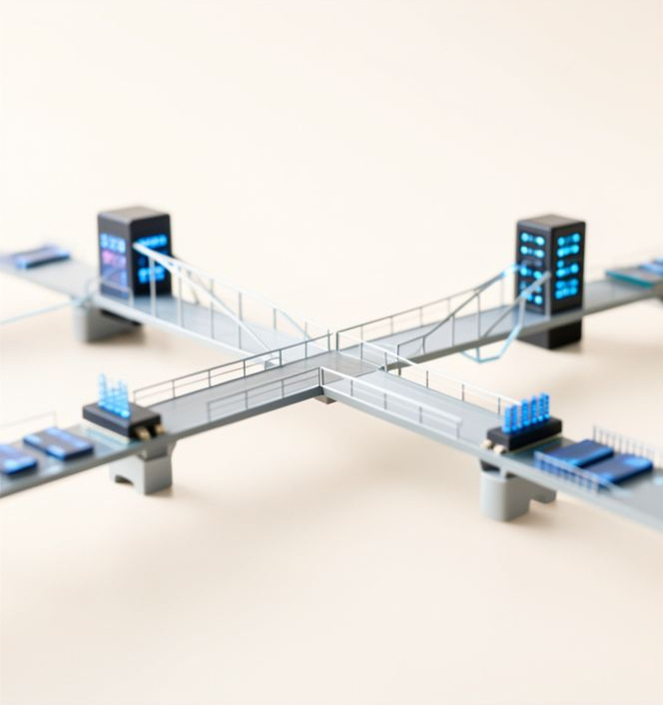
ICEBREAKER & RECAP
What is Coding?
Recall our session on symbols. In India, you use codes daily—from UPI QR codes to Aadhaar digits.
The Hook:
If you compressed all words in this room into 1s and 0s, how would you ensure no two words mixed up?
🔑
Key point
Coding is the mathematical mapping of information for efficient storage and transmission.
17.05.2026 23ITT304-INFORMATION CODING TECHNIQUES |PROPERTIES | P.Thilagarani | SNSCT 3/14

Slide 4

THE PERSONA & PROBLEM
DESIGN THINKING: EMPATHIZE
Meet Arjun
A network engineer at a Bangalore-based startup. He needs to transmit massive sensor data from rural farms to a cloud server with low bandwidth.
The Define Challenge:
How can we design a code that is unambiguous (clear) yet optimal (short) to save battery and bandwidth?
17.05.2026 23ITT304-INFORMATION CODING TECHNIQUES |PROPERTIES | P.Thilagarani | SNSCT 4/14

Slide 5
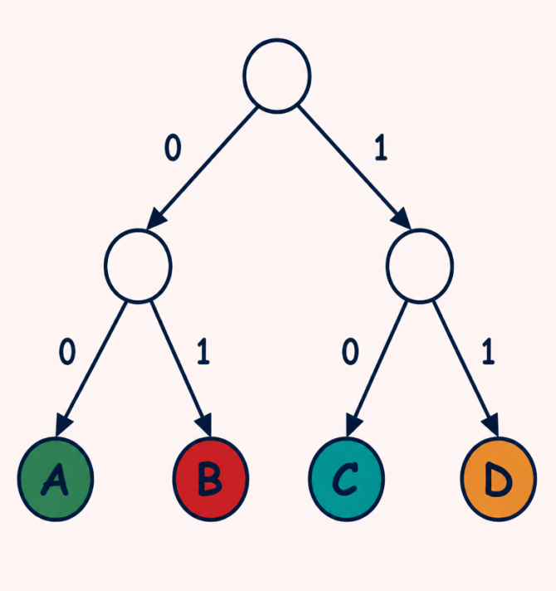
VERTICAL DEPTH: PREFIX PROPERTY
CORE CONCEPT
A code has the Prefix Property (or is 'Prefix-Free') if no code word is a prefix of another.
Why? This allows for 'instantaneous' decoding. As soon as the last bit arrives, the receiver knows the symbol without waiting for a space or the next bit.
🔍
Example
If A=0, B=01, C=11. This is NOT prefix-free because '0' is the start of '01'. The receiver won't know if '0' is A or the start of B!
17.05.2026 23ITT304-INFORMATION CODING TECHNIQUES |PROPERTIES | P.Thilagarani | SNSCT 5/14

Slide 6
INSTANTANEOUS DECODING
Answers on the next slide...
Order these code lengths from most efficient to least efficient for a symbol seen frequently in a dataset (assuming prefix property holds).
1 bit (e.g., '0')
4 bits (e.g., '1111')
3 bits (e.g., '110')
2 bits (e.g., '10')
17.05.2026 23ITT304-INFORMATION CODING TECHNIQUES |PROPERTIES | P.Thilagarani | SNSCT 6/14

Slide 7
INSTANTANEOUS DECODING
✅​
Order these code lengths from most efficient to least efficient for a symbol seen frequently in a dataset (assuming prefix property holds).
1 bit (e.g., '0')
1.
2 bits (e.g., '10')
2.
3 bits (e.g., '110')
3.
4 bits (e.g., '1111')
4.
17.05.2026 23ITT304-INFORMATION CODING TECHNIQUES |PROPERTIES | P.Thilagarani | SNSCT 7/14

Slide 8

IDEATE & PROTOTYPE
DESIGN THINKING
Solving Arjun's Problem
To help Arjun, we use Huffman Coding. This assigns shorter codes to frequent symbols and longer codes to rare ones.
The Prototype
Imagine four types of sensor alerts:
Normal (70%): Code '0'
Warning (20%): Code '10'
Critical (5%): Code '110'
Failure (5%): Code '111'
17.05.2026 23ITT304-INFORMATION CODING TECHNIQUES |PROPERTIES | P.Thilagarani | SNSCT 8/14

Slide 9

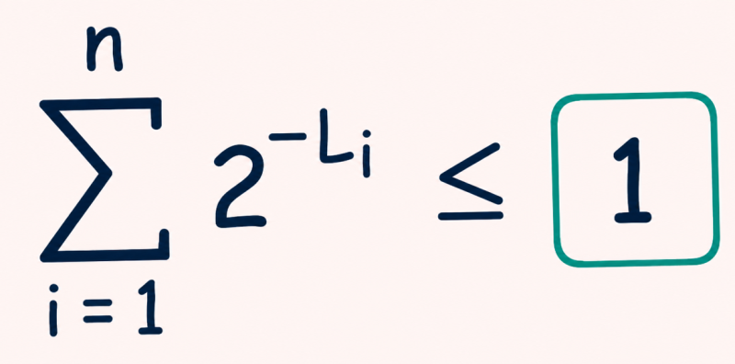
KRAFTS INEQUALITY
MATHEMATICAL DEPTH
For a prefix code with lengths L₁, L₂... Lₙ:
Σ (1/2ᴸᵢ) ≤ 1
If the sum exceeds 1, the code cannot be uniquely decodable without gaps or overlaps.
17.05.2026 23ITT304-INFORMATION CODING TECHNIQUES |PROPERTIES | P.Thilagarani | SNSCT 9/14

Slide 10
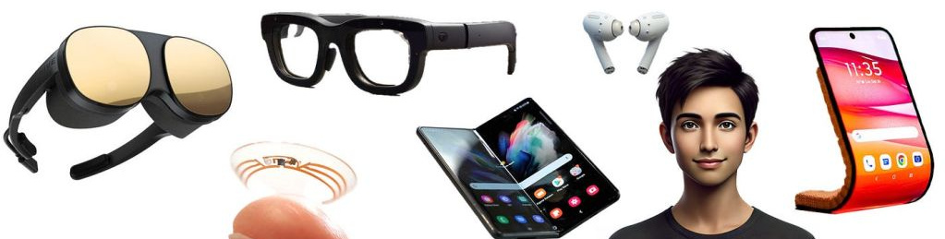
BREADTH: APPLICATIONS & FUTURE
Horizontal Breadth
Multimedia: JPEG and MP3 use these coding properties to reduce file sizes.
Cryptography: Secure coding ensures mapping remains hidden.
Future Scope
Quantum Coding: Using qubits to challenge traditional prefix properties.
5G/6G: Higher packet efficiency via advanced LDPC codes.
17.05.2026 23ITT304-INFORMATION CODING TECHNIQUES |PROPERTIES | P.Thilagarani | SNSCT 10/14

Slide 11
SUMMARY MIND MAP
17.05.2026 23ITT304-INFORMATION CODING TECHNIQUES |PROPERTIES | P.Thilagarani | SNSCT 11/14

Slide 12

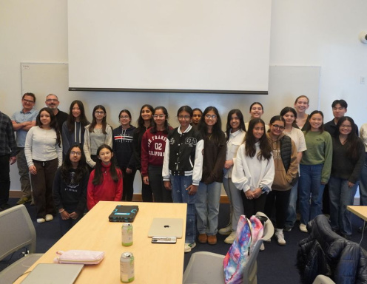
FINAL ASSESSMENT & REFLECTION
Assume you are designing a code for a new Indian language messaging app. Why might a 'Fixed-Length Code' (like ASCII) be worse than a 'Variable-Length Prefix Code' for this scenario?
17.05.2026 23ITT304-INFORMATION CODING TECHNIQUES |PROPERTIES | P.Thilagarani | SNSCT 12/14

Slide 13
FINAL ASSESSMENT & REFLECTION
✅​
You might have said...
Variable-length codes are efficient as common characters use less space.
Fixed-length codes waste space by treating all characters equally.
Prefix codes enable instant processing without needing delimiters.
This reduces data costs for users on limited mobile plans.
17.05.2026 23ITT304-INFORMATION CODING TECHNIQUES |PROPERTIES | P.Thilagarani | SNSCT 13/14

Slide 14
Thank You
17.05.2026 23ITT304-INFORMATION CODING TECHNIQUES |PROPERTIES | P.Thilagarani | SNSCT 14/14

