Slide 1

SNS COLLEGE OF TECHNOLOGY
An Autonomous Institution Coimbatore-35
DEPARTMENT OF INFORMATION TECHNOLOGY
23ITT304 Information Coding Technique
Unit I
Information Theory
Variable Length Codes
P.Thilagarani AP/IT

Slide 2


Shannon’s Theorem
Understanding the Limits of Data Transmission
01.02.2026 INFORMATION CODING TECHNIQUE | Shannon’s Theorem | P.Thilagarani | SNSCT 2/12

Slide 3

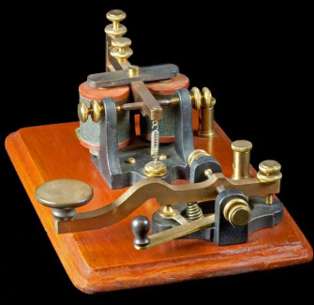
What Is Information?
Beyond Words
Information isn’t just text—it’s anything that reduces uncertainty, like a yes/no answer or a digital signal.
From Analog to Digital
In electronics, information is converted into binary—sequences of 0s and 1s—so machines can process it.
A Simple Analogy
Think of Morse code: short and long pulses carry meaning. Similarly, bits transmit data across channels.
01.02.2026 INFORMATION CODING TECHNIQUE | Shannon’s Theorem | P.Thilagarani | SNSCT 3/12

Slide 4

The Problem of Noise
Real-World Challenge
All communication channels—Wi-Fi, phone lines, radio—have noise: electrical interference or signal loss.
Why It Matters
Noise corrupts data. A '1' might be received as a '0', causing errors in messages or downloads.
Shannon’s Insight
He asked: How much data can we send reliably, even with noise?
01.02.2026 INFORMATION CODING TECHNIQUE | Shannon’s Theorem | P.Thilagarani | SNSCT 4/12

Slide 5
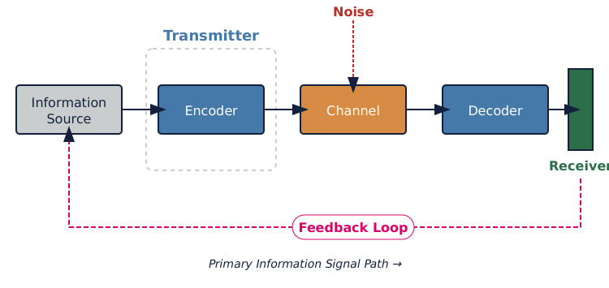
The Communication System
01.02.2026 INFORMATION CODING TECHNIQUE | Shannon’s Theorem | P.Thilagarani | SNSCT 5/12

Slide 6

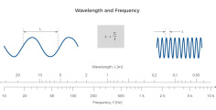

Key Concepts Behind the Theorem
Bandwidth
The maximum frequency range a channel can carry, like how wide a highway is for data.
Noise Power
Unwanted energy in the channel that interferes with the signal.
Signal Power
Strength of the transmitted data signal compared to background noise.
01.02.2026 INFORMATION CODING TECHNIQUE | Shannon’s Theorem | P.Thilagarani | SNSCT 6/12

Slide 7
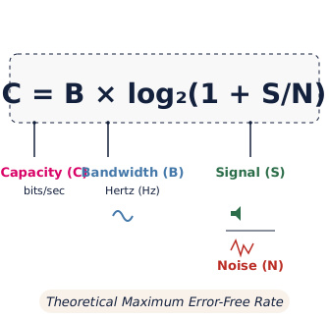
Shannon’s Formula Revealed
The Famous Equation
C = B × log₂(1 + S/N)
Where:
C = Channel capacity (bits/sec)
B = Bandwidth (Hz)
S/N = Signal-to-Noise Ratio
What It Means
This formula gives the maximum error-free data rate on a noisy channel.
Real Insight
Increase capacity by boosting signal or widening bandwidth, but only to a limit.
01.02.2026 INFORMATION CODING TECHNIQUE | Shannon’s Theorem | P.Thilagarani | SNSCT 7/12

Slide 8


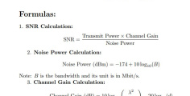
Applying Shannon’s Theorem
Measure Bandwidth
Determine the frequency range of the communication channel.
Calculate S/N
Find the ratio of signal power to noise power in decibels.
Compute C
Plug values into Shannon’s formula to get maximum data rate.
01.02.2026 INFORMATION CODING TECHNIQUE | Shannon’s Theorem | P.Thilagarani | SNSCT 8/12

Slide 9



Real-World Applications
5G Networks
Engineers use Shannon’s limit to design faster, reliable mobile data systems.
Satellite Comms
Ensuring clear signals across vast distances with low power.
Wi-Fi Design
Optimizing router placement and frequency bands for minimal noise.
01.02.2026 INFORMATION CODING TECHNIQUE | Shannon’s Theorem | P.Thilagarani | SNSCT 9/12

Slide 10

Understanding Shannon’s Theorem: From Basics to Application
Question 1:
What does channel capacity mean in the context of Shannon’s Theorem?
Question 2:
Why must the signal-to-noise ratio be greater than zero for effective data transmission according to Shannon’s Theorem?
Question 3:
Calculate the maximum channel capacity for a system with 4000 Hz bandwidth and a signal-to-noise ratio of 15 using Shannon’s formula.
Answers on the next slide...
01.02.2026 INFORMATION CODING TECHNIQUE | Shannon’s Theorem | P.Thilagarani | SNSCT 10/12

Slide 11
Understanding Shannon’s Theorem: From Basics to Application
Answer 1:
Channel capacity is the maximum rate at which data can be transmitted over a communication channel with negligible errors, as defined by Shannon’s Theorem.
Answer 2:
The signal-to-noise ratio (S/N) must be greater than zero because a zero or negative ratio implies the signal is lost in noise, making reliable communication impossible.
Answer 3:
If a channel has a bandwidth of 4000 Hz and a signal-to-noise ratio of 15, the maximum channel capacity is 16,000 bits/sec, calculated using C = B × log₂(1 + S/N) = 4000 × log₂(16) = 4000 × 4.
01.02.2026 INFORMATION CODING TECHNIQUE | Shannon’s Theorem | P.Thilagarani | SNSCT 11/12

Slide 12

The Legacy of Shannon
A Foundational Breakthrough
Shannon’s Theorem set the theoretical foundation for the digital age.
More Than Just Theory
It guides every device that sends data—from smartphones to Mars rovers.
Think About It
Next time your video call is smooth, remember: Shannon made it possible.
01.02.2026 INFORMATION CODING TECHNIQUE | Shannon’s Theorem | P.Thilagarani | SNSCT 12/12

Slide 13
Thank you
01.02.2026 INFORMATION CODING TECHNIQUE | Shannon’s Theorem | P.Thilagarani | SNSCT 12/12

