Slide 1

Dr. SNS RAJALAKSHMI COLLEGE OF ARTS AND SCIENCE
(AUTONOMOUS)
Department of Mathematics
DISCRETE MATHEMATICS WITH PROBABILITY AND HYPOTHESIS TESTING
Unit III
Topic: Probability
Dr. K.Sasikala
Assistant Professor
Dept. of Mathematics
Dr. SNSRCAS

Slide 2
A consulting firm rents car from three agencies such that 50% from agency L, 30% from agency M and 20% from agency N. If 90% of the cars from L, 70% of cars from M and 60% of the cars from N are in good conditions
(i) what is the probability that the firm will get a car in good condition?
(ii) if a car is in good condition, what is probability that it has come from agency N?

Slide 3
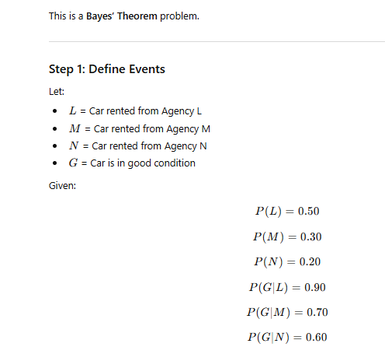

Slide 4
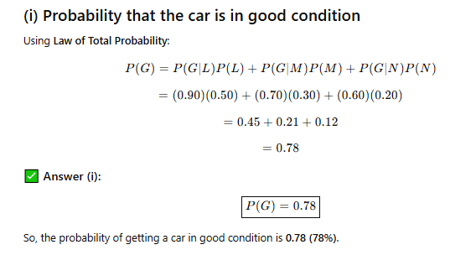

Slide 5
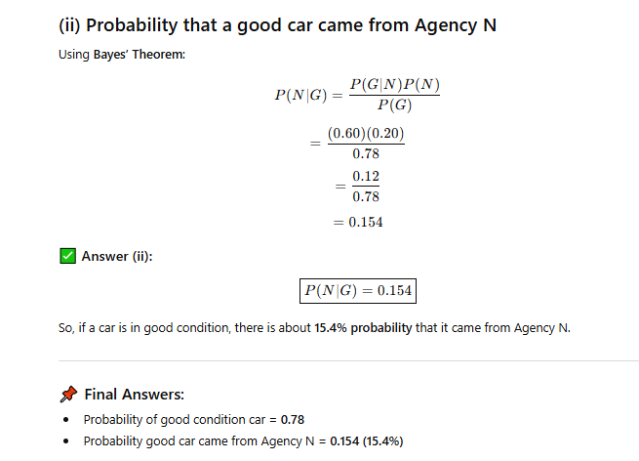

Slide 6
Thank You

