Slide 1

SNS COLLEGE OF TECHNOLOGY
Coimbatore-35
An Autonomous Institution
Department of AIML
23AMO304-Introduction To Business Intelligence
Unit I: Foundations of BI | Evolution & Drivers
TOPIC- Business Intelligence and Analytics – Evolution and Drivers

Slide 2



Recap & Icebreaker
The Data Chaos Challenge
Before we dive in, let's reflect on the current state of information in most organizations.
Icebreaker: Can you name a time you had the data but couldn't make a decision?
Recap: The transition from manual ledger keeping to digital data storage.
The Gap: Data exists, but "Intelligence" is missing.

Slide 3


Define the Core Challenge
Persona: Alex, Operations Lead
Problem: "I spend 70% of my time manually aggregating Excel sheets and only 30% actually managing the team."
Empathize: Feeling of "Information Blindness."
The Challenge: How do we turn siloed, raw data into a competitive steering wheel?

Slide 4
The Evolution: From DSS to AI
BI isn't new; it has transformed with computing power.
1970s: Decision Support Systems (DSS) - Rule-based models.
1990s: Traditional BI - Static reporting and Data Warehousing.
2010s: Self-Service BI - Visual discovery (Tableau/Qlik).
2020s: Augmented Analytics - AI-driven insights and NLQ.

Slide 5





The Design Thinking Lens
Empathize
Define
Ideate
Understand the decision-maker's pain points, pressure, and goals.
Pinpoint the specific data gaps preventing strategic growth.
Conceptualize automated workflows and real-time visualization solutions.

Slide 6
Market & Technical Drivers
Why Now?
Several forces have converged to make BI the "New Oil" of business.
Big Data: The 3 V's (Volume, Velocity, Variety).
Cloud Accessibility: Scalable processing at lower costs.
Competitive Pressure: Faster cycles require data-backed agility.
AI Democratization: Complex models are now available to non-coders.

Slide 7
Prototype: Retail Optimization
Simulation Case Study
A regional retailer sees high waste in fresh produce. We prototype a BI solution.
Input: Inventory levels + Local weather + Footfall.
Process: Correlation analysis in real-time.
Output: Smart Reordering Dashboard.
Activity: Group discussion on "What metrics would Alex need on his tablet?"

Slide 8
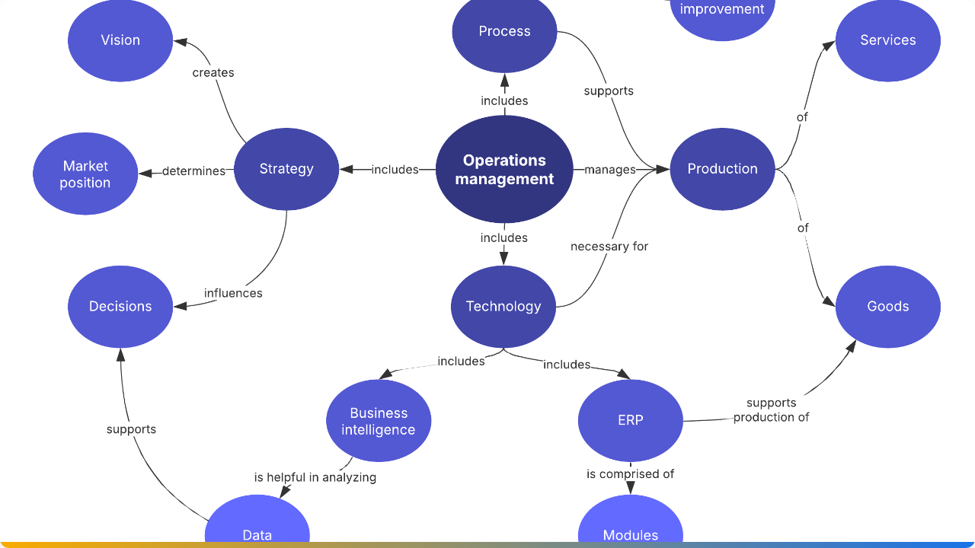



The Big Picture
Past
Now
Next
Descriptive: What happened?
Diagnostic: Why did it happen?
Predictive: What will happen?
BI is the journey from Hindsight to Foresight.

Slide 9

Assessment & Reflection
Quick Assessment: Identify one "Driver" and one "Evolution Stage" that led to the rise of Self-Service Analytics.
Reflection: How can the T-Shaped model help you in your future career as a BI professional?
Questions? Discussion time!

Slide 10

Image Sources
https://lucid.app/systemTemplates/thumb/45d33cc1-27d5-4cac-b86d-92cc222f63b1/0/124/NULL/2400/true?clipToPage=false
Source: lucid.co

