Slide 1

SNS COLLEGE OF TECHNOLOGY
An Autonomous Institution Coimbatore-35
DEPARTMENT OF INFORMATION TECHNOLOGY
23ITT304 Information Coding Technique
Unit V
CONVOLUTIONAL CODES AND APPLICATIONS
Convolutional Codes
P.Thilagarani AP/IT

Slide 2
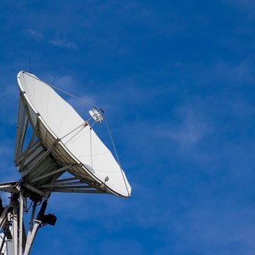
Convolutional Codes
Reliable Data Transmission for Modern Digital Communication
5.04.2026 INFORMATION CODING TECHNIQUES | Convolutional Codes| P.Thilagarani | SNSCT 2/13

Slide 3

Icebreaker: The Whispering Gallery
Can you hear me now?
Imagine sending a critical text message during a chaotic monsoon in Mumbai. Electrical noise and physical barriers interfere with the signal.
🔑
Key point
How do we ensure the receiver gets the exact message even when the channel is noisy?
5.04.2026 INFORMATION CODING TECHNIQUES | Convolutional Codes| P.Thilagarani | SNSCT 3/13

Slide 4

Empathizing with the Engineer
DESIGN THINKING: EMPATHY
Meet Arjun, a systems engineer designing a deep-space probe for ISRO.
Arjun's challenge isn't just sending data; it's the fact that data gets corrupted across millions of miles. He needs a way to build memory into the code so the receiver can 'guess' the correct bit even if some are lost.
5.04.2026 INFORMATION CODING TECHNIQUES | Convolutional Codes| P.Thilagarani | SNSCT 4/13

Slide 5
Defining the Problem: Memoryless vs. Memory
Block Codes
Data sliced into fixed blocks.
No inter-block correlation.
Example: Hamming Codes.
Convolutional Codes
Operates on continuous streams.
Output depends on current/past bits.
Superior streaming error correction.
5.04.2026 INFORMATION CODING TECHNIQUES | Convolutional Codes| P.Thilagarani | SNSCT 5/13

Slide 6
Ideate: The Shift Register Approach
The Solution
We use Shift Registers and Modulo-2 Adders. By sliding a window over the input data, we create a mathematical 'fingerprint' of the sequence.
Constraint Length (K)
Number of stages in the shift register.
Code Rate (r)
Ratio of input bits to output bits (e.g., 1/2).
5.04.2026 INFORMATION CODING TECHNIQUES | Convolutional Codes| P.Thilagarani | SNSCT 6/13

Slide 7
Prototype: Visualizing the Trellis
The Trellis Diagram is the most powerful way to visualize convolutional encoding. It shows all possible state transitions over time.
Remember
Each path through the trellis represents a unique encoded sequence.
🧠
5.04.2026 INFORMATION CODING TECHNIQUES | Convolutional Codes| P.Thilagarani | SNSCT 7/13

Slide 8
Test Your Knowledge: The Encoding Process
Answers on the next slide...
What is the correct sequence of events when a bit enters a convolutional encoder?
The encoder performs modulo-2 addition based on generator polynomials.
The encoded output bits are transmitted over the channel.
The register shifts all bits one position to the right.
The bit enters the first stage of the shift register.
5.04.2026 INFORMATION CODING TECHNIQUES | Convolutional Codes| P.Thilagarani | SNSCT 8/13

Slide 9
Test Your Knowledge: The Encoding Process
✅​
What is the correct sequence of events when a bit enters a convolutional encoder?
The bit enters the first stage of the shift register.
1.
The encoder performs modulo-2 addition based on generator polynomials.
2.
The encoded output bits are transmitted over the channel.
3.
The register shifts all bits one position to the right.
4.
5.04.2026 INFORMATION CODING TECHNIQUES | Convolutional Codes| P.Thilagarani | SNSCT 9/13

Slide 10
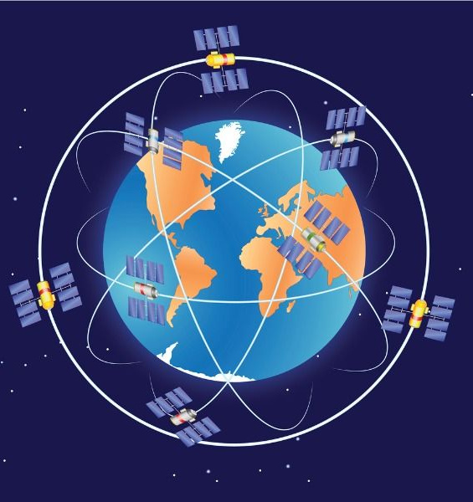
Horizontal Breadth: Global Impact
APPLICATIONS
Convolutional codes aren't just for textbooks; they power the modern world:
Deep Space: Voyager and Mars Rover missions.
Wireless: 4G LTE and 5G standards (using Turbo and Polar extensions).
Broadcasting: Digital Video Broadcasting (DVB).
5.04.2026 INFORMATION CODING TECHNIQUES | Convolutional Codes| P.Thilagarani | SNSCT 10/13

Slide 11

Summary Mind Map
Structure & Tools - Registers, Adders, Trellis, and State Tables.
Decoding & Metrics - Viterbi Algorithm; Free Distance (dfree).
5.04.2026 INFORMATION CODING TECHNIQUES | Convolutional Codes| P.Thilagarani | SNSCT 11/13

Slide 12

Final Reflection & Assessment
If you were designing a communication system for an underground metro with high interference, would you choose a higher constraint length (K) or a higher code rate (r)? Why?
5.04.2026 INFORMATION CODING TECHNIQUES | Convolutional Codes| P.Thilagarani | SNSCT 12/13

Slide 13
Final Reflection & Assessment
✅​
You might have said...
Higher K improves error correction via increased bit memory.
Lower code rate (r) adds redundancy, aiding high-noise areas like metros.
Trade-off: Increasing K raises Viterbi decoder complexity.
Conclusion: Higher K is preferred for interference if hardware handles lag.
5.04.2026 INFORMATION CODING TECHNIQUES | Convolutional Codes| P.Thilagarani | SNSCT 13/13

Slide 14
Thank you

