Slide 1

SNS COLLEGE OF TECHNOLOGY
An Autonomous Institution Coimbatore-35
DEPARTMENT OF INFORMATION TECHNOLOGY
23ITT304 Information Coding Techniques
Unit V
MASTERING DIGITAL COMMUNICATION AND APPLICATIONS
DECODING THE HIDDEN PATTERN
P.Thilagarani AP/IT

Slide 2

DECODING THE HIDDEN PATTERN
Mastering the Viterbi Algorithm in Information Coding
5.04.2026 INFORMATION CODING TECHNIQUES | DECODING THE HIDDEN PATTERN| P.Thilagarani | SNSCT 2/14

Slide 3

ICEBREAKER: THE BLURRED MESSAGE
RECAP & HOOK
Imagine you receive a text message through heavy interference: 'Meet me at the p_rk'.
Your brain instantly fills in 'park' because it's the most likely sequence. In digital communication, how does a machine do this mathematically?
🔑
Key point
We've studied Convolutional Codes. Today, we learn the 'Gold Standard' for decoding them: the Viterbi Algorithm.
5.04.2026 INFORMATION CODING TECHNIQUES | DECODING THE HIDDEN PATTERN| P.Thilagarani | SNSCT 3/14

Slide 4

EMPATHIZE: THE ENGINEER'S CHALLENGE
DESIGN THINKING
The Persona: Aarav
Aarav is a telecommunications engineer at a 5G startup in Bengaluru.
The Problem: His data packets are getting corrupted by noise. He needs a decoding method that is highly accurate but doesn't consume infinite battery power on a smartphone.
🔍
Example
Brute-force checking every possible path for a 100-bit message would take more time than the age of the universe!
5.04.2026 INFORMATION CODING TECHNIQUES | DECODING THE HIDDEN PATTERN| P.Thilagarani | SNSCT 4/14

Slide 5
DEFINE & IDEATE: MAXIMUM LIKELIHOOD
To help Aarav, we define our goal: find the Maximum Likelihood (ML) sequence. We use Dynamic Programming to break the problem into steps and discard impossible paths early.
The 'Hard' Way
Exhaustive search of 2ⁿ paths. Complexity grows exponentially.
The Viterbi Way
Compare paths at each state. Keep the 'survivor' and prune the rest.
5.04.2026 INFORMATION CODING TECHNIQUES | DECODING THE HIDDEN PATTERN| P.Thilagarani | SNSCT 5/14

Slide 6
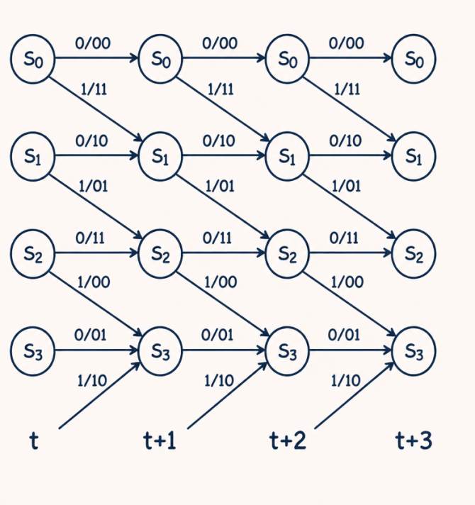
THE TRELLIS STRUCTURE
TECHNICAL DEPTH
The Viterbi algorithm operates on a Trellis Diagram.
Nodes: Represent the possible states of the encoder memory.
Edges: Represent transitions between states based on input bits.
Branch Metric: The distance (usually Hamming distance) between received bits and the edge label.
5.04.2026 INFORMATION CODING TECHNIQUES | DECODING THE HIDDEN PATTERN| P.Thilagarani | SNSCT 6/14

Slide 7
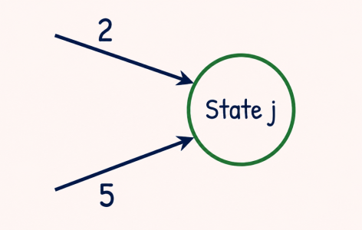
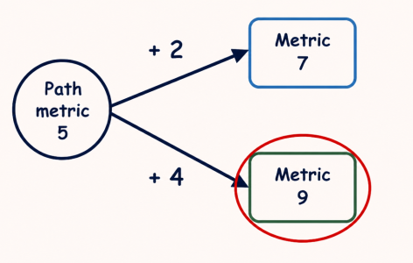
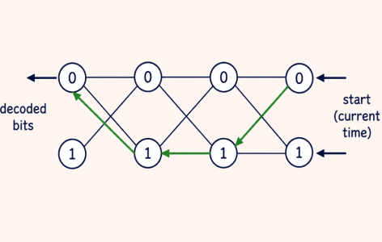
PROTOTYPE: THE DECODING STEP
Calculate Metrics
At each time step, calculate the Hamming distance for all incoming branches.
Select Survivor
Sum the branch metric with the previous 'Path Metric'. Keep the minimum.
Traceback
Once the whole message is processed, follow the surviving path backward to find the bits.
5.04.2026 INFORMATION CODING TECHNIQUES | DECODING THE HIDDEN PATTERN| P.Thilagarani | SNSCT 7/14

Slide 8

BREADTH: BEYOND BITS
INTERDISCIPLINARY LINKS
The Viterbi algorithm isn't just for satellites. It's the engine behind:
Speech Recognition: Mapping sound waves to phonemes.
Bioinformatics: Aligning DNA sequences.
Natural Language Processing: Part-of-speech tagging.
🤯
Fun fact
Andrew Viterbi, the inventor, used the profits from this algorithm to co-found Qualcomm!
5.04.2026 INFORMATION CODING TECHNIQUES | DECODING THE HIDDEN PATTERN| P.Thilagarani | SNSCT 8/14

Slide 9
TEST: THE VITERBI SEQUENCE
Answers on the next slide...
What is the correct sequence of operations at each time interval in a Viterbi decoder?
Select the path with the minimum total metric (survivor)
Update the state metric and store the decision bit
Calculate branch metrics for all paths
Add branch metrics to existing path metrics
5.04.2026 INFORMATION CODING TECHNIQUES | DECODING THE HIDDEN PATTERN| P.Thilagarani | SNSCT 9/14

Slide 10
TEST: THE VITERBI SEQUENCE
✅​
What is the correct sequence of operations at each time interval in a Viterbi decoder?
Calculate branch metrics for all paths
1.
Add branch metrics to existing path metrics
2.
Select the path with the minimum total metric (survivor)
3.
Update the state metric and store the decision bit
4.
5.04.2026 INFORMATION CODING TECHNIQUES | DECODING THE HIDDEN PATTERN| P.Thilagarani | SNSCT 10/14

Slide 11
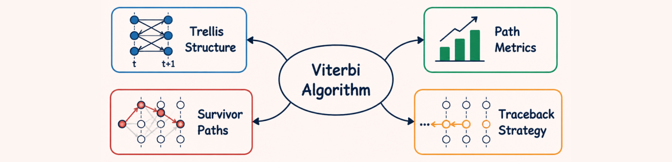
SUMMARY MIND MAP
Key Concepts
Efficiency: O(L) complexity vs exponential.
Metrics: Hamming for hard; Euclidean for soft.
Storage: Only survivors kept at each state.
Performance
Constraint Length (K): Improves error correction but doubles complexity.
Applications: Deep space, WiFi, 5G, Hard drives.
5.04.2026 INFORMATION CODING TECHNIQUES | DECODING THE HIDDEN PATTERN| P.Thilagarani | SNSCT 11/14

Slide 12


FINAL REFLECTION
In a scenario where a satellite has limited battery power but needs to transmit high-resolution images, would you increase the constraint length (K) of your Viterbi decoder? Why or why not?
5.04.2026 INFORMATION CODING TECHNIQUES | DECODING THE HIDDEN PATTERN| P.Thilagarani | SNSCT 12/14

Slide 13
FINAL REFLECTION
✅​
You might have said...
Increasing K improves error correction (fewer re-transmissions needed).
However, it increases computational load exponentially (2ᴷ⁻¹).
This might drain the battery faster due to processing energy.
Engineers must find the 'Sweet Spot' between power and reliability.
5.04.2026 INFORMATION CODING TECHNIQUES | DECODING THE HIDDEN PATTERN| P.Thilagarani | SNSCT 13/14

Slide 14
Thank You
5.04.2026 INFORMATION CODING TECHNIQUES | DECODING THE HIDDEN PATTERN| P.Thilagarani | SNSCT 14/14

