Slide 1

Dr. SNS RAJALAKSHMI COLLEGE OF ARTS AND SCIENCE
(AUTONOMOUS)
Department of Mathematics
DISCRETE MATHEMATICS WITH PROBABILITY AND HYPOTHESIS TESTING
Unit IV
Topic: Test of Hypothesis
Dr. K.Sasikala
Assistant Professor
Dept. of Mathematics
Dr. SNSRCAS

Slide 2
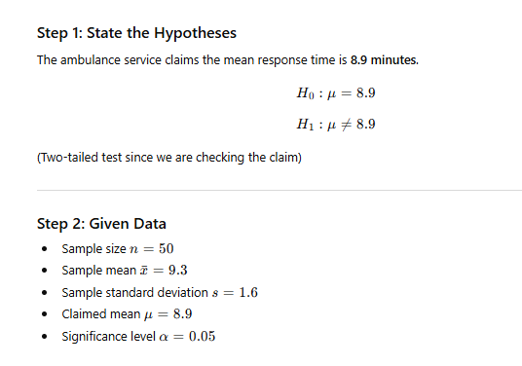
An ambulance service claims that it takes on an average 8.9 minutes to reach its destination in emergency calls. To check on this, claim the agency which licenses ambulance services has them timed on 50 emergency calls, getting a mean of 9.3 minutes with a standard deviation of 1.6 minutes. What can they conclude at 5% level of significance?

Slide 3
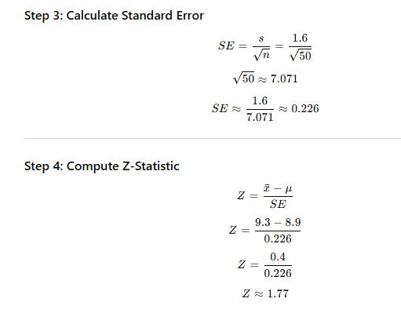

Slide 4
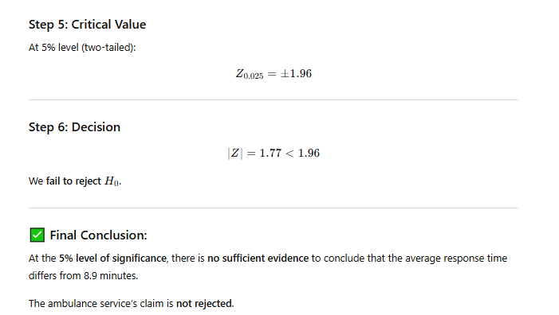

Slide 5
Thank You

