Slide 1

SNS COLLEGE OF TECHNOLOGY
An Autonomous Institution Coimbatore-35
DEPARTMENT OF INFORMATION TECHNOLOGY
23ITT304 Information Coding Techniques
Unit V
MASTERING DIGITAL COMMUNICATION AND APPLICATIONS
INFORMATION CODING & GLOBAL CONNECTIVITY
P.Thilagarani AP/IT

Slide 2

INFORMATION CODING & GLOBAL CONNECTIVITY
Efficiency and Reliability in Digital Communications
5.04.2026 INFORMATION CODING TECHNIQUES | INFORMATION CODING & GLOBAL CONNECTIVITY| P.Thilagarani | SNSCT 2/10

Slide 3
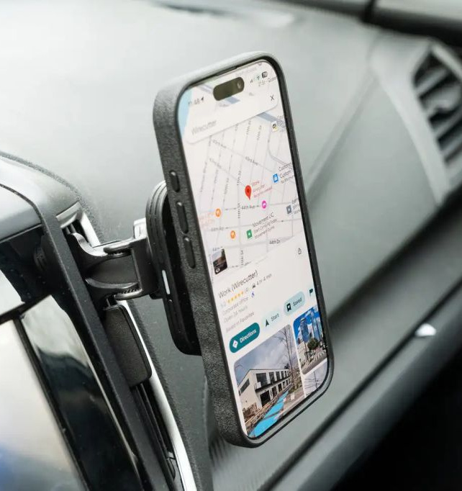
RECAP & ICEBREAKER
Quick Check
We've previously discussed Entropy and Channel Capacity. If a channel is noisy, can we still send data without error?
Icebreaker
Think about your phone. How does it maintain a crystal-clear voice call while you are moving at 60 km/h in a car?
🔑
Key point
The answer lies in Source and Channel Coding—converting raw data into a format that survives the journey.
5.04.2026 INFORMATION CODING TECHNIQUES | INFORMATION CODING & GLOBAL CONNECTIVITY| P.Thilagarani | SNSCT 3/10

Slide 4
THE PERSONA: MEET ROHAN
EMPATHIZE
The Persona
Rohan is a Network Engineer in Bangalore managing satellite uplinks for remote villages.
The Pain Points
Bandwidth is expensive.
Signal interference from monsoon rains (Rain Fade).
Data corruption during storage on aging servers.
5.04.2026 INFORMATION CODING TECHNIQUES | INFORMATION CODING & GLOBAL CONNECTIVITY| P.Thilagarani | SNSCT 4/10

Slide 5
DEFINE & IDEATE
DESIGN THINKING
The Problem
How to maximize throughput over unreliable media?
The Solutions
Source Coding: Remove redundancy.
Channel Coding: Add 'smart' redundancy to fix errors.
⚠️
Watch out
Without coding, noise corrupts data, causing failure.
5.04.2026 INFORMATION CODING TECHNIQUES | INFORMATION CODING & GLOBAL CONNECTIVITY| P.Thilagarani | SNSCT 5/10

Slide 6
SATELLITE & DEEP SPACE APPS
VERTICAL DEPTH
Satellite communication relies on Forward Error Correction (FEC) because re-transmission (ARQ) takes too long (high latency).
Turbo Codes & LDPC: Used in DVB-S2 satellite TV and 5G.
Reed-Solomon: The gold standard for correcting 'burst' errors caused by atmospheric interference.
5.04.2026 INFORMATION CODING TECHNIQUES | INFORMATION CODING & GLOBAL CONNECTIVITY| P.Thilagarani | SNSCT 6/10

Slide 7
MOBILE & STORAGE SYSTEMS
HORIZONTAL BREADTH
Data Storage (SSD/CD)
Hard drives use ECC (Error Correction Code) to handle 'bit rot'—the physical decay of stored charge.
Mobile (5G/LTE)
Coding allows thousands of users to share the same frequency spectrum via CDMA or OFDMA.
5.04.2026 INFORMATION CODING TECHNIQUES | INFORMATION CODING & GLOBAL CONNECTIVITY| P.Thilagarani | SNSCT 7/10

Slide 8
PROTOTYPE: CYCLIC REDUNDANCY
PROTOTYPE
Hamming Codes
Imagine a 7-bit block. We add 3 parity bits. If one bit flips, the receiver calculates a 'Syndrome' that points exactly to the corrupted bit.
Impact
This allows 'Self-Healing' data packets without needing to ask the sender to resend the file.
5.04.2026 INFORMATION CODING TECHNIQUES | INFORMATION CODING & GLOBAL CONNECTIVITY| P.Thilagarani | SNSCT 8/10

Slide 9


GROUP ACTIVITY: THE NOISE CHALLENGE
Role-Play Exercise
Divide into 'Transmitters', 'The Channel', and 'Receivers'.
Transmitters: Write a 4-bit binary code.
The Channel: Change one bit randomly.
Receivers: Apply a simple Parity check to see if you can detect the error. Discuss: Can you fix it, or just detect it?
5.04.2026 INFORMATION CODING TECHNIQUES | INFORMATION CODING & GLOBAL CONNECTIVITY| P.Thilagarani | SNSCT 9/10

Slide 10
5.04.2026 INFORMATION CODING TECHNIQUES | INFORMATION CODING & GLOBAL CONNECTIVITY| P.Thilagarani | SNSCT 10/10

