Slide 1

Dr. SNS RAJALAKSHMI COLLEGE OF ARTS AND SCIENCE (AUTONOMOUS)
Department of Mathematics
BUSINESS CALCULUS AND FINANCIAL COMPUTATION
Unit IV
Topic: Capital Budgeting & Depreciation
Dr. K.Sasikala
Assistant Professor
Dept. of Mathematics
Dr. SNSRCAS

Slide 2
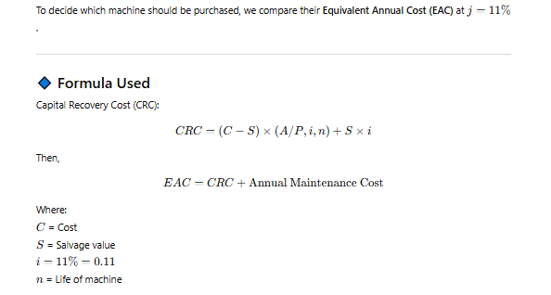

Slide 3
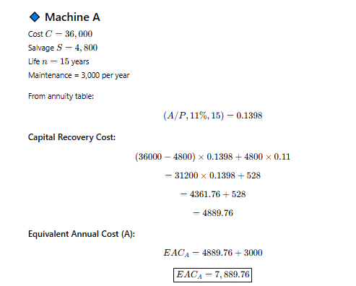

Slide 4
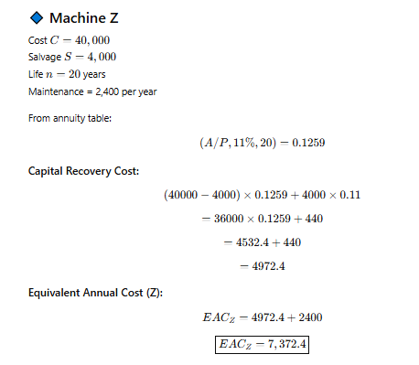
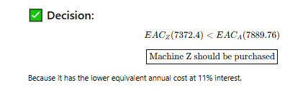

Slide 5
Thank You

