Slide 1

SNS COLLEGE OF TECHNOLOGY An Autonomous Institution
Coimbatore-35
Department of Mathematics
23MAT103- DIFFERENTIAL EQUATIONS AND TRANSFORMS
I B.E./ B.Tech. / II SEMESTER
UNIT III : PARTIAL DIFFERENTIAL EQUATIONS

Slide 2

WHAT IS A PDE?
SHORT DEFINITION
PDE VS ODE
A Partial Differential Equation is an equation involving an unknown function and its partial derivatives with respect to two or more independent variables.
An ODE involves derivatives with respect to a single variable. A PDE involves derivatives with respect to multiple variables (e.g., space x and time t).
HIGHLIGHT
The key distinction: multiple independent variables working together to describe how a quantity changes.
10/03/26 Second Order PDE with Constant coefficients/23MAT103- DET\ Ms.Yasodha.S/AP-MATHS/SNSCT 2/18

Slide 3
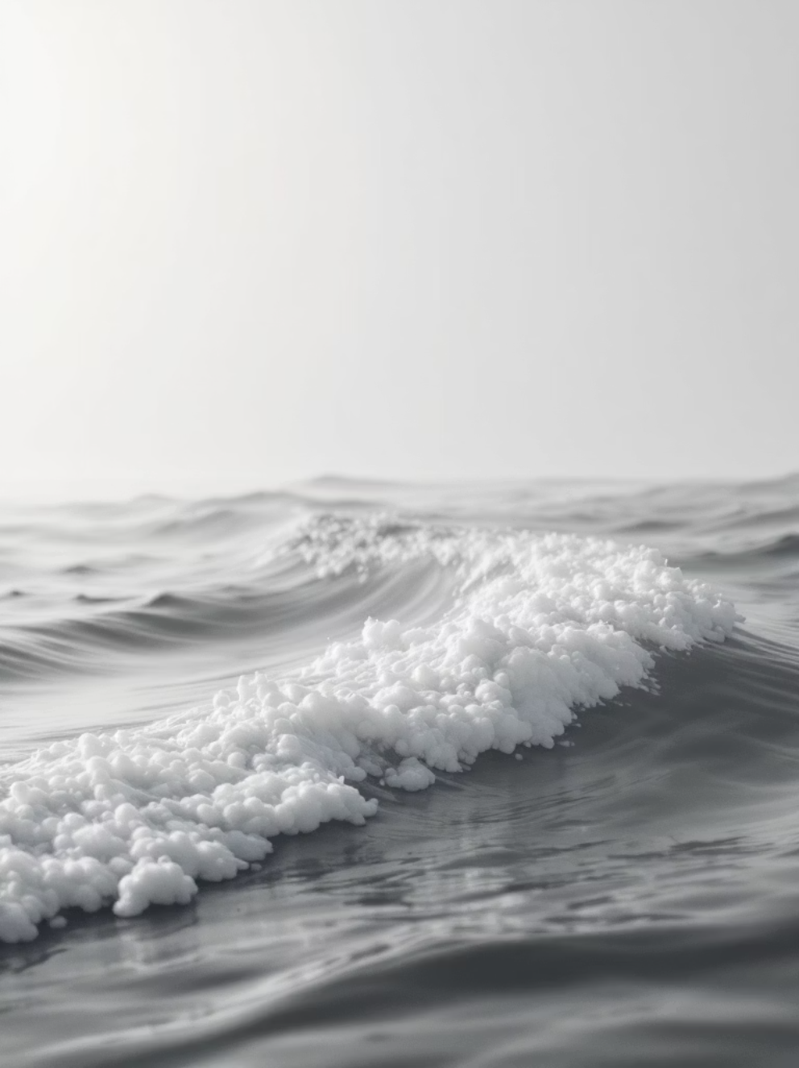

REAL-LIFE INTUITION
HEAT SPREADING
Temperature in a metal plate changes across both space and time — a PDE describes exactly how heat flows from hot to cold regions.
WAVE MOTION
A vibrating string or a water wave changes its shape across position and time — PDEs capture this dynamic, evolving behaviour.
10/03/26 Second Order PDE with Constant coefficients/23MAT103- DET\ Ms.Yasodha.S/AP-MATHS/SNSCT 3/18

Slide 4
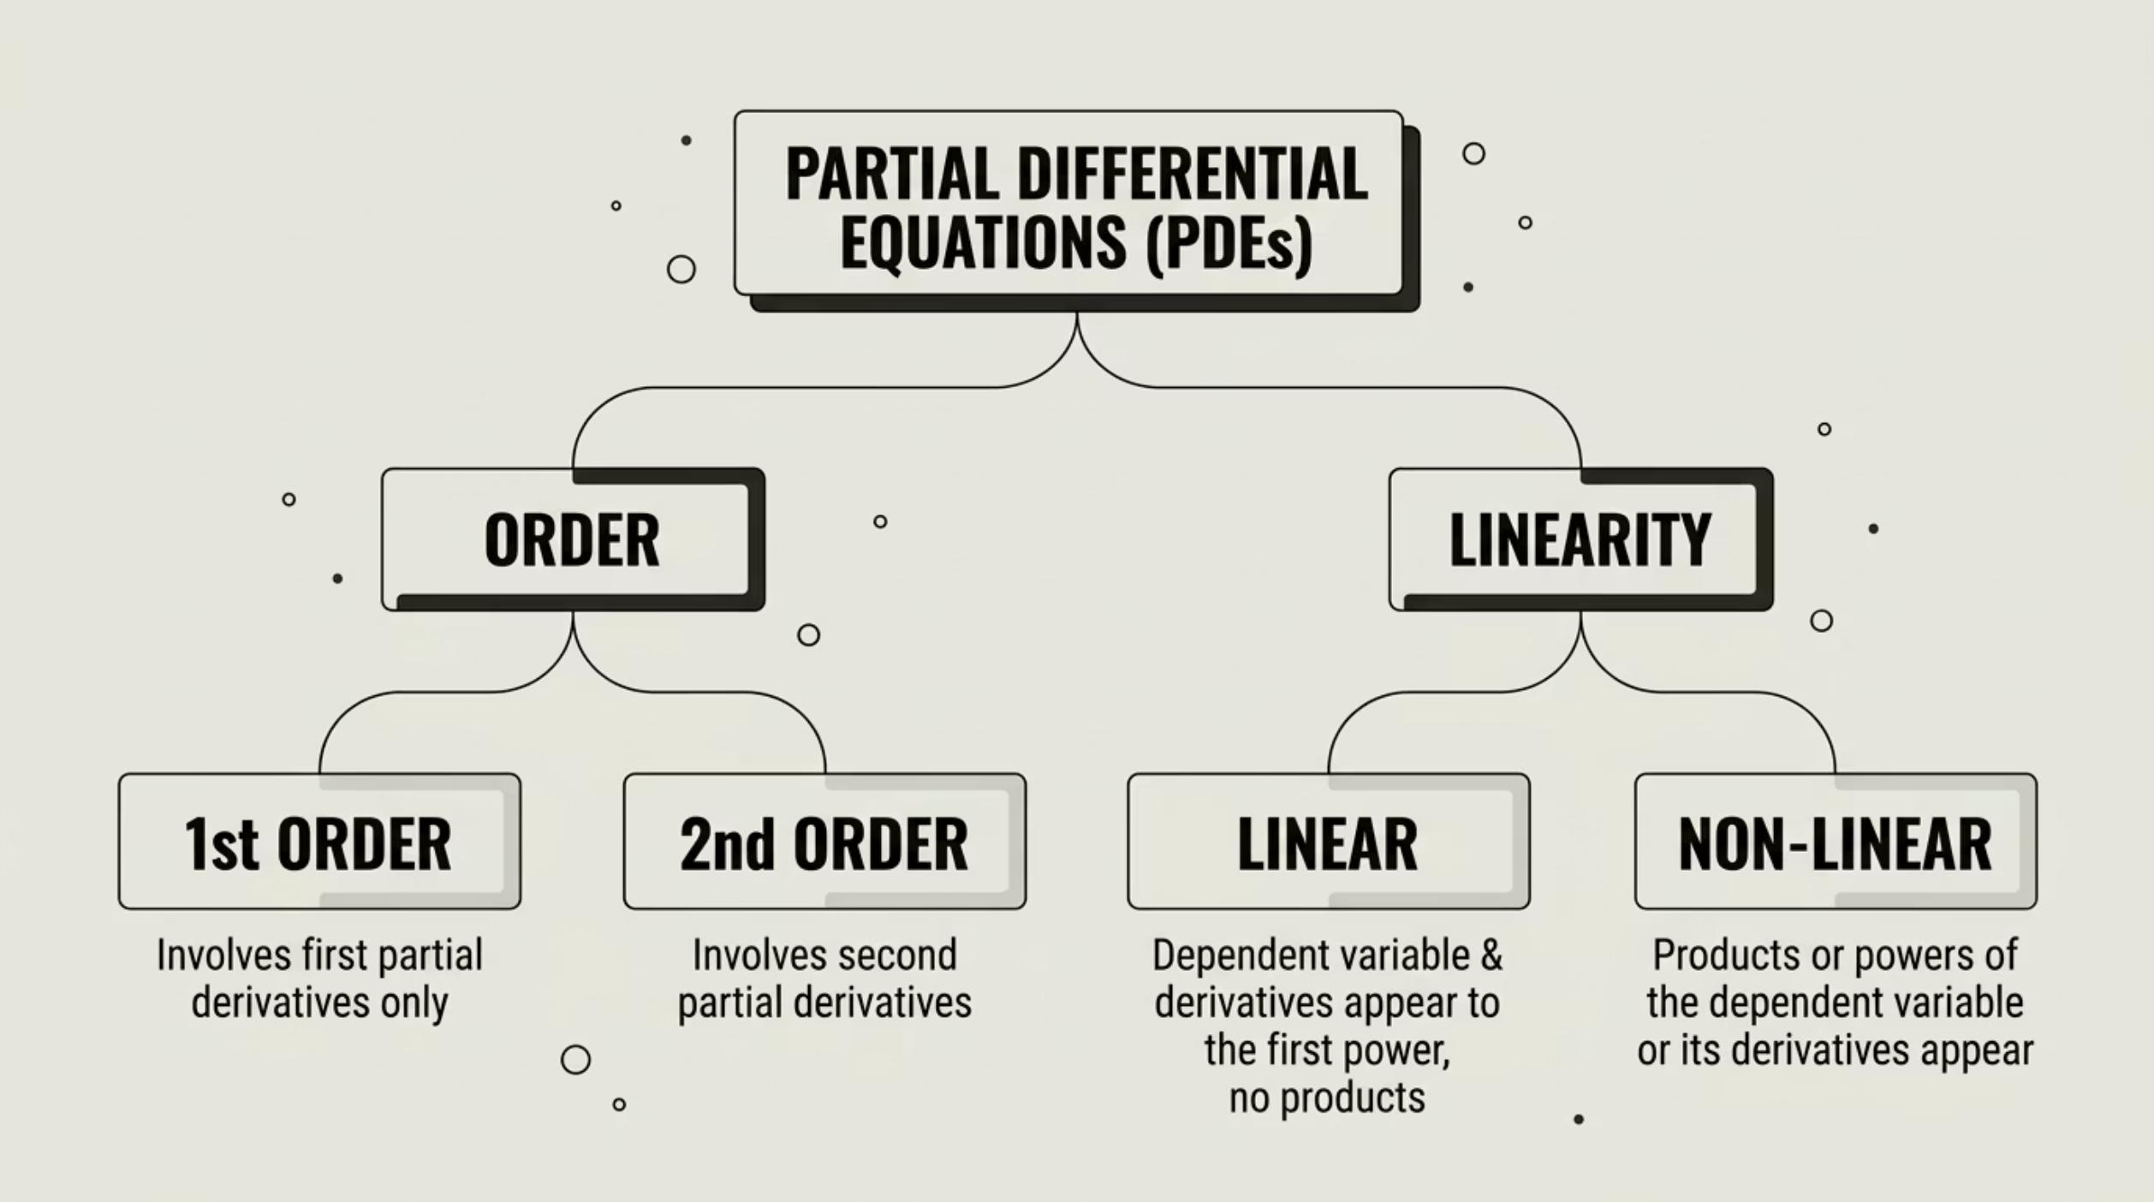

CLASSIFICATION OF PDES
PDEs are classified by their order and linearity — understanding these categories helps choose the right solution method.
1ST ORDER
2ND ORDER
LINEAR
NON-LINEAR
Involves only first partial derivatives. Example: transport equations.
Involves second partial derivatives. Most physically important PDEs fall here.
Dependent variable and its derivatives appear to the first power only.
Products or powers of the dependent variable or its derivatives appear.
10/03/26 Second Order PDE with Constant coefficients/23MAT103- DET\ Ms.Yasodha.S/AP-MATHS/SNSCT 4/18

Slide 5
TYPES OF PDES
Second-order linear PDEs are grouped into three fundamental types based on their discriminant — each describes a different physical phenomenon.
ELLIPTIC
PARABOLIC
HYPERBOLIC
Describes steady-state phenomena — no time dependence. Example: Laplace's equation. Think of the stable temperature distribution in a room.
Describes diffusion and heat flow over time. Example: Heat equation. Think of how warmth spreads through a metal rod.
Describes wave propagation and vibrations. Example: Wave equation. Think of sound travelling through air or a plucked guitar string.
10/03/26 Second Order PDE with Constant coefficients/23MAT103- DET\ Ms.Yasodha.S/AP-MATHS/SNSCT 5/18

Slide 6



Key Equations
🔥 Heat Equation
〰️ Wave Equation
Describes how temperature u evolves over time in a medium with thermal diffusivity \alpha.
Describes how a wave propagates through space at speed c.
⚖️ Laplace Equation
EACH PAIRED WITH A VISUAL
Every equation above corresponds to a physical phenomenon you can see and measure — from cooling metal to vibrating strings to electric fields.
Describes steady-state distributions — no change over time. Used in electrostatics and fluid flow.
10/03/26 Second Order PDE with Constant coefficients/23MAT103- DET\ Ms.Yasodha.S/AP-MATHS/SNSCT 6/18

Slide 7
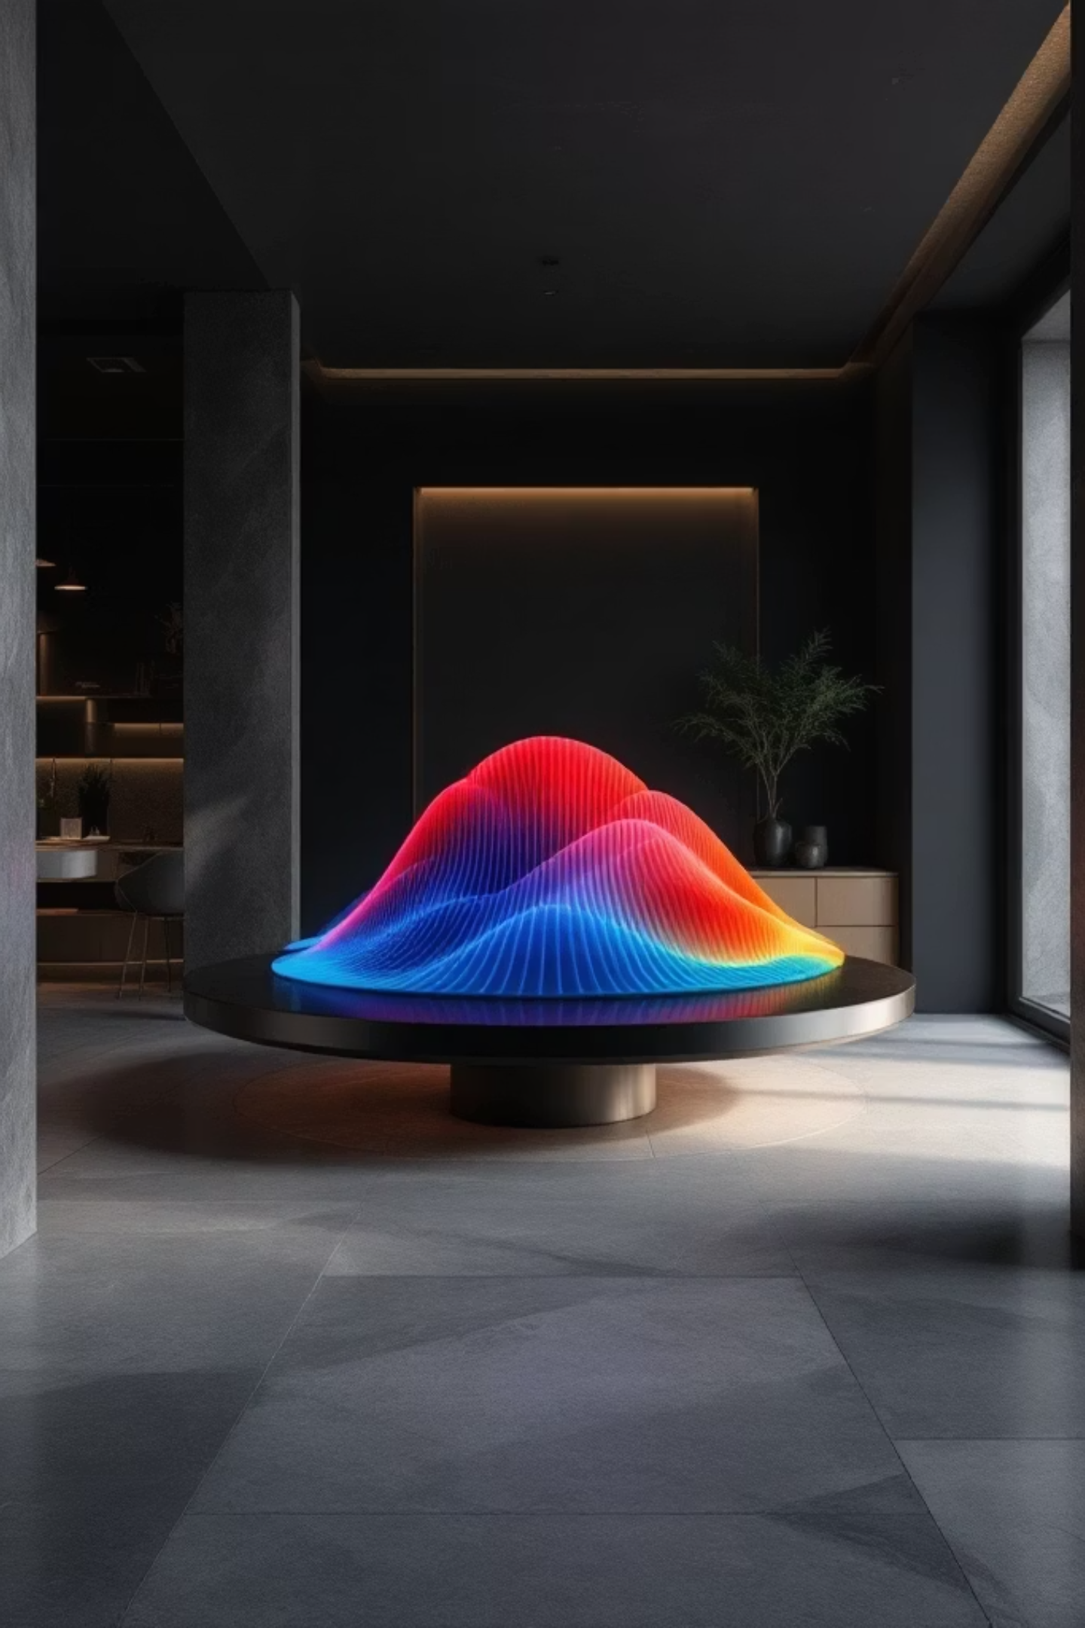



VISUALISATION OF SOLUTIONS
Solutions to PDEs are not just numbers — they are fields that evolve across space and time. Visualising them reveals the physics hidden inside the mathematics.
HEATMAPS
Colour-coded 2D grids showing how a quantity (e.g., temperature) varies across a surface at a given instant.
WAVE GRAPHS
Sinusoidal curves that shift and evolve — showing how wave solutions travel and change shape over time.
SURFACE PLOTS
3D mesh surfaces that show how solutions evolve simultaneously in space and time — the most complete picture.
10/03/26 Second Order PDE with Constant coefficients/23MAT103- DET\ Ms.Yasodha.S/AP-MATHS/SNSCT 7/18

Slide 8

Solution Idea
SEPARATION OF VARIABLES
The core idea: assume the solution can be written as a product of functions, each depending on only one variable. This breaks one hard PDE into two simpler ODEs.
INTRODUCE SEPARATION CONSTANT
SUBSTITUTE INTO PDE
Insert product and rearrange terms by variable.
Each side depends on one variable, set equal to constant.
ASSUME PRODUCT FORM
SOLVE ODES AND COMBINE
Let u(x,t)=X(x)·T(t).
Solve for X(x) and T(t), then form u(x,t).
10/03/26 Second Order PDE with Constant coefficients/23MAT103- DET\ Ms.Yasodha.S/AP-MATHS/SNSCT 8/18

Slide 9



APPLICATIONS
PDEs are not abstract — they power the technology and science that shapes our world every day.
ENGINEERING
PHYSICS
FINANCE
Heat systems, structural analysis, fluid dynamics in engines and pipelines — PDEs model how physical systems behave under stress and temperature.
Waves, electricity, magnetism, quantum mechanics — Maxwell's equations and Schrödinger's equation are both PDEs at their core.
The Black-Scholes model for option pricing is a PDE — used daily by financial institutions to value derivatives and manage risk.
10/03/26 Second Order PDE with Constant coefficients/23MAT103- DET\ Ms.Yasodha.S/AP-MATHS/SNSCT 9/18

Slide 10


CASE STUDY: HEAT DISTRIBUTION IN A METAL ROD
THE PROBLEM
VISUAL INTUITION
One end is hot, one end is cold. How does temperature distribute itself along the rod over time?
Heat flows from high temperature → low temperature. The gradient drives the flow. Over time, the rod reaches a uniform steady-state temperature.
THE HEAT EQUATION
REAL-WORLD APPLICATIONS
Cooling systems in computers and electronics
Engine thermal management in automobiles
Heat sink design in aerospace engineering
Industrial furnace and reactor modelling
Here u(x,t) is temperature at position x and time t, and \alpha is the thermal diffusivity of the metal.
10/03/26 Second Order PDE with Constant coefficients/23MAT103- DET\ Ms.Yasodha.S/AP-MATHS/SNSCT 10/18

Slide 11
References
https://math.stackexchange.com/questions/2112841/difference-between-linear-semilinear-and-quasilinear-pdes
https://www.youtube.com/watch?v=MLXsbLf58Cw
https://link.springer.com/chapter/10.1007/978-1-4615-9979-1_4
https://www.youtube.com/watch?v=MLXsbLf58Cw
https://shorturl.at/uMcci
10/03/26 Second Order PDE with Constant coefficients/23MAT103- DET\ Ms.Yasodha.S/AP-MATHS/SNSCT 11/18

