Slide 1

Dr. SNS RAJALAKSHMI COLLEGE OF ARTS AND SCIENCE
(AUTONOMOUS)
Department of Mathematics
DISCRETE MATHEMATICS WITH PROBABILITY AND HYPOTHESIS TESTING
Unit III
Topic: Probability
Dr. K.Sasikala
Assistant Professor
Dept. of Mathematics
Dr. SNSRCAS

Slide 2
The probability that a girl, preparing for competitive examination will get a State Government service is 0.12, the probability that she will get a Central Government job is 0.25, and the probability that she will get both is 0.07.
Find the probability that
she will get at least one of the two jobs
(ii) she will get only one of the two jobs.

Slide 3
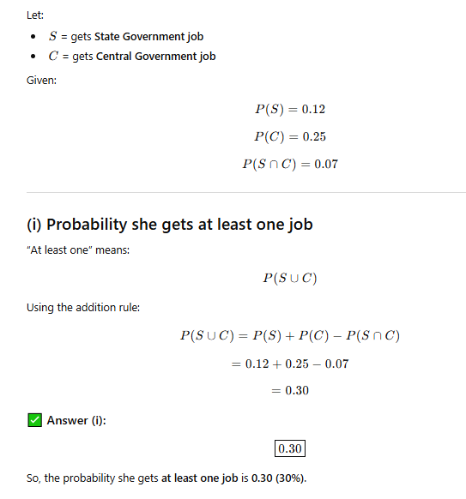

Slide 4
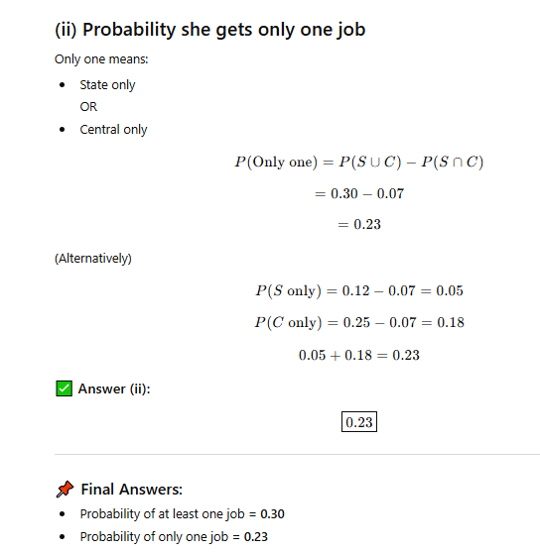

Slide 5
Thank You

