Slide 1

Dr. SNS RAJALAKSHMI COLLEGE OF ARTS AND SCIENCE
(AUTONOMOUS)
Department of Mathematics
DISCRETE MATHEMATICS WITH PROBABILITY AND HYPOTHESIS TESTING
Unit III
Topic: Probability
Dr. K.Sasikala
Assistant Professor
Dept. of Mathematics
Dr. SNSRCAS

Slide 2
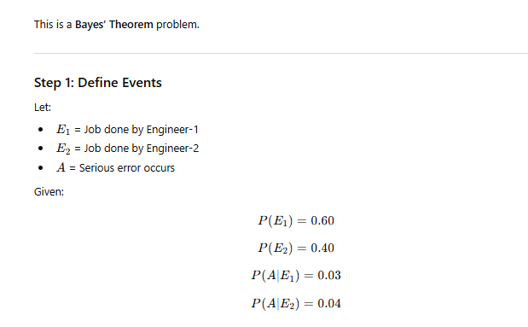
A construction company employs 2 executive engineers. Engineer-1 does the work for 60% of jobs of the company. Engineer-2 does the work for 40% of jobs of the company. It is known from the past experience that the probability of an error when engineer-1 does the work is 0.03, whereas the probability of an error in the work of engineer-2 is 0.04. Suppose a serious error occurs in the work, which engineer would you guess did the work?

Slide 3
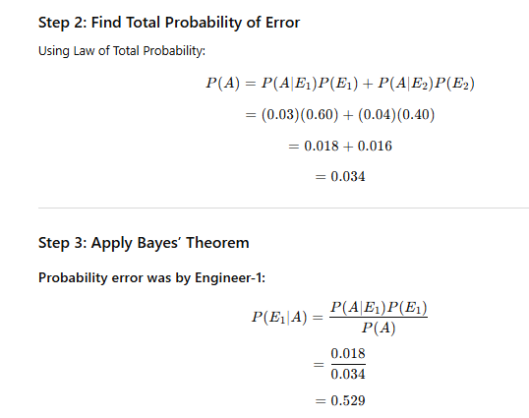

Slide 4
Thank You

