Slide 1

Dr. SNS RAJALAKSHMI COLLEGE OF ARTS AND SCIENCE
(AUTONOMOUS)
Department of Mathematics
DISCRETE MATHEMATICS WITH PROBABILITY AND HYPOTHESIS TESTING
Unit III
Topic: Probability
Dr. K.Sasikala
Assistant Professor
Dept. of Mathematics
Dr. SNSRCAS

Slide 2
An advertising executive is studying television viewing habits of married men and women during prime time hours. Based on the past viewing records he has determined that during prime time wives are watching television 60% of the time. It has also been determined that when the wife is watching television, 40% of the time the husband is also watching. When the wife is not watching the television, 30% of the time the husband is watching the television.
Find the probability that
(i) the husband is watching the television during the prime time of television (ii) if the husband is watching the television, the wife is also watching the television

Slide 3
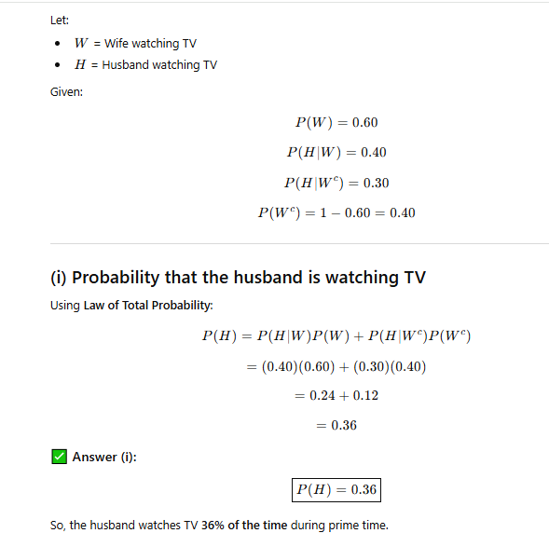

Slide 4
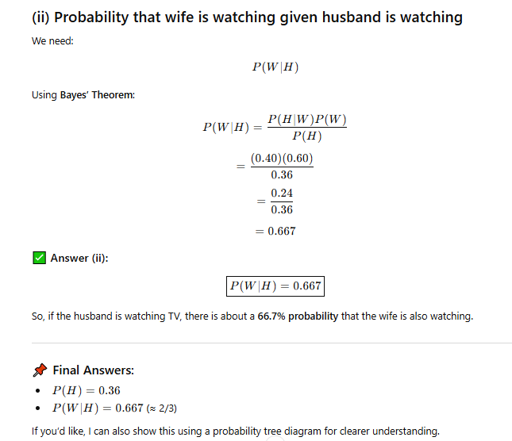

Slide 5
Thank You

