Slide 1

Dr. SNS RAJALAKSHMI COLLEGE OF ARTS AND SCIENCE
(AUTONOMOUS)
Department of Mathematics
DISCRETE MATHEMATICS WITH PROBABILITY AND HYPOTHESIS TESTING
Unit III
Topic: Probability
Dr. K.Sasikala
Assistant Professor
Dept. of Mathematics
Dr. SNSRCAS

Slide 2
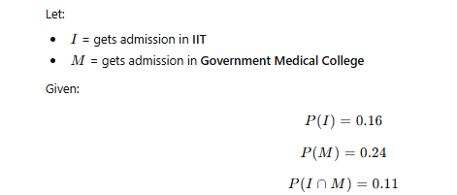
The probability that a girl will get an admission in IIT is 0.16, the probability that she will get an admission in Government Medical College is 0.24, and the probability that she will get both is 0.11. Find the probability that (i) She will get atleast one of the two seats (ii) She will get only one of the two seats.

Slide 3
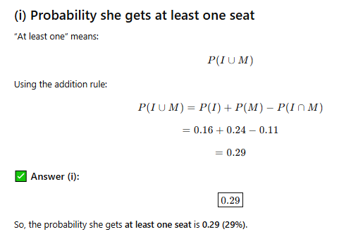

Slide 4
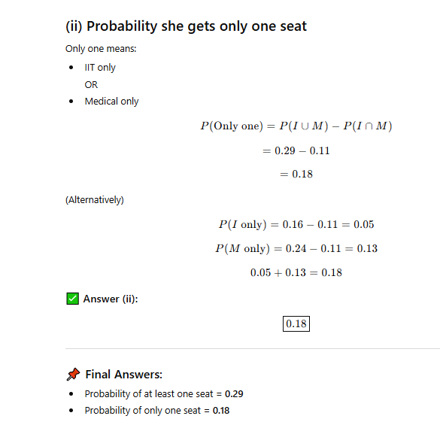

Slide 5
Thank You

