Slide 1

Problems Faced by Agro Industries
Basics of Agricultural Business Management: Functional Retail Management

Slide 2

What We'll Explore Today
TODAY'S SESSION
Core Topics
Key challenges facing agricultural industries
Supply chain disruptions and logistics issues
Market access and pricing volatility
Technology adoption barriers
Environmental and regulatory pressures
Labour shortages and skills gaps
•
•
Interacti e Learning Acti ities
Quick polls, think-pair-share discussions, word cloud generation, group work, and reflective exercises throughout.

Slide 3
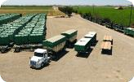


Supply Chain Disruptions
CHALLENGE 1
Transportation Cold Chain Failures Bottlenecks
Inentory Management Gaps
Inadequate refrigeration and storage facilities lead to significant post-harvest losses, particularly for perishable goods like fruits, vegetables, and dairy.
Delays in moving produce from farms to markets increase spoilage rates and reduce profit margins. Infrastructure limitations affect timely deliveries.
Poor tracking systems result in overstocking or understocking, affecting cash flow and customer satisfaction in retail operations.

Slide 4
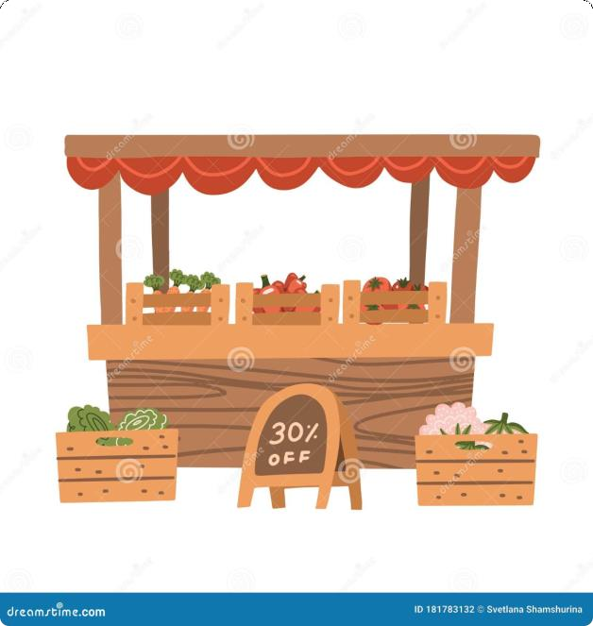
Market Access C Pricing Challenges
Price Volatility
Agricultural markets experience dramatic price fluctuations due to weather conditions, global demand shifts, and speculation.
Farmers struggle to predict returns on investment.
Limited Market Information
Many producers lack access to real-time market data, preventing informed selling decisions. Information asymmetry favours intermediaries over farmers.
Middleman Dependencies
Multiple intermediaries reduce farmer profits whilst increasing consumer prices. Direct market linkages remain underdeveloped in many regions.

Slide 5
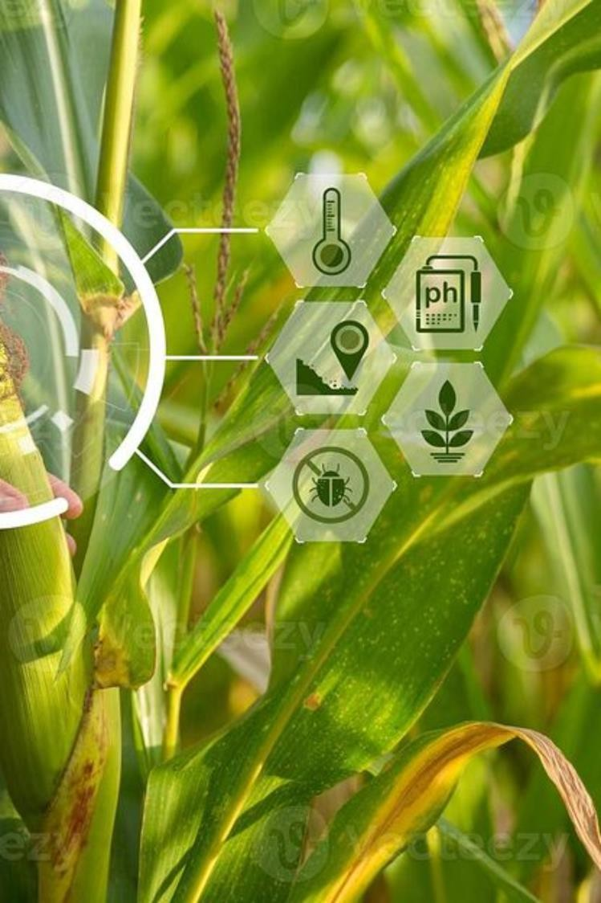
Technology Adoption Barriers
High Initial Costs
Modern farming equipment and digital tools require substantial upfront investment, placing them beyond reach for small and marginal farmers.
Digital Literacy Gaps
Lack of technical skills and training prevents effective utilisation of precision agriculture tools, management software, and e-commerce platforms.
Infrastructure Limitations
Poor internet connectivity in rural areas restricts access to digital marketplaces, weather apps, and online agricultural advisory services.

Slide 6

Engagement Acti ities
CLASSROOM INTERACTION
Quick Poll
Think–Pair–Share
Word Cloud Acti ity
3 minutes
3 minutes
3 minutes
Which challenge affects agro industries most in your region? Vote using your devices or show of hands.
Consider a local agro business. Identify one major problem it faces. Discuss with a partner, then share insights with the class.
Submit words describing agro industry challenges. We'll generate a collective word cloud showing our shared understanding.
Reflection
2 minutes
Write down one new insight you've gained. How might this knowledge influence your future career in agricultural retail?

Slide 7




Design Thinking Workshop
Group Acti ity: Problem-Sol ing
Stage: Empathise & Define
Activity: In groups of 4–5, select one agro industry challenge. Interview classmates acting as stakeholders (farmers, retailers, consumers).
Define the problem from multiple perspectives.
Empathise
Define
Ideate
Prototype
Test
Outcome: Each group presents a problem statement and one innovative solution idea. Document insights on flip charts.

Slide 8
Real-World Scenario Analysis
CASE STUDY
Case: "Green Valley Farmers' Cooperative"
A 50-member cooperative struggles with inconsistent product quality, delayed payments from retailers, and lack of cold storage. Members are considering direct-to-consumer sales but face digital marketing challenges.
Discussion Points
Strategic Options
Implementation Challenges
What are the root causes of Green Valley's problems? How do they interconnect?
Should the cooperative invest in cold storage, pursue direct sales, or negotiate better terms with existing retailers?
What resources and partnerships would each solution require? What are the potential risks?

Slide 9


Key Learnings C Next Steps
Summary: Core Insights
Take-Home Assignment
Agro industries face multifaceted challenges across supply chains, markets, technology, and regulations
Solutions require integrated
approaches combining infrastructure, skills development, and policy support Retail management in agriculture demands understanding both farmer and consumer perspectives
Technology can bridge gaps but requires investment in training
and connectivity
Visit a local agribusiness (farm, cooperative, or agricultural retail shop). Interview the manager about their top three operational challenges. Prepare a 2-page report with:
•
•
Problem description and impact
Proposed solutions with justification
Implementation plan outline
1.
•
Due: Next session

Slide 10
Questions, Reflections C Thanks
QCA Session
Final Reflection
Thank You
Share your questions about today's topics. Let's explore any areas needing clarification together.
What surprised you most? Which challenge will you focus on in your career? Write your thoughts and share if comfortable.
Your engagement and insights made this session valuable. Keep exploring agricultural business management with curiosity and innovation.
Remember: The challenges facing agro industries are also opportunities for creative, impactful solutions. You are the next generation of agricultural business leaders.

