Slide 1

Role of Processing Industries in Agricultural Business Management
FUNCTIONAL RETAIL MANAGEMENT

Slide 2
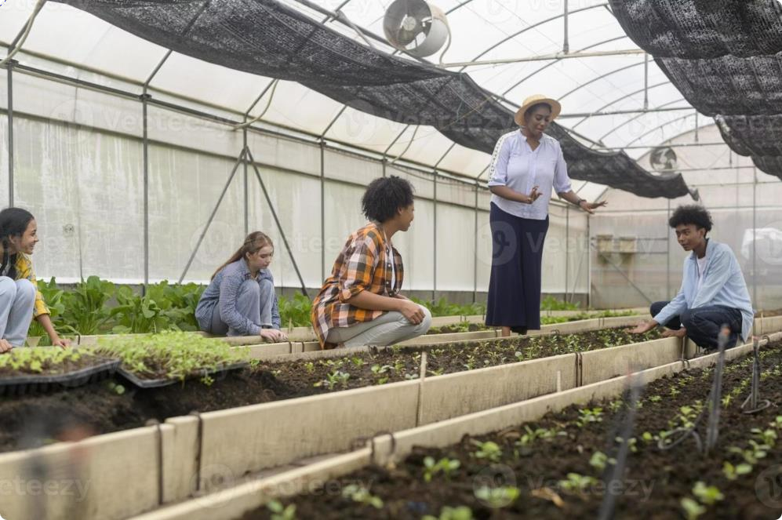
Today's Learning Journey
Topics We'll Explore
Understanding processing industries in agribusiness
Value addition and product
transformation
Quality control and food safety standards
Supply chain integration and market
linkages
Economic impact and employment generation
•
•
•
•
Interactie Acti ities
We'll engage through polls, group discussions, word clouds, and hands-on design thinking exercises throughout this session.

Slide 3
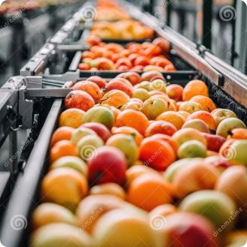
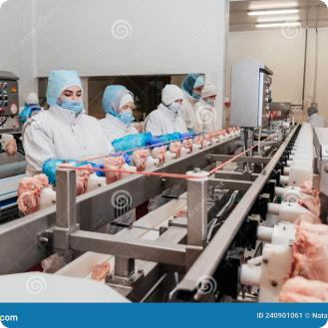
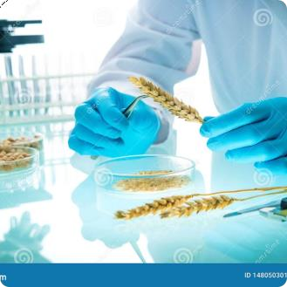
What Are Agricultural Processing Industries?
Primary Processing
Secondary Processing
Quality Assurance
Initial transformation of raw agricultural produce—cleaning, sorting, grading, and packaging—to prepare commodities for market or further processing.
Converting primary products into consumer-ready goods such as juices, jams, dairy products, and frozen foods that add significant value.
Ensuring products meet safety standards and quality specifications through systematic testing, certification, and compliance with regulations.

Slide 4
Classroom Interaction: Quick Poll
3 MINUTES
Your Experience
Poll Question 1
Have you visited an agricultural processing facility? What products are commonly processed in your region? Share your observations!
Which processing sector interests you most: dairy, fruits and vegetables, grains, or meat products?
Think about local examples: dairy plants, grain mills, fruit processing units, or vegetable packaging centres.
Poll Question 2
What challenges do you think processors face: quality control, supply consistency, or market access?
Poll Question 3
Rate your understanding of food safety standards from 1-5.

Slide 5
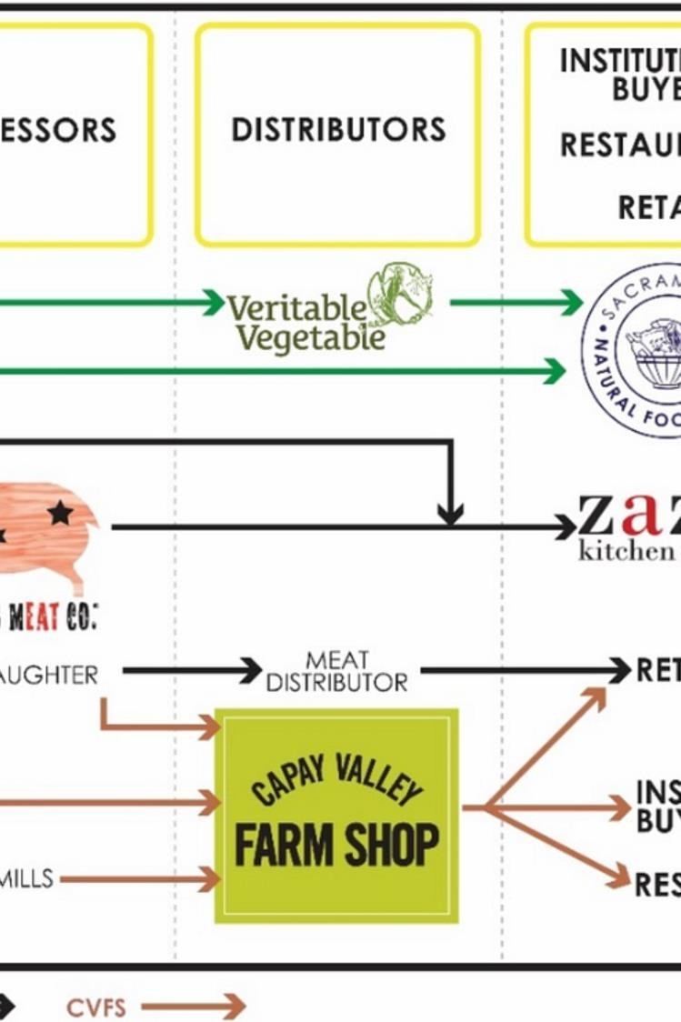

Value Addition Through Processing
Raw Material
Fresh produce from farms with basic market value
Processing
Transformation adding shelf life, convenience, and nutrition
Finished Product
Market-ready goods with enhanced value and consumer appeal
Retail Distribution
Products reach consumers through diverse channels
Processing industries transform commodities worth pennies into products worth pounds, creating employment and economic growth whilst reducing post-harvest losses significantly.

Slide 6


Think–Pair–Share Actiity
3 MINUTES
Discussion Prompt
Think: Consider how processing industries impact farmers' income and rural employment. What benefits and challenges can you identify?
Pair: Turn to your partner and discuss your thoughts for 90 seconds. Share specific examples from your local context.
Share: Selected pairs will present key insights to the class. Focus on practical implications and innovative solutions.
Consider aspects like market access, price stability, quality requirements, and contract farming arrangements.

Slide 7
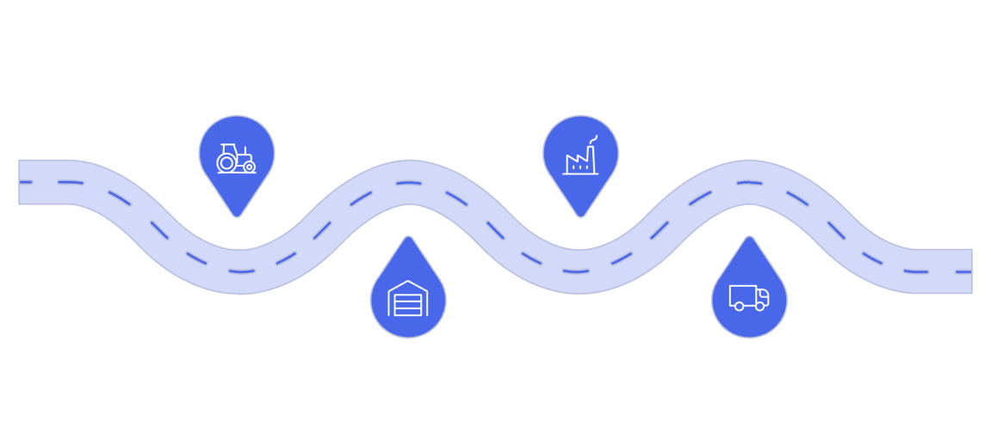


Supply Chain Integration and Market Linkages
Critical Success Factors
Farm Production
Grow crops and ensure quality standards
Processing Facilities
Transform raw produce into marketable goods
Contract Farming
Agreements securing supply and providing farmers with guaranteed markets and technical support
Cold Chain Infrastructure
Temperature-controlled logistics preserving product quality from farm to retail
Collection Centres
Distribution Networks
Transport products to regional hubs
Aggregate harvests and perform initial sorting
Technology Integration
Effective integration connects farmers directly with processors, ensuring consistent supply, fair
pricing, and quality standards whilst reducing intermediaries and wastage.
Digital platforms enabling traceability, inventory management, and demand forecasting

Slide 8

Word Cloud Acti ity
3 MINUTES
What Comes to Mind?
Using your mobile devices, submit 3-5 words that you associate with agricultural processing industries. Think about: technology, challenges, opportunities, sustainability, innovation, quality, safety, and market trends.
Step 1
Step 2
Step 3
Access the word cloud platform via the QR code displayed
Submit your words—be specific and thoughtful
Watch as our collective understanding takes visual shape
We'll discuss the most prominent themes and what they reveal about our collective understanding of the sector.

Slide 9


Group Acti ity: Design Thinking Challenge
01
Empathise
Identify challenges faced by a small-scale fruit processing unit in your region
02
Define
Clearly articulate the core problem affecting profitability or quality
03
Ideate
Brainstorm innovative solutions using available resources and technology
04
Expected Outcomes
Prototype
Sketch a basic model or process flow for your solution
Practical understanding of problem-solving in agribusiness
Collaborative skills and creative thinking development
Innovative solutions addressing real industry challenges
Presentation and communication skills enhancement
05
Test C Present
Share your solution with the class and gather feedback
Groups of 4-5 students. You have 15 minutes to complete all stages and prepare a 3-minute presentation.

Slide 10


Key Takeaways and Next Steps
Key Learning Points
Processing industries transform agricultural commodities, add value, create employment, and strengthen supply chains whilst ensuring quality and food safety.
Case Study Assignment
Analyse a local processing unit: document their operations, identify three challenges, and propose evidence-based solutions.
Submit in one week.
Take-Home Task
Research two successful agri-processing enterprises in the UK. Compare their business models, market strategies, and sustainability practices.
2 MINUTES
Final Reflection and QCA
Share one insight you gained today and one question you still have about agricultural processing industries. Your reflections help shape our future sessions.
Thank you for your active participation and thoughtful engagement. Your curiosity and questions drive our collective learning journey in agricultural
business management.

