Slide 1


Significance of Distribution Systems
Basics of Agricultural Business Management
Functional Retail Management

Slide 2
Topics h Interactive Activities
SESSION OVERVIEW
Content Topics
Understanding distribution systems Role in agricultural business
Functional retail management Channel strategies and logistics
Engagement Activities
Quick Poll (3 mins)
Think-Pair-Share (3 mins)
Word Cloud Activity (3 mins)
Reflection (2 mins)
Group Design Thinking Activity

Slide 3

Understanding Distribution Systems
Definition
A distribution system is the network that moves agricultural products from producers to consumers efficiently, ensuring freshness and maximising market reach.
Key Components
Includes wholesalers, retailers, transportation networks, storage facilities, and information systems that coordinate the flow of goods.
Strategic Importance
Determines product availability, pricing competitiveness, market penetration, and ultimately the profitability of agricultural businesses.

Slide 4

ǫuick Poll Activity
ACTIVITY 1
Engagement Activity
Duration: 3 minutes
Question: Which distribution channel do you think is most effective for fresh vegetables in urban India?
Direct farm-to-consumer markets Traditional retail outlets (kiranas) Modern supermarket chains Online grocery platforms
Use your mobile devices to submit responses and we'll discuss the results together!

Slide 5
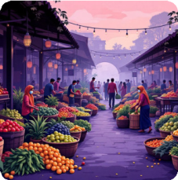

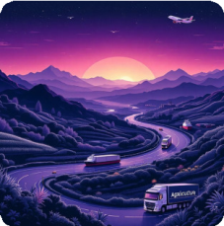
Role of Distribution in Agricultural Business
Market Access
Connects farmers with diverse markets, reducing post-harvest losses and enabling better price realisation through wider geographical reach.
Value Preservation
Proper distribution systems maintain product quality through cold chains, proper handling, and timely delivery to end consumers.
Supply Chain Efficiency
Streamlines operations, reduces intermediaries, lowers costs, and ensures products reach markets when demand is highest.

Slide 6
Think-Pair-Share h Word Cloud
ACTIVITY 2 & 3
1 2
3
Think (1 min)
Individually reflect: What challenges do Indian farmers face in
agricultural distribution? Write down 2-3 key challenges.
Pair (2 mins)
Turn to your partner and share your thoughts. Discuss similarities and differences in your observations.
Agree on top challenges.
Word Cloud (3 mins)
Submit your key challenge words using the provided link. We'll
generate a live word cloud showing our collective insights on distribution challenges!

Slide 7
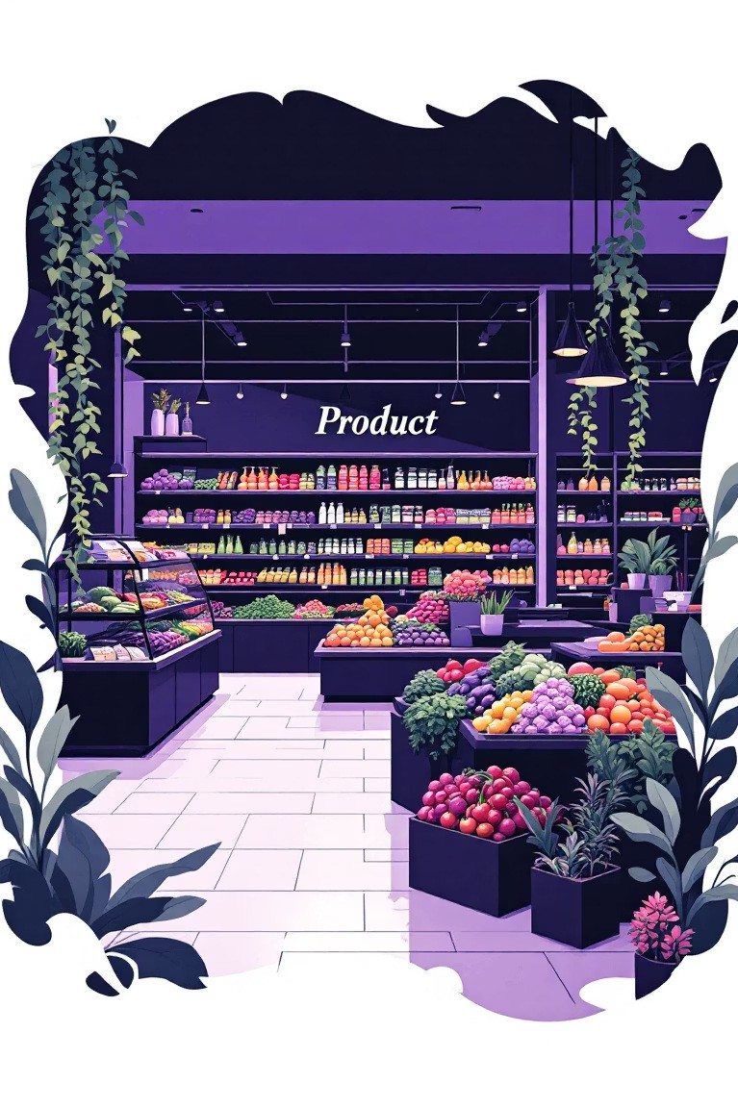
Functional Retail Management
Core Functions
Inventory Management: Balancing stock levels to meet demand whilst minimising wastage
Visual Merchandising: Attractive product displays that drive sales
Customer Service: Building relationships and ensuring satisfaction
Pricing Strategy: Competitive pricing aligned with value proposition
Success Factors
Location selection and footfall analysis
Supply chain integration
Technology adoption (POS, inventory systems)
Staff training and development Quality assurance protocols

Slide 8

Design Thinking Challenge
GROUP ACTIVITY
Define
Expected Outcome
Deliverable: A distribution model sketch with:
Empathise
Ideate
Target market identification
Channel strategy diagram Cost-benefit analysis
Technology integration points
Presentation: 3-minute pitch per group
Prototype h Test
Work in groups of 4-5 students to design an innovative distribution system for perishable vegetables in your local area.

Slide 9
Case Study h Key Learnings
Case: Mother Dairy
Scenario: How Mother Dairy built India's largest milk distribution network serving 30+ lakh litres daily across 1,600 retail outlets.
Discussion Points: What distribution strategies enabled their success? How did they maintain quality? What lessons apply to other agricultural products?
Key Learning Points
Distribution creates value
Effective distribution systems bridge the gap between production and consumption,
adding significant value through time, place, and form utilities.
Multiple channels matter
Successful agricultural businesses utilise multi-channel strategies combining traditional and modern retail formats to
maximise market coverage.
Technology is transformative
Digital tools, cold chains, and logistics management systems dramatically improve efficiency, reduce losses, and enhance profitability in agricultural distribution.

Slide 10

Assignments h Reflection
Take-Home Assignment
Task: Visit two different retail formats (traditional kirana and modern supermarket) in your locality.
Final Reflection
Duration: 2 minutes
Think quietly about today's session:
What was your biggest insight?
How will you apply this knowledge?
What questions remain unanswered?
Share: Volunteers can share one key takeaway with the class.
Analyse:
Distribution channels used Product sourcing methods
Inventory management practices
Customer service approaches
Deliverable: 500-word comparative analysis report (Due: Next session)
Thank you for your active participation! Your engagement makes learning meaningful.

