Slide 1

SNS COLLEGE OF TECHNOLOGY
An Autonomous Institution Coimbatore-35
DEPARTMENT OF INFORMATION TECHNOLOGY
23ITT304 Information Coding Techniques
Unit V
CONVOLUTIONAL CODES AND APPLICATIONS
State diagram
P.Thilagarani AP/IT

Slide 2

State Diagrams in Information Coding
Mapping System Behavior for Technical Excellence
5.04.2026 INFORMATION CODING TECHNIQUES | State Diagrams | P.Thilagarani | SNSCT 2/14

Slide 3

Icebreaker & Objective
RECAP
Think of a simple ATM. How does it know to ask for a PIN only after the card is inserted?
Objectives:
Define and construct State Diagrams.
Apply Design Thinking to system behavior.
Integrate technical depth with broad real-world applications.
5.04.2026 INFORMATION CODING TECHNIQUES | State Diagrams | P.Thilagarani | SNSCT 3/14

Slide 4

Empathize & Define
PERSONA
Meet Ananya
Ananya is a software developer in Bangalore designing a secure messaging app.
The Problem:
Users are experiencing 'deadlocks' where the app freezes between 'Sending' and 'Delivered' states. Without a visual map, the coding team cannot identify where the logic fails.
5.04.2026 INFORMATION CODING TECHNIQUES | State Diagrams | P.Thilagarani | SNSCT 4/14

Slide 5

Ideate: The State Machine Approach
To solve Ananya's problem, we use a Finite State Machine (FSM) to map system conditions.
Core Components
States: The conditions (e.g., Idle, Active).
Transitions: The movement between states.
Events: The triggers (e.g., button press).
🔑
Key point
A state diagram ensures no logic paths are missed.
5.04.2026 INFORMATION CODING TECHNIQUES | State Diagrams | P.Thilagarani | SNSCT 5/14

Slide 6
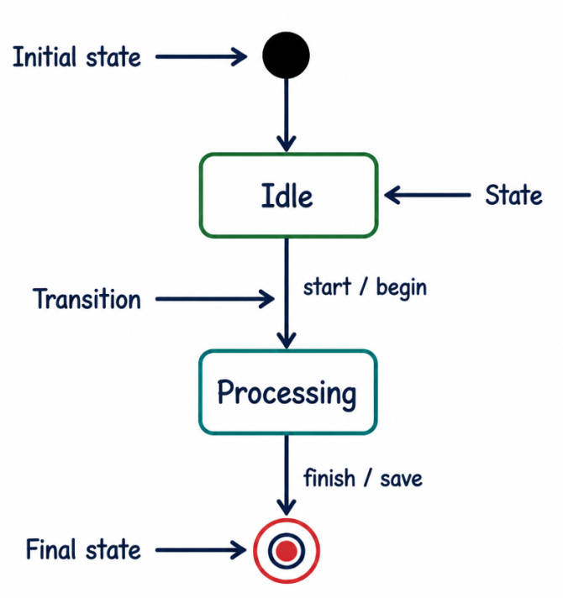
Vertical Depth: Technical Syntax
TECHNICAL DETAILS
In information coding, we represent states as circles and transitions as directed arcs.
Initial State: Marked with a solid black circle.
Final State: A bullseye (circle within a circle).
Guard Conditions: Boolean expressions [x > 0] that must be true for a transition to occur.
5.04.2026 INFORMATION CODING TECHNIQUES | State Diagrams | P.Thilagarani | SNSCT 6/14

Slide 7
Sequencing a Transition
Answers on the next slide...
What is the correct logical flow when a system changes state?
Guard condition is evaluated
Action is performed
New state is reached
Event occurs (Trigger)
5.04.2026 INFORMATION CODING TECHNIQUES | State Diagrams | P.Thilagarani | SNSCT 7/14

Slide 8
Sequencing a Transition
✅​
What is the correct logical flow when a system changes state?
Event occurs (Trigger)
1.
Guard condition is evaluated
2.
Action is performed
3.
New state is reached
4.
5.04.2026 INFORMATION CODING TECHNIQUES | State Diagrams | P.Thilagarani | SNSCT 8/14

Slide 9
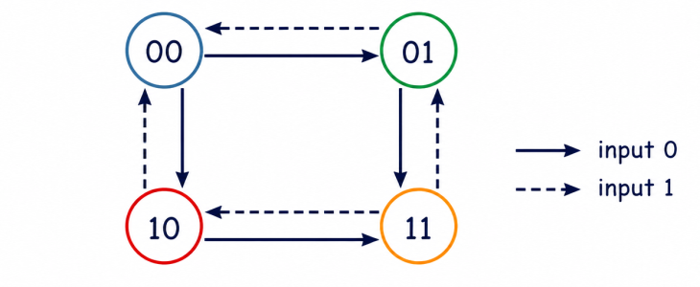
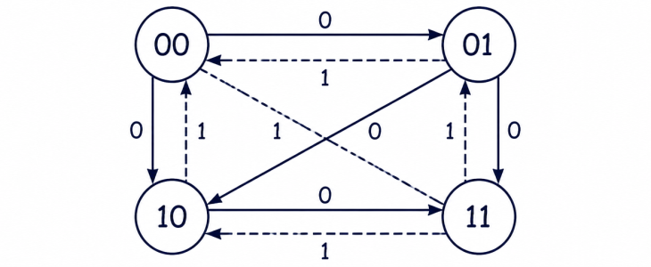
Prototype: Convolutional Encoder
In information theory, state diagrams represent encoders. For a (2,1,2) encoder, the 'state' is the contents of the memory shift registers.
Step 1: Define States
With 2 memory cells, we have 2² = 4 states (00, 01, 10, 11).
Step 2: Map Transitions
Draw solid lines for input '0' and dashed lines for input '1'.
5.04.2026 INFORMATION CODING TECHNIQUES | State Diagrams | P.Thilagarani | SNSCT 9/14

Slide 10

Horizontal Breadth: Applications
BROAD CONTEXT
Beyond coding, state diagrams are the 'T-Shaped' bridge to other fields:
UI/UX Design: User flow through an app.
Robotics: Logic for sensor-based movement.
Telecom: Call setup and teardown protocols (5G/LTE).
🔍
Example
A self-driving car stays in the 'Cruise' state until the 'Obstacle Detected' event triggers a transition to 'Brake'.
5.04.2026 INFORMATION CODING TECHNIQUES | State Diagrams | P.Thilagarani | SNSCT 10/14

Slide 11

Summary & Key Takeaways
Mind Map: State Diagram Essentials
1. Identification
States: Nouns
Transitions: Verbs/Events
2. Design Thinking
Solves complexity
Optimizes UX
3. Scaling
Hardware: Registers
Software: Logic/Networks
5.04.2026 INFORMATION CODING TECHNIQUES | State Diagrams | P.Thilagarani | SNSCT 11/14

Slide 12


Final Assessment & Reflection
If you were designing a 'Smart Home' system, what 'state' would the lights be in if the 'Motion Sensor' event fails? How does a state diagram help you prevent the user from being left in the dark?
5.04.2026 INFORMATION CODING TECHNIQUES | State Diagrams | P.Thilagarani | SNSCT 12/14

Slide 13
Final Assessment & Reflection
✅​
You might have said...
It identifies 'Error' or 'Safe' fallback states.
It ensures every event has a defined outcome.
It allows developers to simulate failures before installation.
It helps define 'Guard Conditions' to prevent unnecessary triggers.
5.04.2026 INFORMATION CODING TECHNIQUES | State Diagrams | P.Thilagarani | SNSCT 13/14

Slide 14
Thank You
5.04.2026 INFORMATION CODING TECHNIQUES | State Diagrams | P.Thilagarani | SNSCT 2/14

