Slide 1

Dr. SNS RAJALAKSHMI COLLEGE OF ARTS AND SCIENCE
(AUTONOMOUS)
Department of Mathematics
DISCRETE MATHEMATICS WITH PROBABILITY AND HYPOTHESIS TESTING
Unit IV
Topic: Test of Hypothesis
Dr. K.Sasikala
Assistant Professor
Dept. of Mathematics
Dr. SNSRCAS

Slide 2
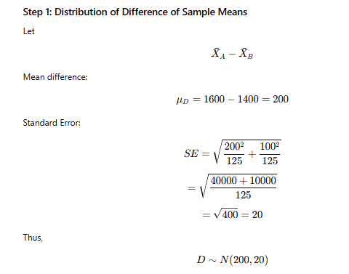
The electric light bulbs of manufacturer A, have mean life time of 1600 hours with a S.D of 200 hours, while those of manufacturer B have a mean life time of 1400h with a S.D of 100 hr. If random samples of 125 bulbs from each manufacturer are selected, then what is the probability that the bulbs will have a mean lifetime that is at least (a) 160 and (b) 250h more than B bulbs?

Slide 3
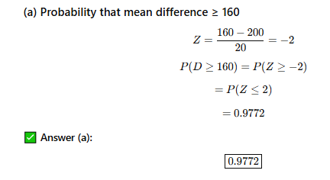

Slide 4
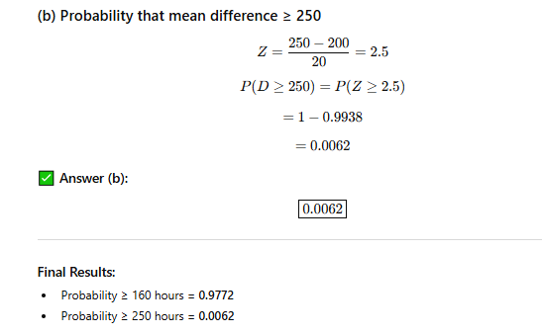

Slide 5
Thank You

