Slide 1

Dr. SNS RAJALAKSHMI COLLEGE OF ARTS AND SCIENCE
(AUTONOMOUS)
Department of Mathematics
DISCRETE MATHEMATICS WITH PROBABILITY AND HYPOTHESIS TESTING
Unit IV
Topic: Test of Hypothesis
Dr. K.Sasikala
Assistant Professor
Dept. of Mathematics
Dr. SNSRCAS

Slide 2
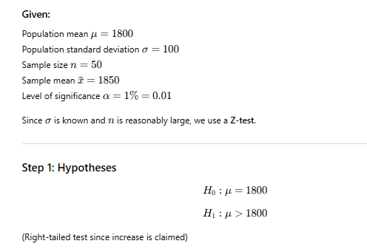
The mean breaking strength of cables supplied by a manufacturer is 1800 with a S.D of 100. By a new technique in the manufacturing process it is claimed that the breaking strength of the cables has increased. In order to test this, claim a sample of 50 cables is tested. It is found that the mean breaking strength is 1850. Can we support the claim at 1% level of significance?

Slide 3
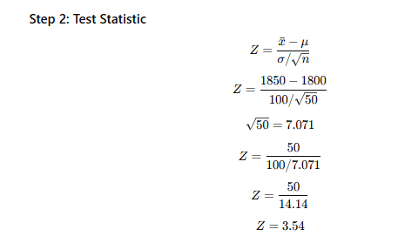

Slide 4
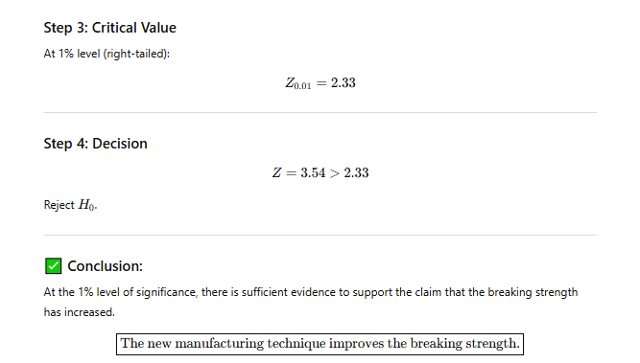

Slide 5
Thank You

