Slide 1


Mastering Mensuration: Measuring the World Around Us
From the edge of a room to the curve of a dome — every shape has a story told in numbers.

Slide 2
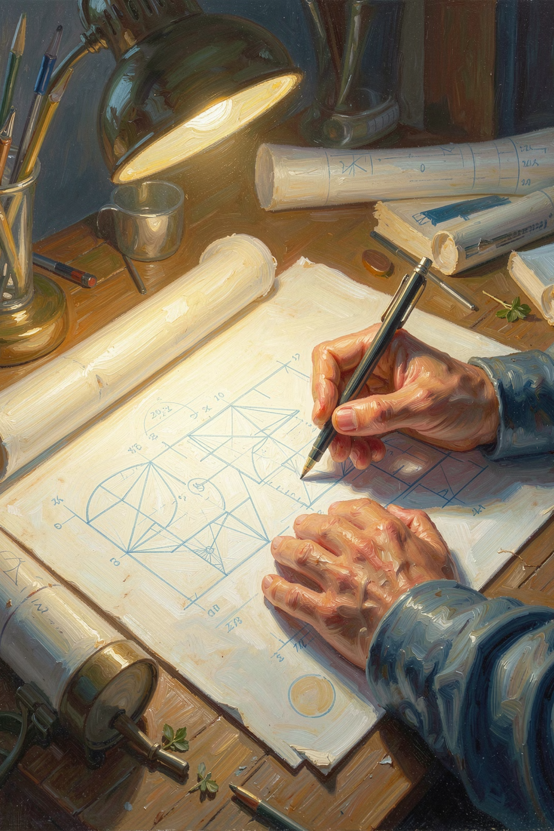
What is Mensuration?
Definition
Core Concepts
The mathematical study of measuring geometric figures — lengths, areas, and volumes of shapes both flat and solid.
Translating physical reality into precise calculations of perimeter, area, and volume.
Real-World Use
Indispensable in engineering, architecture, interior design, and countless everyday decisions.

Slide 3

Perimeter vs. Area: The Foundation
Perimeter
Total distance around the boundary of a 2D shape. Used for fencing, borders, and framing. Measured in linear units (cm, m, km).
Area
Total space enclosed within the boundary. Used for flooring, painting, and land. Measured in square units (cm², m², km²).

Slide 4


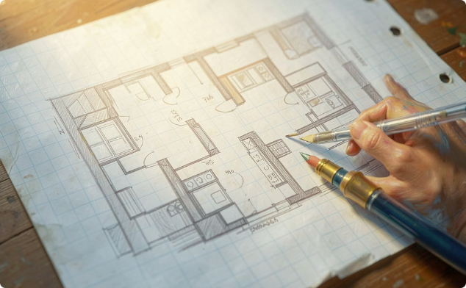
2D Mastery: Squares and Rectangles
Square
Rectangle
Real-World Use
All four sides are equal.
Area = side × side
Perimeter = 4 × side
Opposite sides are equal.
Area = length × breadth
Perimeter = 2 × (l + b)
Calculating floor space for room layouts, tiling, or framing photographs and paintings.

Slide 5
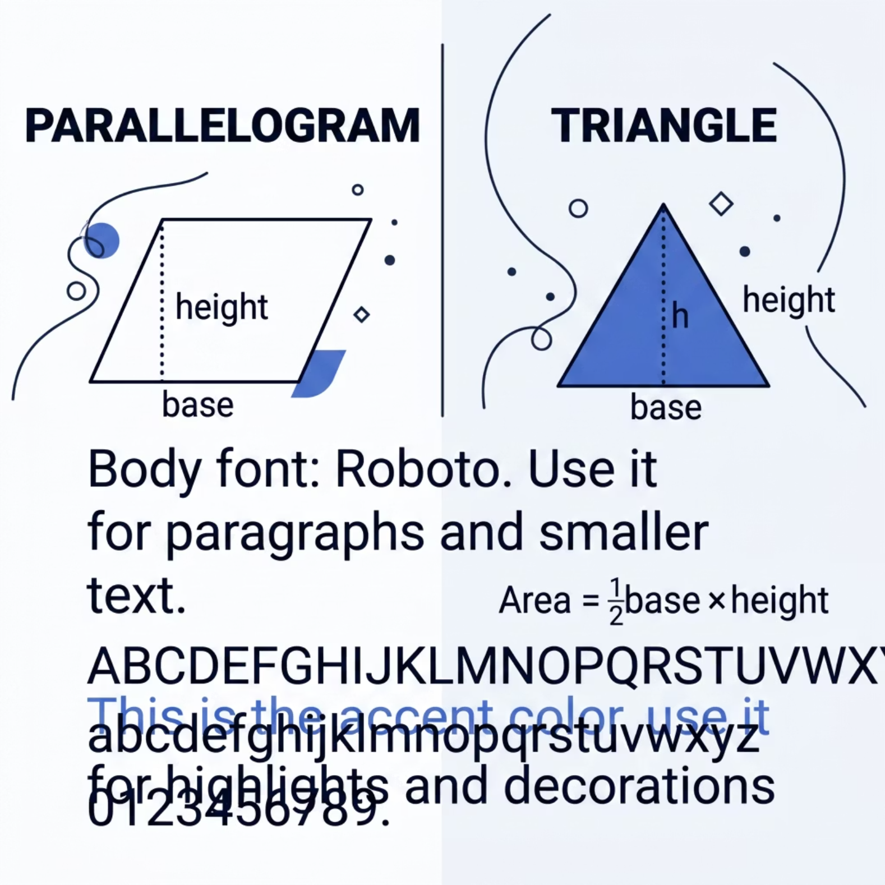


Expanding to Polygons: Triangles and Parallelograms
Key Insight
A triangle is exactly half a parallelogram — slice a parallelogram diagonally and you get two congruent triangles.
Complex irregular polygons can always be broken down into simpler rectangles and triangles to make calculation manageable.

Slide 6
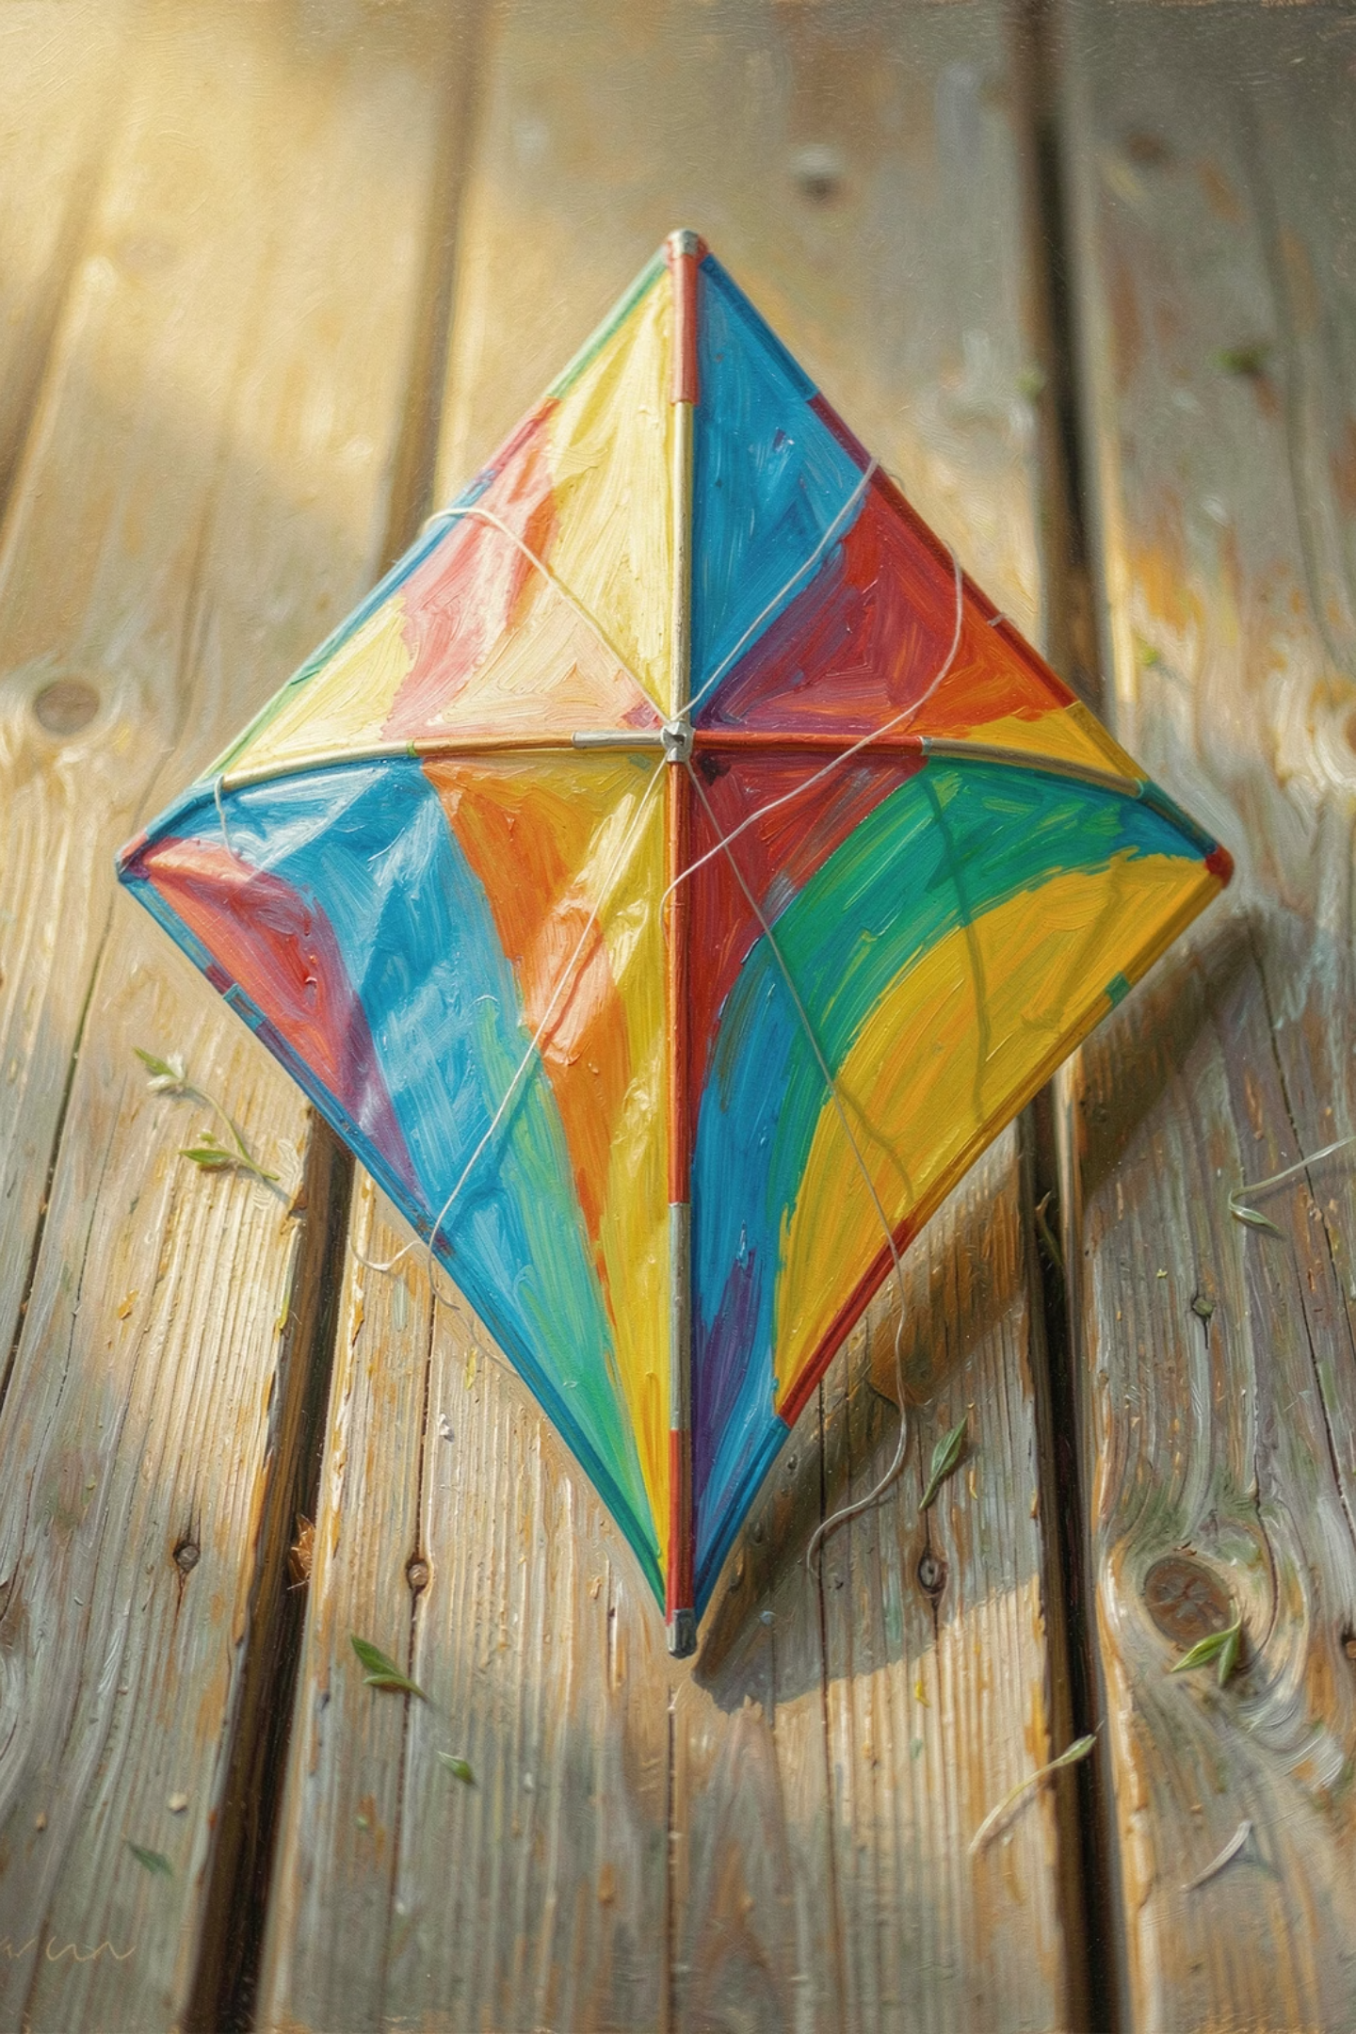
Specialised Shapes: Trapezium and Rhombus
Trapezium
Area = ½ × height × (sum of parallel sides)
Think of it as averaging two different bases over a shared height.
Rhombus
Area = ½ × diagonal₁ × diagonal₂
A tilted square — its diagonals bisect each other at right angles, revealing its symmetry.

Slide 7

The Circle: Nature's Perfect Shape
Key Measurements
Radius (r): Distance from centre to edge.
Diameter (d): Twice the radius.
The constant π ≈ 3.14159 exists because a circle's circumference is always the same multiple of its diameter — a universal truth in geometry.
Circumference
Area
2 × π × r
π × r²

Slide 8

Stepping into 3D: Volume and Surface Area
The 3D Transition
Moving from flat 2D planes to solid objects like cubes, cuboids, and cylinders adds a new dimension — depth.
Surface Area
The total area of all exterior faces of a 3D object — think of unfolding a box into a flat net.
Volume
The amount of 3D space enclosed inside a solid object — how much it can hold or occupy.

Slide 9

Building the 3D World: Formulas in Action
Cuboid: Surface Area
Cube: Surface Area
Cylinder: Surface Area
These formulas power real-world decisions — from calculating the cardboard needed for a box, to estimating paint for a cylindrical water tank, to designing architectural structures at scale.

Slide 10

Conclusion: Geometry in Action
Mensuration is not just a chapter in a textbook — it is the language in which the physical world is designed, built, and understood.
From Classroom to Reality
Every formula you have learned maps directly to something tangible — a floor, a wall, a container, a city block.
Accuracy and Efficiency
Precise measurement eliminates waste, reduces cost, and ensures structures are safe and functional.
Your Next Step
Look around you — apply these principles to real objects in your surroundings and watch geometry come alive.

Slide 11
Conclusion: Geometry in Action
Mensuration is not just a chapter in a textbook — it is the language in which the physical world is designed, built, and understood.
From Classroom to Reality
Every formula you have learned maps directly to something tangible — a floor, a wall, a container, a city block.
Accuracy and Efficiency
Precise measurement eliminates waste, reduces cost, and ensures structures are safe and functional.
Your Next Step
Look around you — apply these principles to real objects in your surroundings and watch geometry come alive.

