Slide 1


Population vs. Sample: The Art of Statistical Inference
How studying a carefully chosen few allows us to understand the many — the foundational principle of statistical reasoning.

Slide 2


Defining the Universe
Population
The Target
The complete collection of all individuals, objects, or measurements that share a defined characteristic under study. It is the full universe your research seeks to understand.
Every unit that possesses the specific attribute of interest belongs to this universe — whether it is all registered voters, all manufactured bolts, or every patient with a diagnosis.
The population is defined by the research question, not by geography or size.

Slide 3
Types of Populations
Finite
Infinite
A countable, bounded set of units. Examples: students enrolled in a university, employees in a company, registered vehicles in a city.
An uncountable or boundless set. Examples: all possible outcomes of repeated coin flips, all water molecules in an ocean.
Existent
Hypothetical
Concrete, real-world groups that physically exist and can be enumerated at a point in time.
Conceptual or theoretical groups used in models — populations that could exist under defined conditions.

Slide 4

Why We Don't Study Everything
Conducting a full census of a large population is rarely practical. The constraints are real and significant.
Cost & Time
Logistical Impossibility
The Power of Sampling
Surveying every unit demands enormous financial and human resources, often making it prohibitive.
For infinite or dispersed populations, a complete enumeration is simply not achievable.
A well-drawn sample delivers speed, efficiency, and surprisingly high accuracy through a manageable subset.

Slide 5

The Representative Subset
A sample is not merely a smaller version of the population — it is a carefully selected mirror that, when chosen well, faithfully reflects the whole.

Slide 6
Anatomy of a Sample
Subset
Sampling Frame
Sampling Unit
A selected portion of the population chosen to act as a proxy for the whole. Its quality determines the validity of all conclusions drawn.
The source list or database from which sample units are drawn — e.g., an electoral roll, employee directory, or customer database.
The basic element available for selection — the individual, household, firm, or transaction that constitutes one entry in the frame.

Slide 7
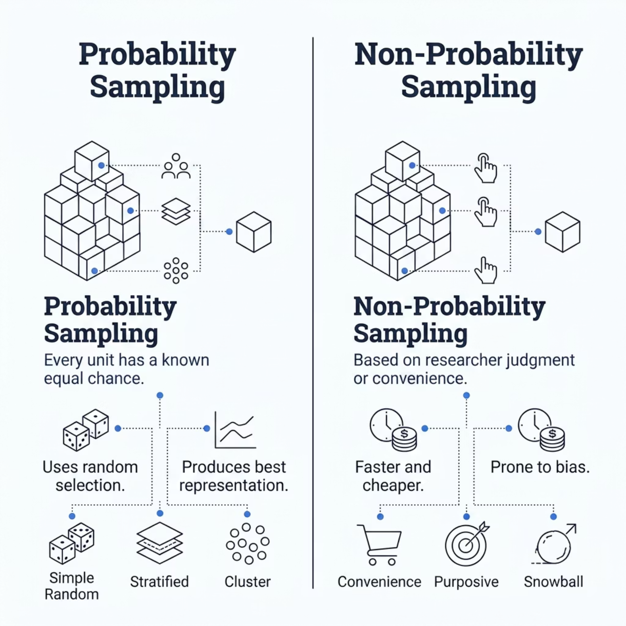



Choosing Your Method
Which Should You Use?
The choice depends on your research goals, available resources, and the level of precision required.
Use Probability Sampling when generalisability and statistical validity are essential.
Use Non-Probability Sampling for exploratory research where speed matters more than precision.

Slide 8

The Math of Reliability
Sampling Error
The Golden Rule
The inevitable gap between the true population parameter (e.g., mean, proportion) and the value estimated from the sample statistic. It can be quantified and controlled.
Larger samples systematically reduce sampling error, narrow confidence intervals, and increase the reliability of inferences drawn about the population.
Doubling sample size roughly halves the margin of error — but with diminishing returns beyond a point.

Slide 9

Calculating Sample Size
The Core Formula
Rule of Thumb
In applied research, a commonly used guideline is to target 1/10th of the total population as a starting estimate for general reliability — particularly for smaller finite populations.
Where Z = Z-score for confidence level, p = estimated standard deviation (proportion), and e = acceptable margin of error.
For a 95% confidence level, Z = 1.96. For ±5% margin of error, e = 0.05.
Population: 500
Population: 5,000
Target ~50 units
Target ~500 units

Slide 10

From Subset to Insight
A sample is more than a slice of data — it is the bridge between the unknown population and actionable knowledge.
01
Define the Population
Set clear boundaries for who or what is under study.
02
Design the Sample
Choose an appropriate method and calculate the right size.
03
Collect & Analyse
Gather data and apply statistical tools to estimate population parameters.
04
Infer with Confidence
Draw conclusions about the full population from your representative subset.

