Slide 1


Unveiling the Spread: The Science of Variation
Understanding not just where data clusters — but how widely it roams.

Slide 2


The Illusion of the Average
Two datasets can share the exact same mean and yet look nothing alike.
Central tendency tells us where the middle is — but it conceals the chaos underneath. A class of students, a set of exam scores, or a portfolio of investments may all average out identically, yet differ dramatically in their spread and risk.
Relying on averages alone is statistically incomplete — and potentially misleading.

Slide 3
Defining Variation
Variation measures how scores are scattered around a central point. It is the foundation of data reliability, risk assessment, and statistical inference.
Spread
Reliability
Risk
How far individual values stray from the centre of the distribution
Low variation signals consistent, dependable data patterns
High variation signals volatility and unpredictable outcomes

Slide 4


MEASURE 1
The Range: The Total Distance
The simplest measure of variation: subtract the lowest value from the highest.
Formula: Range = Maximum − Minimum
Powerful for a quick snapshot, but highly sensitive to extreme outliers. A single unusual value can inflate the range dramatically — making it unreliable for skewed distributions.

Slide 5

The Interquartile Range: Cutting Through the Noise
By focusing on the middle 50% of data, the IQR reveals where the bulk of values truly live — undistorted by extremes.

Slide 6
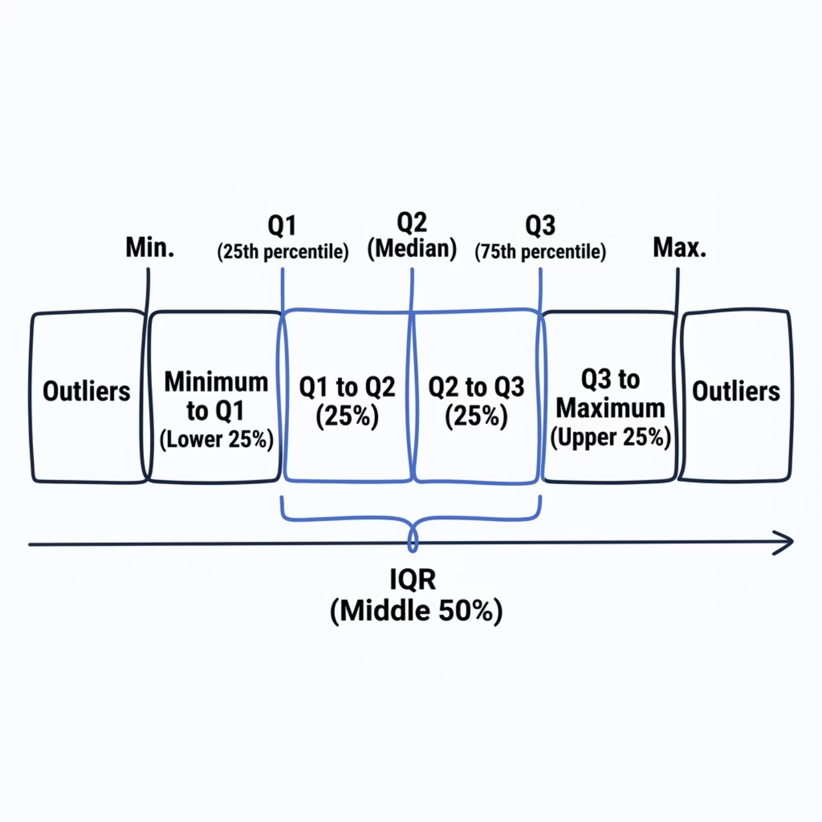

MEASURE 2
The Interquartile Range (IQR)
Formula: IQR = Q3 − Q1
Focuses exclusively on the central 50% of the distribution
Resistant to the distorting effect of extreme outliers
Preferred for skewed data and non-normal distributions

Slide 7

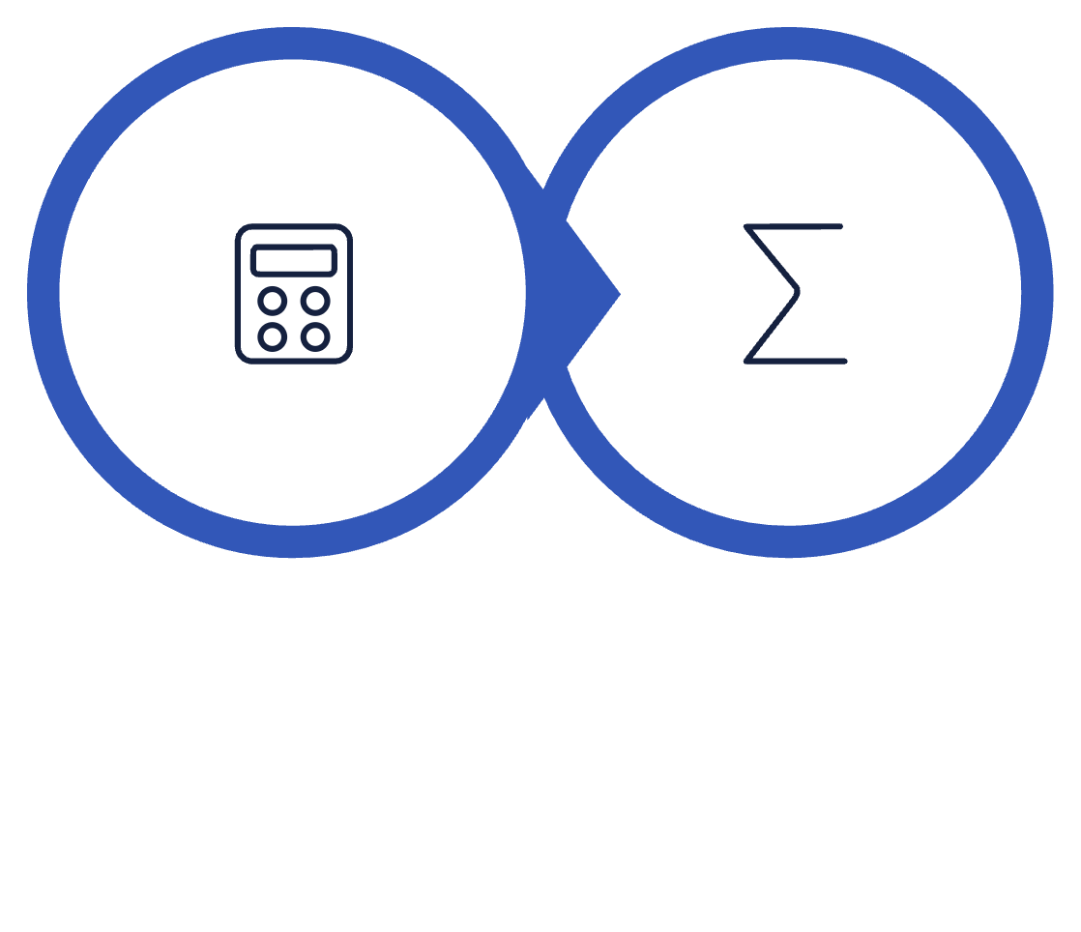

MEASURE 3
Variance: The Foundation
Variance calculates the average of squared distances from the mean — giving every deviation equal weight, regardless of direction.
Why square the differences? Raw deviations above and below the mean cancel each other out, summing to zero. Squaring removes all negative signs so every deviation contributes meaningfully to the total.
Square Distances
Average Squares
Limitation: Variance is expressed in squared units, making it harder to interpret directly in context.

Slide 8

MEASURE 4
Standard Deviation: The Industry Standard
The square root of variance — returning the measure to the original units of the data, making it directly interpretable and universally trusted.
Interpretability
Expressed in the same units as your data — kilograms, marks, rupees
Universality
The standard in research, finance, quality control, and data science
Sensitivity
Captures every value's deviation — nothing is ignored or discarded

Slide 9
Anatomy of a Distribution
The Empirical Rule reveals how standard deviation maps onto a normal distribution:
68%
95%
99.7%
Within 1 SD
Within 2 SD
Within 3 SD
The majority of values cluster close to the mean
Almost all typical observations fall in this range
Virtually the entire distribution — rare outliers beyond this
Standard deviation does not merely measure spread — it defines the shape and behaviour of an entire population's data.

Slide 10


Why It Matters
Low Variability
Signals consistency and predictable outcomes — reliable processes, stable results
High Variability
Signals volatility and hidden risk — unpredictable systems, wider uncertainty
Every statistic you encounter is incomplete without its measure of variation. The mean tells you where data is. Variation tells you how much to trust it.

