Slide 1


The Art of Data Visualisation
Turning Numbers into Narrative

Slide 2
The Power of Perception
Bridging the Gap
Data visualisation connects complex information to human understanding — making the invisible visible.
Pre-Attentive Processing
Our brains detect patterns, shapes, and orientation before conscious thought — good design exploits this instinct.
The Ultimate Goal
Move beyond raw data to spark decisive action. A great chart doesn't just inform — it compels.

Slide 3



The Core Principles of Design
Simplicity
Accuracy
Consistency
Clutter is the enemy of insight. Strip away every element that doesn't serve the data.
Maintain a truthful Lie Factor — visual representation must always be directly proportional to the data it encodes.
A uniform design language reduces cognitive load, letting your audience focus on meaning rather than decoding style.

Slide 4
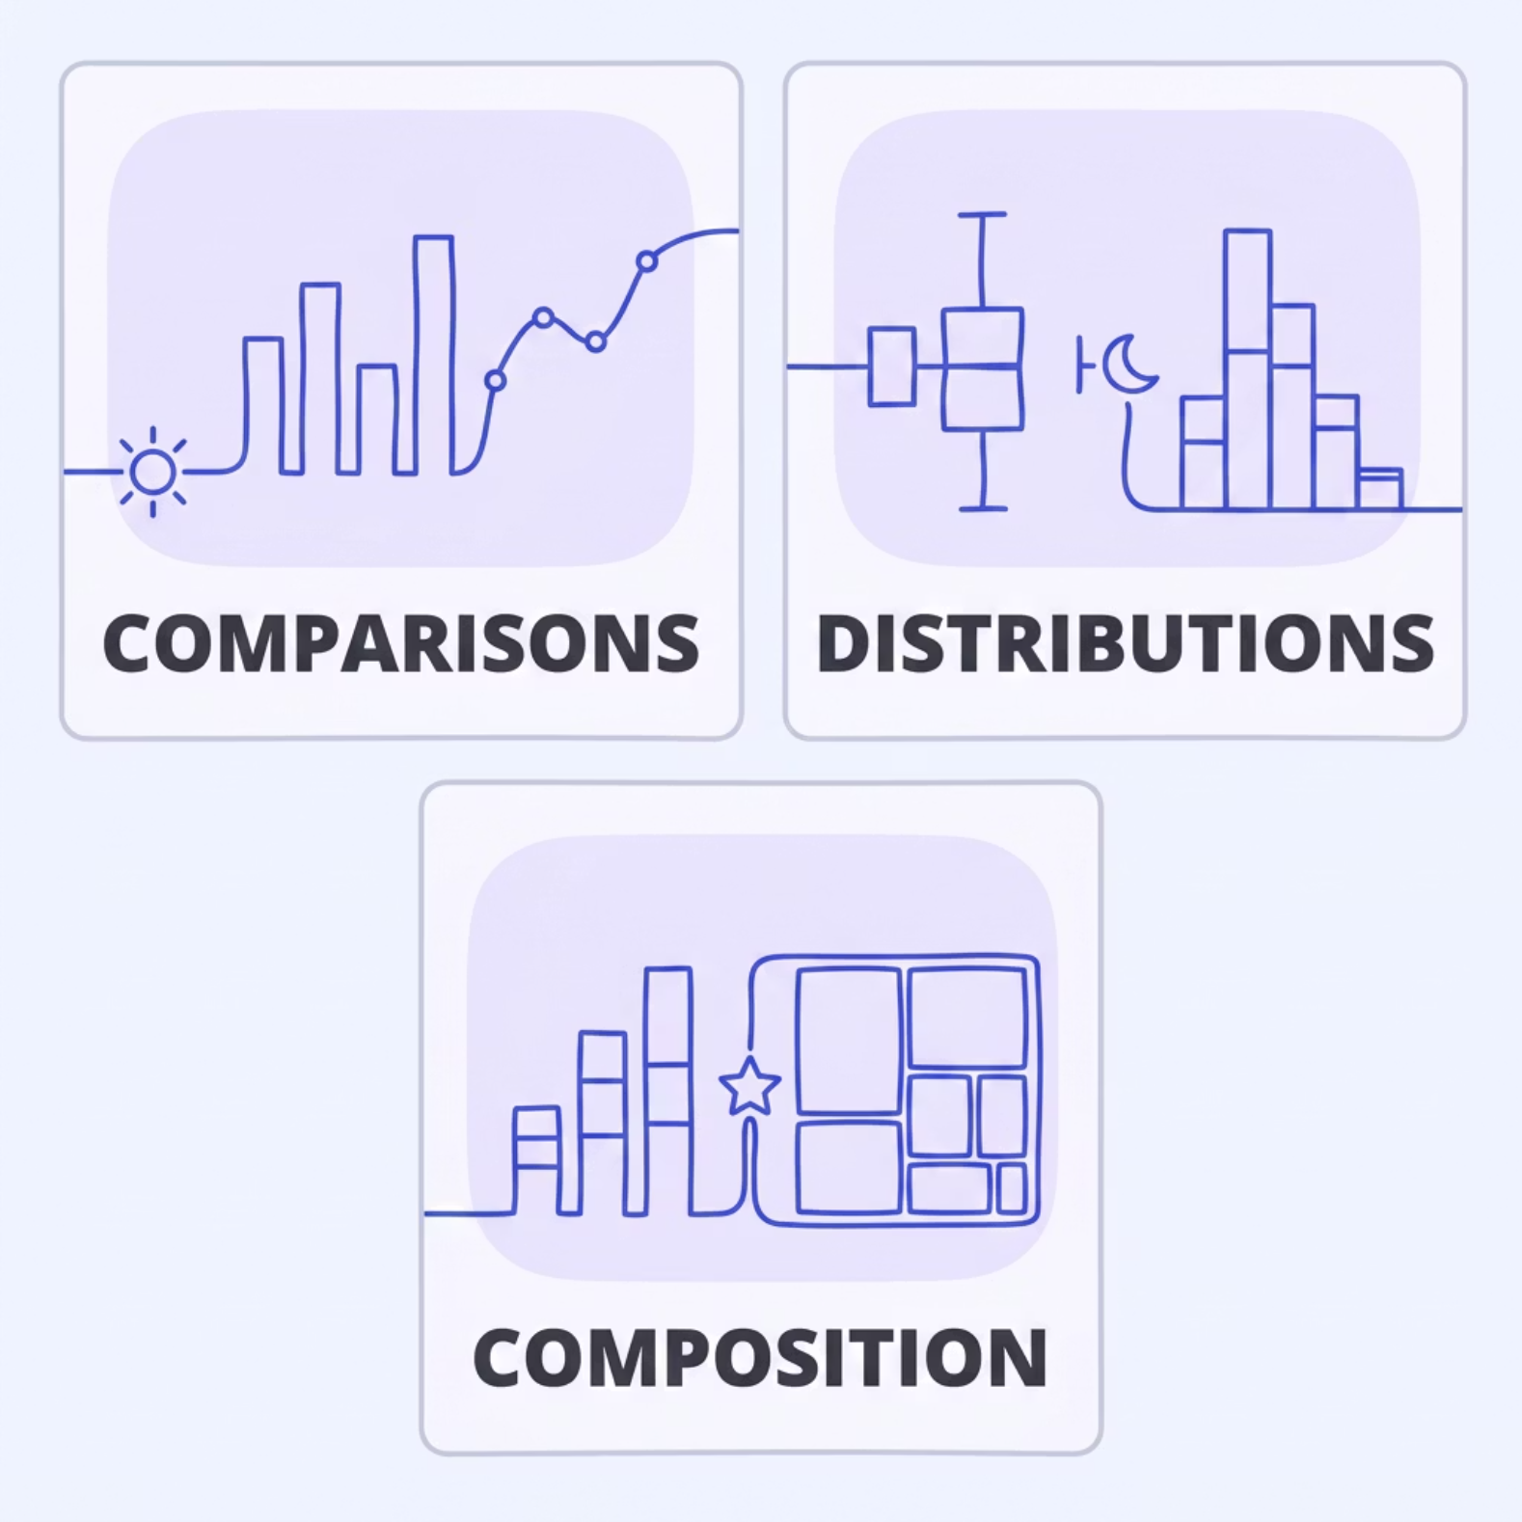

Choosing Your Visual Language
Match the Chart to the Question
Every chart type answers a different question. Using the wrong one misleads your audience before they read a single number.
Comparisons: Bar charts for groups; line graphs for trends
Distributions: Box plots or histograms to reveal data shape
Composition: Stacked bars or treemaps — not pie charts

Slide 5


Complexity vs. Clarity
A dense, unformatted table forces the reader to do all the work. A clean, well-structured chart with deliberate highlights does the thinking for them — guiding the eye straight to the insight.
The best visualisation is the one that answers the question before the audience even asks it.

Slide 6
The Pitfalls of Modern Tools
1
2
3
Avoid 3D Charts
Beware of Area Encoding
Never Truncate the Axis
Three-dimensional effects distort scale, skew perspective, and actively confuse the reader. Flat is always more honest.
Use height or width to encode a single dimension — never both simultaneously. Bubble and area charts require extreme care.
Bar charts must always start at zero. A truncated axis exaggerates differences and manufactures drama that isn't in the data.

Slide 7

Know Your Audience
Tailor Your Depth
Sometimes, Ditch the Chart
Calibrate the complexity of your analysis to the expertise in the room. Experts want nuance; executives want the headline.
If your insight is a single powerful number, let it stand alone. Plain, bold text is often the most impactful data visualisation of all.

Slide 8


Context is King
Label Everything
Annotate the "Why"
A chart without titles, axis labels, and a legend is just a drawing. Never assume the context is obvious.
Use callout text to explain significant spikes or dips. Don't leave the audience guessing at the story behind the data.

Slide 9
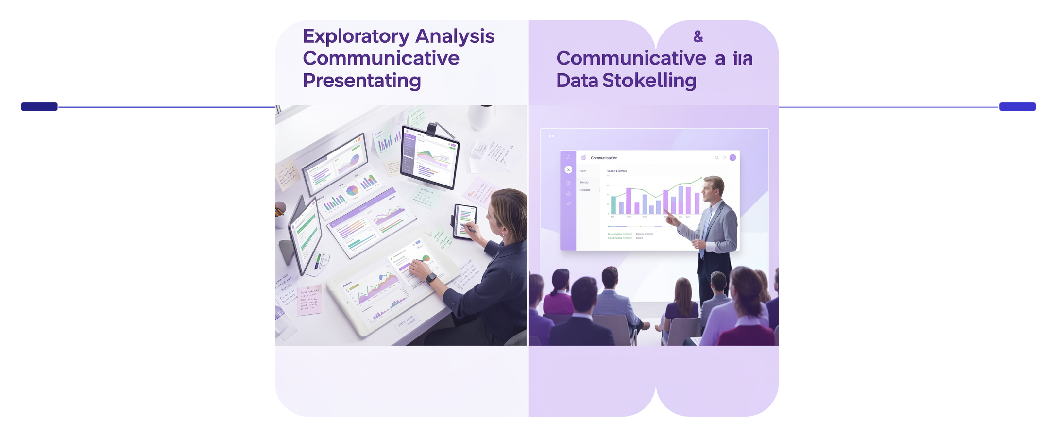

Strategic Storytelling
Start with Your Best Punch
Lead with your most shocking or important finding. Hook the audience in the first moment — everything after becomes supporting evidence for a conclusion they already want to believe.
Exploratory
Communicative
Analyze flexibly and iterate to discover patterns
Present structured, decisive insights for your audience
Decide your mode before you build: are you exploring, or are you persuading?

Slide 10

Be the Translator
Your role is not simply to display data — it is to guide your audience to a conclusion with clarity and conviction.
Create Visual Moments
Design slides that are memorable. The best charts leave a single, undeniable truth lodged in the mind long after the presentation ends.
One Clear Truth
Let your final slide carry one data-backed message. Clarity at the close is what drives action — and action is always the goal.

