Slide 1

Data Types & Scales of Measurement
Pick the right scale — or risk telling the wrong story entirely.

Slide 2


The Rule of the Game
A variable's level of measurement is the single most important property to establish before any analysis. It determines which mathematical operations are valid, which statistics are meaningful, and which comparisons you're actually allowed to make.
Use the wrong scale → invalid statistics → misleading conclusions.

Slide 3

Two Kinds of Data
Qualitative Data
Quantitative Data
Non-numerical entries — categories or labels that describe a characteristic. Examples: eye colour, nationality, blood type.
Numerical measurements or counts that can be meaningfully calculated. Examples: height, temperature, exam score.

Slide 4
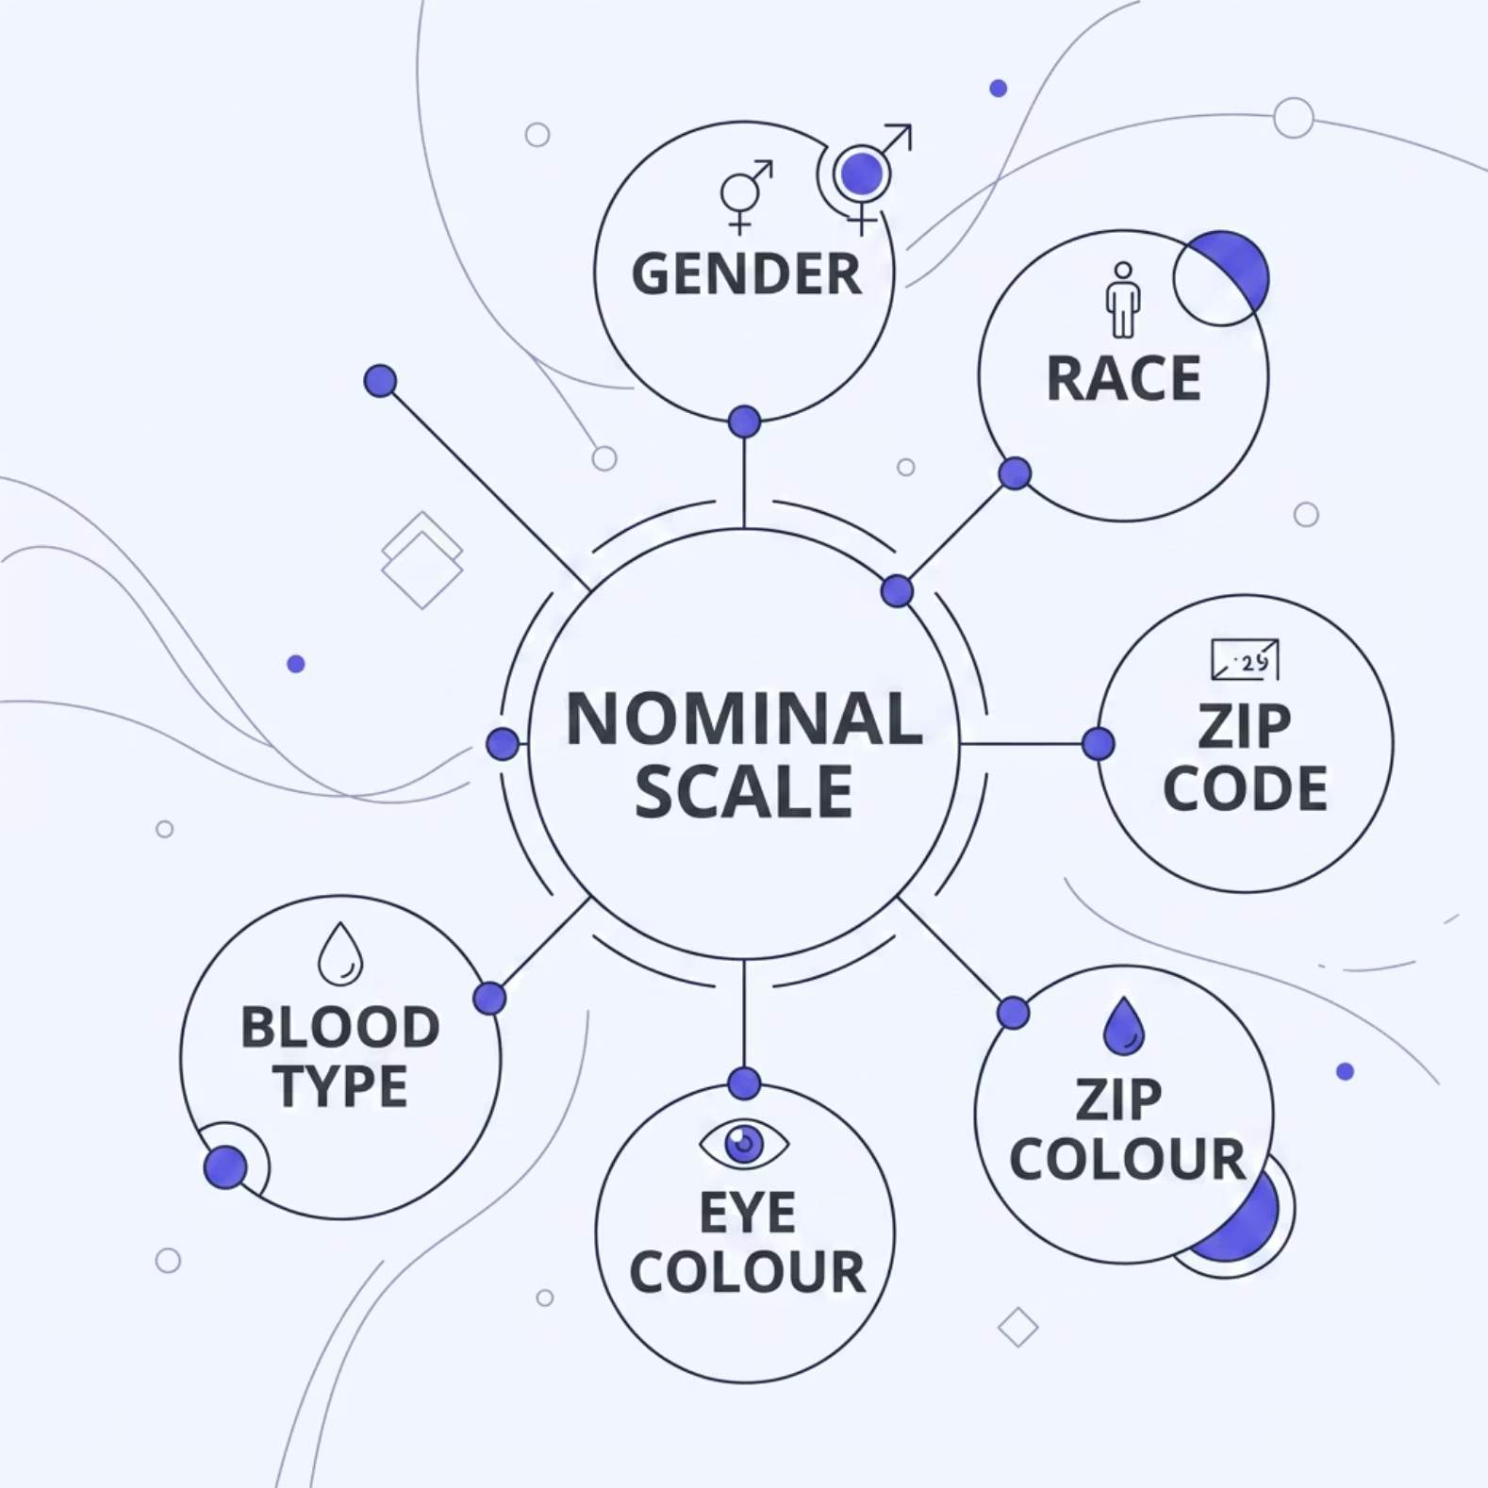

Nominal: Categories Without Ranking
What it is
Nominal data places observations into categories that cannot be rank-ordered. One category is simply different from another — not better, higher, or more.
Gender, race, zip code, political party
Arithmetic operations do not apply
Only valid summary: frequency counts & mode

Slide 5






Ordinal: You Can Rank, But Not Measure Distance
Ordinal data gives you a meaningful order between categories — but the gaps between ranks are unknown and unequal.
Freshman
Year 1
Sophomore
Year 2
Junior
Year 3
Senior
Year 4
You know Senior > Junior, but not how much greater. Calculating an average rank is misleading.

Slide 6


Interval: Distances Matter, Zero Doesn't
Key properties
Interval scales have equal, meaningful distances between values — but no true zero point. Zero is just another value on the scale, not an absence of the property.
Differences between values are valid
Averages can be computed
Ratios are not meaningful
0 °C ≠ "no temperature." It's the freezing point of water — an arbitrary reference.

Slide 7

Ratio: The Scale That Lets You Compare Multiples
Ratio is the most powerful level of measurement. It shares all the properties of an interval scale — plus a true zero point that represents a genuine absence of the quantity.
Age
Weight
0 years = not yet born. "Twice as old" is meaningful.
0 kg = no mass. One object truly can be twice as heavy.
Height
0 cm = no height. Proportional comparisons are valid.

Slide 8
The Hidden Trap: Same Numbers, Different Meaning
Interval Example
Ratio Example
20 °C − 10 °C = a real 10-degree difference. But 20 °C is not "twice as hot" as 10 °C — because zero is arbitrary.
A person aged 20 is genuinely twice as old as a person aged 10 — because age has a true zero. The same arithmetic, entirely different validity.
Applying ratio reasoning to interval data is one of the most common errors in data analysis.

Slide 9
Quick "What's Allowed?" Guide
1
2
Nominal
Ordinal
Compare frequencies only. Mode is the only valid average. No ranking, no arithmetic.
Compare order and ranks. Median is appropriate. Do not assume equal distances.
3
4
Interval
Ratio
Compute differences and means. Standard deviation is valid. Avoid zero-based ratios.
All operations valid — differences, averages, ratios, and geometric mean all make sense.

Slide 10

Choose the Scale. Then Choose the Analysis.
Every statistical decision flows from the level of measurement. Identify your data type first — and the appropriate analysis becomes clear.
Identify
Validate
Determine the data type and scale
Confirm which operations are permitted
Analyse
Apply only the statistics your scale supports

