Slide 1
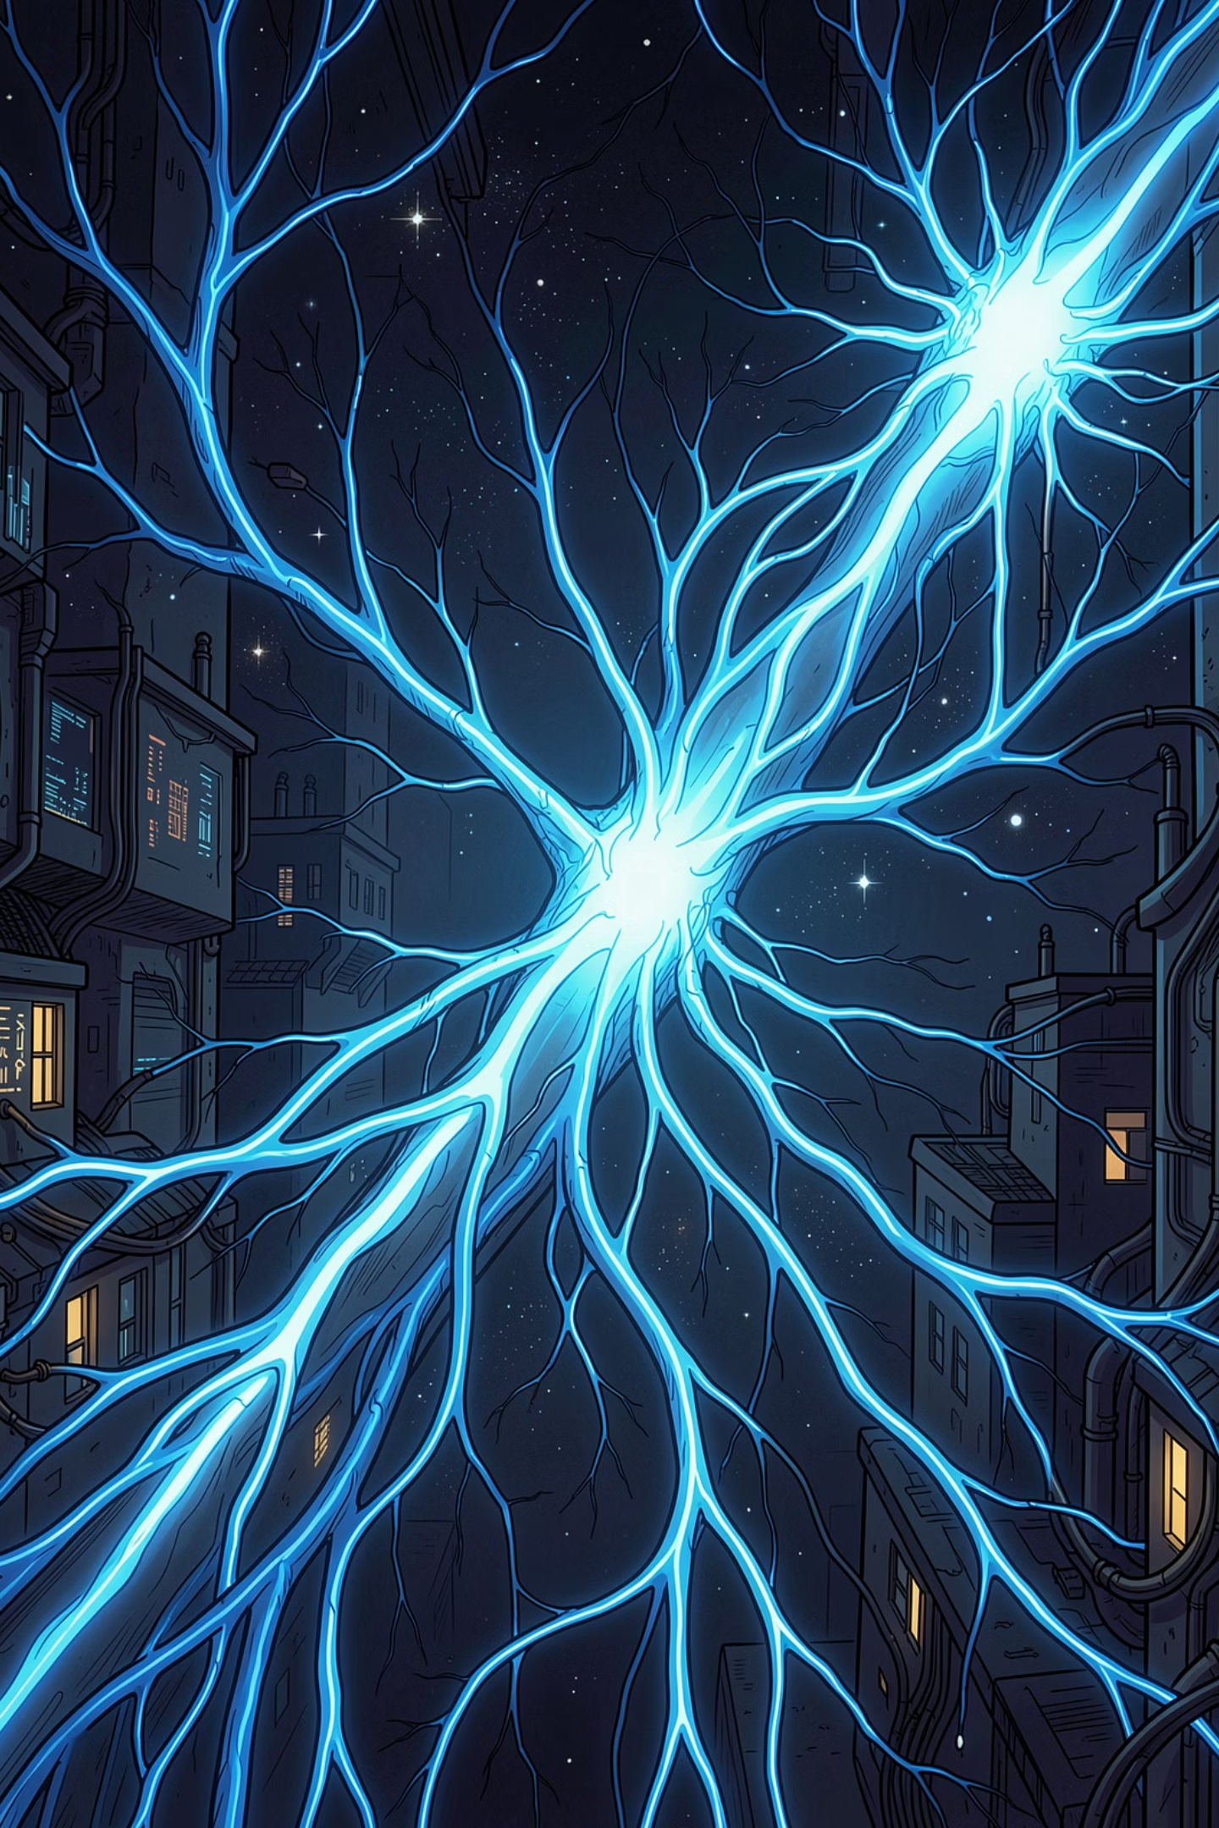

The Language Revolution
From BERT to GPT
How transformer architectures reshaped our understanding of language — and what comes next.

Slide 2

FOUNDATION
The Transformer Breakthrough
2017: A Paradigm Shift
Google's "Attention Is All You Need" paper introduced the Transformer architecture, replacing sequential RNNs with parallel attention mechanisms.
Why It Matters
Attention allows models to weigh the importance of every word in a sequence simultaneously — enabling deep contextual understanding at scale.
The Foundation
Every modern Large Language Model — BERT, GPT, T5, and beyond — is built on this architecture.

Slide 3

BERT
BERT: The Master of Context
Bidirectional Encoder Representations from Transformers
Unlike earlier models that read text left-to-right or right-to-left, BERT's encoder processes the entire sequence simultaneously in both directions.
Masked Language Modeling
Next Sentence Prediction
Random words are hidden; BERT learns to predict them using full context.
Learns relationships between sentence pairs for deeper semantic understanding.

Slide 4

BERT IMPACT
Why BERT Changed NLP
11
340M
2018
NLP Benchmarks
Parameters
Year of Release
State-of-the-art results across 11 major NLP tasks upon release in 2018.
BERT-Large achieved unprecedented depth with 340 million learnable parameters.
Published by Google Research, instantly redefining the NLP landscape.
BERT excels at Natural Language Understanding (NLU) — powering search engines, sentiment analysis, and question-answering systems.

Slide 5


GPT FAMILY
The GPT Family: The Generative Powerhouse
Decoder-Only Architecture
GPT uses only decoder transformer blocks, optimized for generating coherent, fluent text one token at a time.
Autoregressive Design
Each token is predicted based on all previous context — enabling natural, flowing language generation.
Generative Pre-training
Trained on vast internet text, GPT learns grammar, facts, reasoning, and even coding abilities.

Slide 6
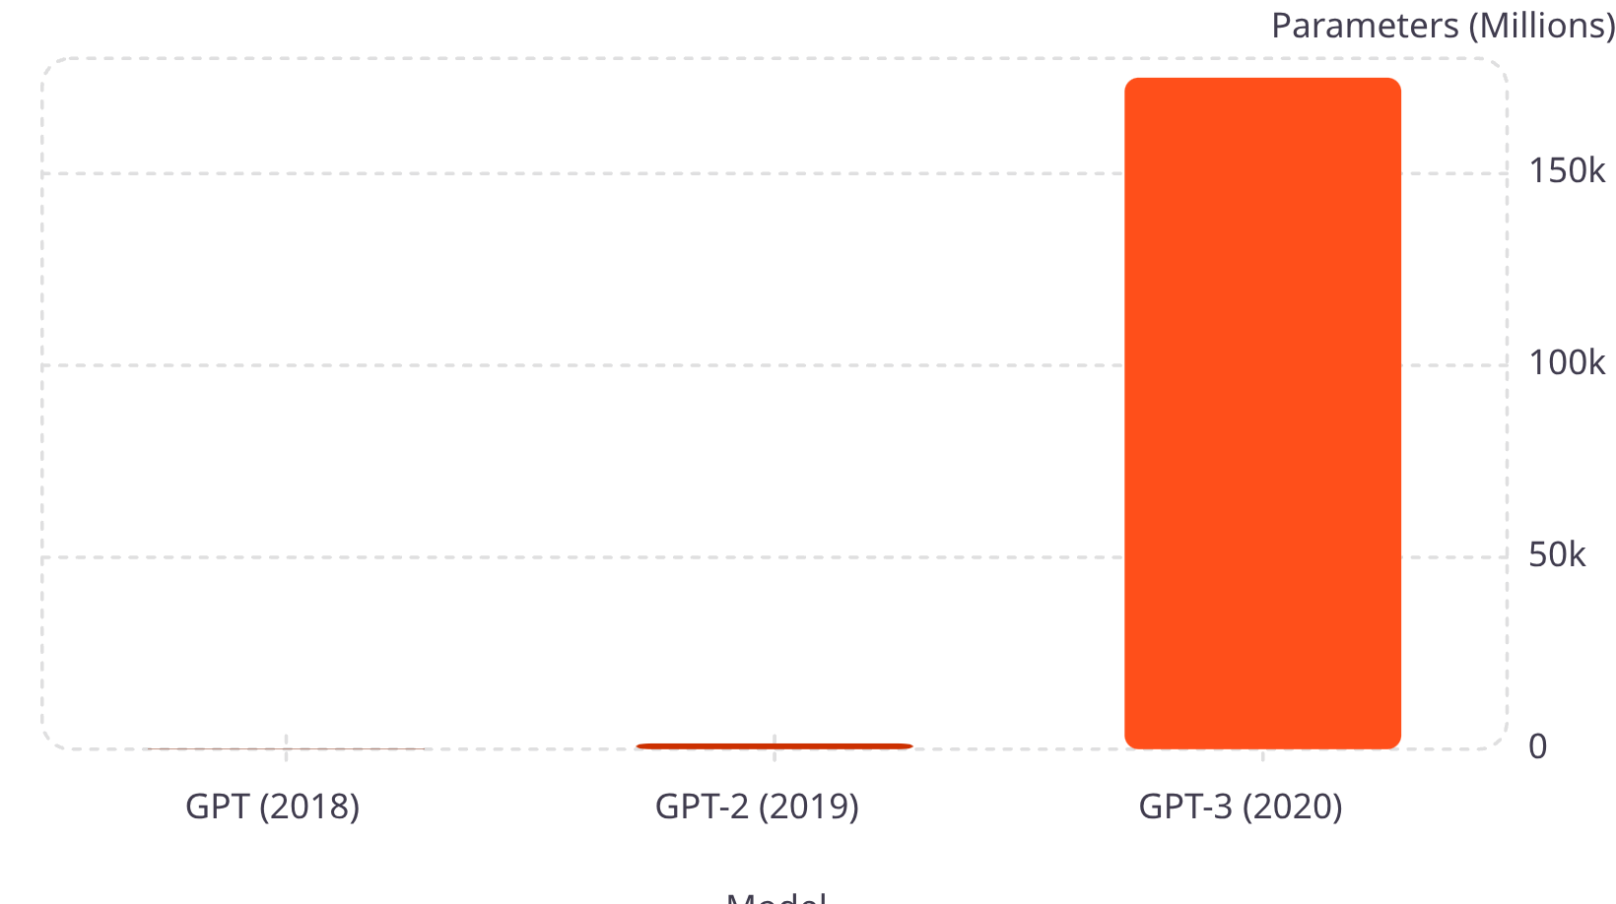

SCALING
The Scaling Story
Exponential Growth
In just two years, parameter count grew by over 1,000x — from 117 million to 175 billion.
With scale came emergent capabilities: reasoning, few-shot learning, and code generation that were not explicitly programmed.
GPT-3's 175B parameters enabled in-context learning — solving new tasks from examples alone.

Slide 7
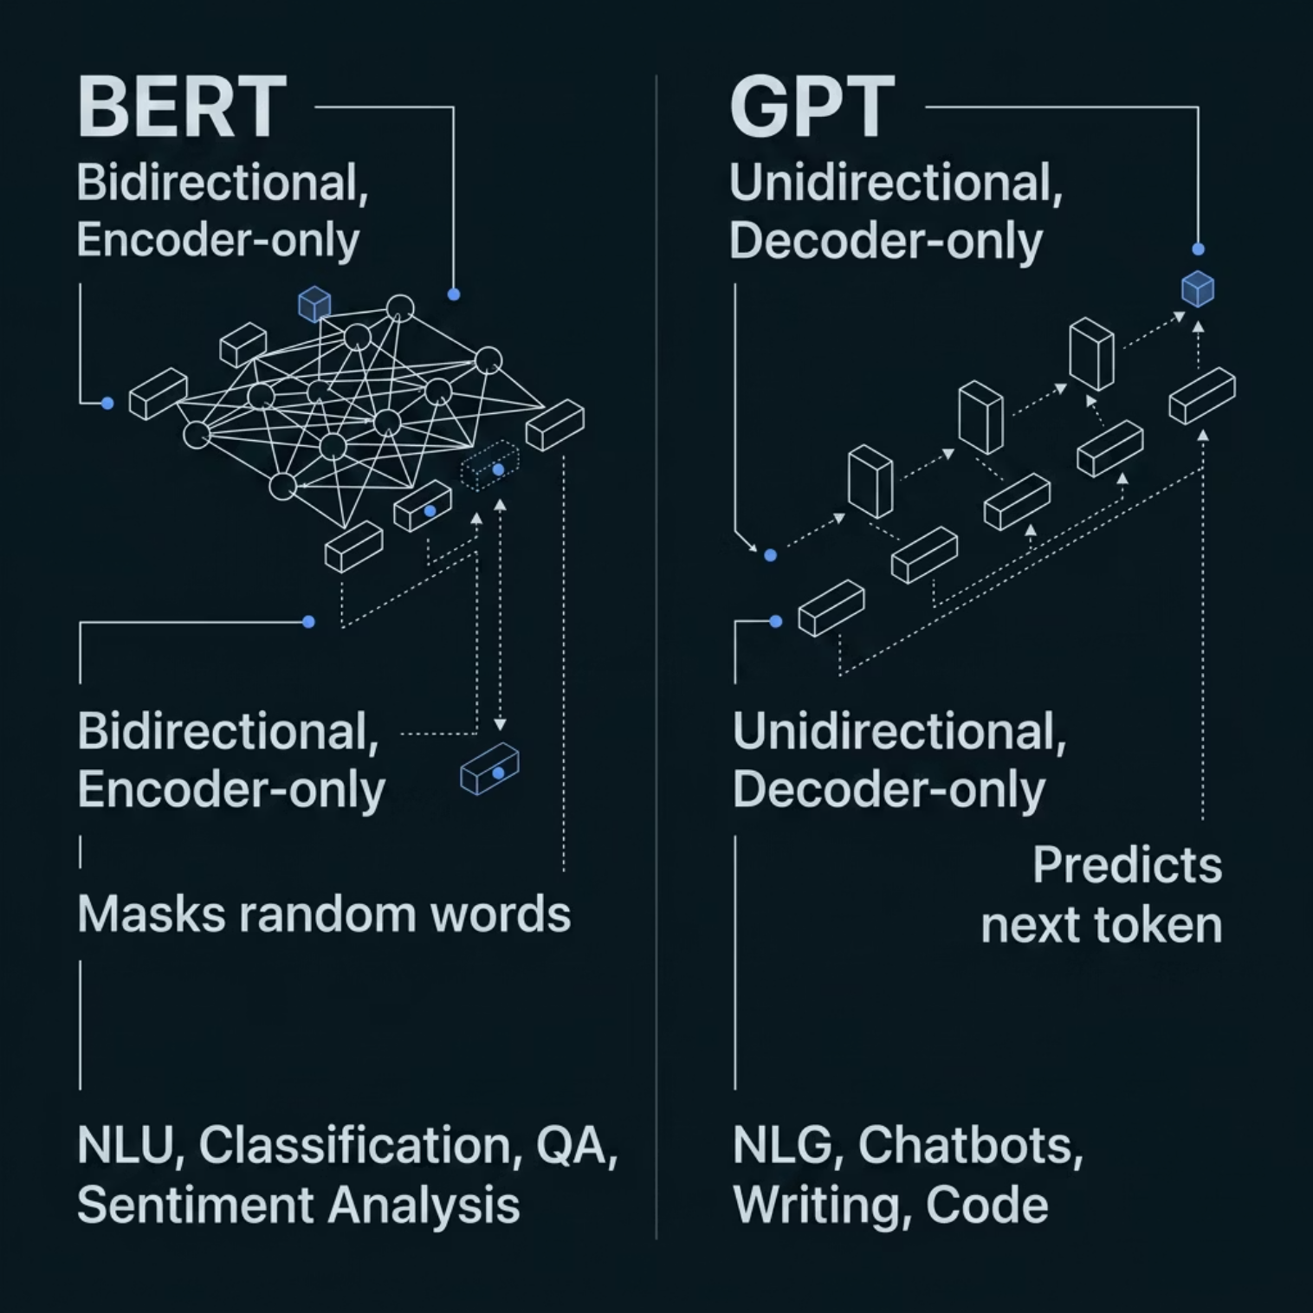

COMPARISON
Understanding vs. Generating
Two Philosophies, One Architecture
BERT and GPT share the Transformer foundation but diverge in purpose:
BERT reads everything at once — ideal for deep understanding
GPT reads left-to-right — ideal for fluent generation
Both pre-train on massive text, but optimize different objectives

Slide 8
ARCHITECTURE
Key Architectural Differences
BERT
GPT
Training Objective
Bidirectional attention — full context at once
Encoder-only stack
Masks random tokens during training
Optimized for understanding
Unidirectional attention — causal masking
Decoder-only stack
Predicts next token autoregressively
Optimized for generation
BERT: Masked LM — fill in the blank
GPT: Causal LM — predict what's next
Both leverage massive unlabeled corpora
Fine-tuning adapts each to downstream tasks

Slide 9


APPLICATIONS
Modern Applications
BERT-Style Use Cases
GPT-Style Use Cases
Search Engines
Chatbots & Assistants
Google Search uses BERT to understand query intent and rank results.
Conversational AI like ChatGPT, Claude, and Gemini.
Code Generation
Document Classification
GitHub Copilot writes, debugs, and explains code.
Legal, medical, and financial document categorization at scale.
Creative Writing
Entity Recognition
Summarization, translation, storytelling, and content creation.
Extracting names, dates, and relationships from unstructured text.
Fine-tuning and Prompt Engineering bridge the gap — adapting general models to specific tasks.

Slide 10
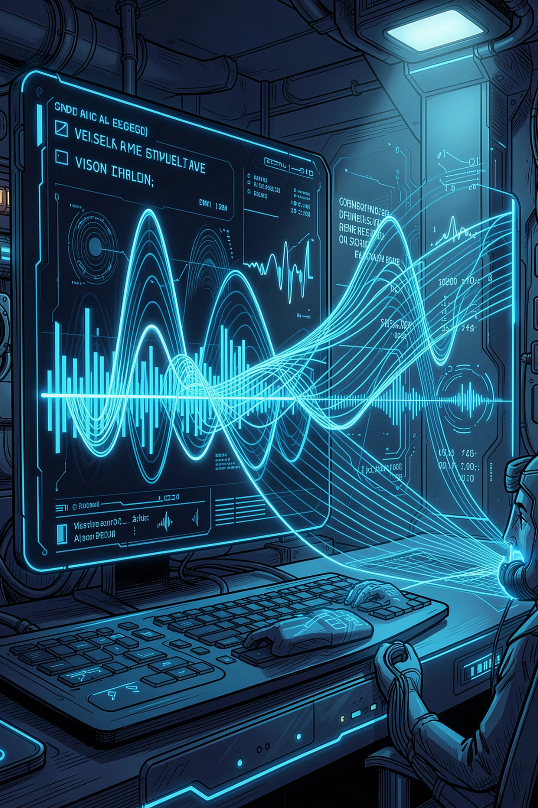



WHAT'S NEXT
The Future of Language Models
Multimodal Systems
Parameter Efficiency
Models like GPT-4V fuse text, vision, and audio into unified reasoning engines.
LoRA and adapter methods enable fine-tuning with a fraction of the compute cost.
RAG & Live Knowledge
Retrieval Augmented Generation connects LLMs to live data, reducing hallucinations.

