Slide 1
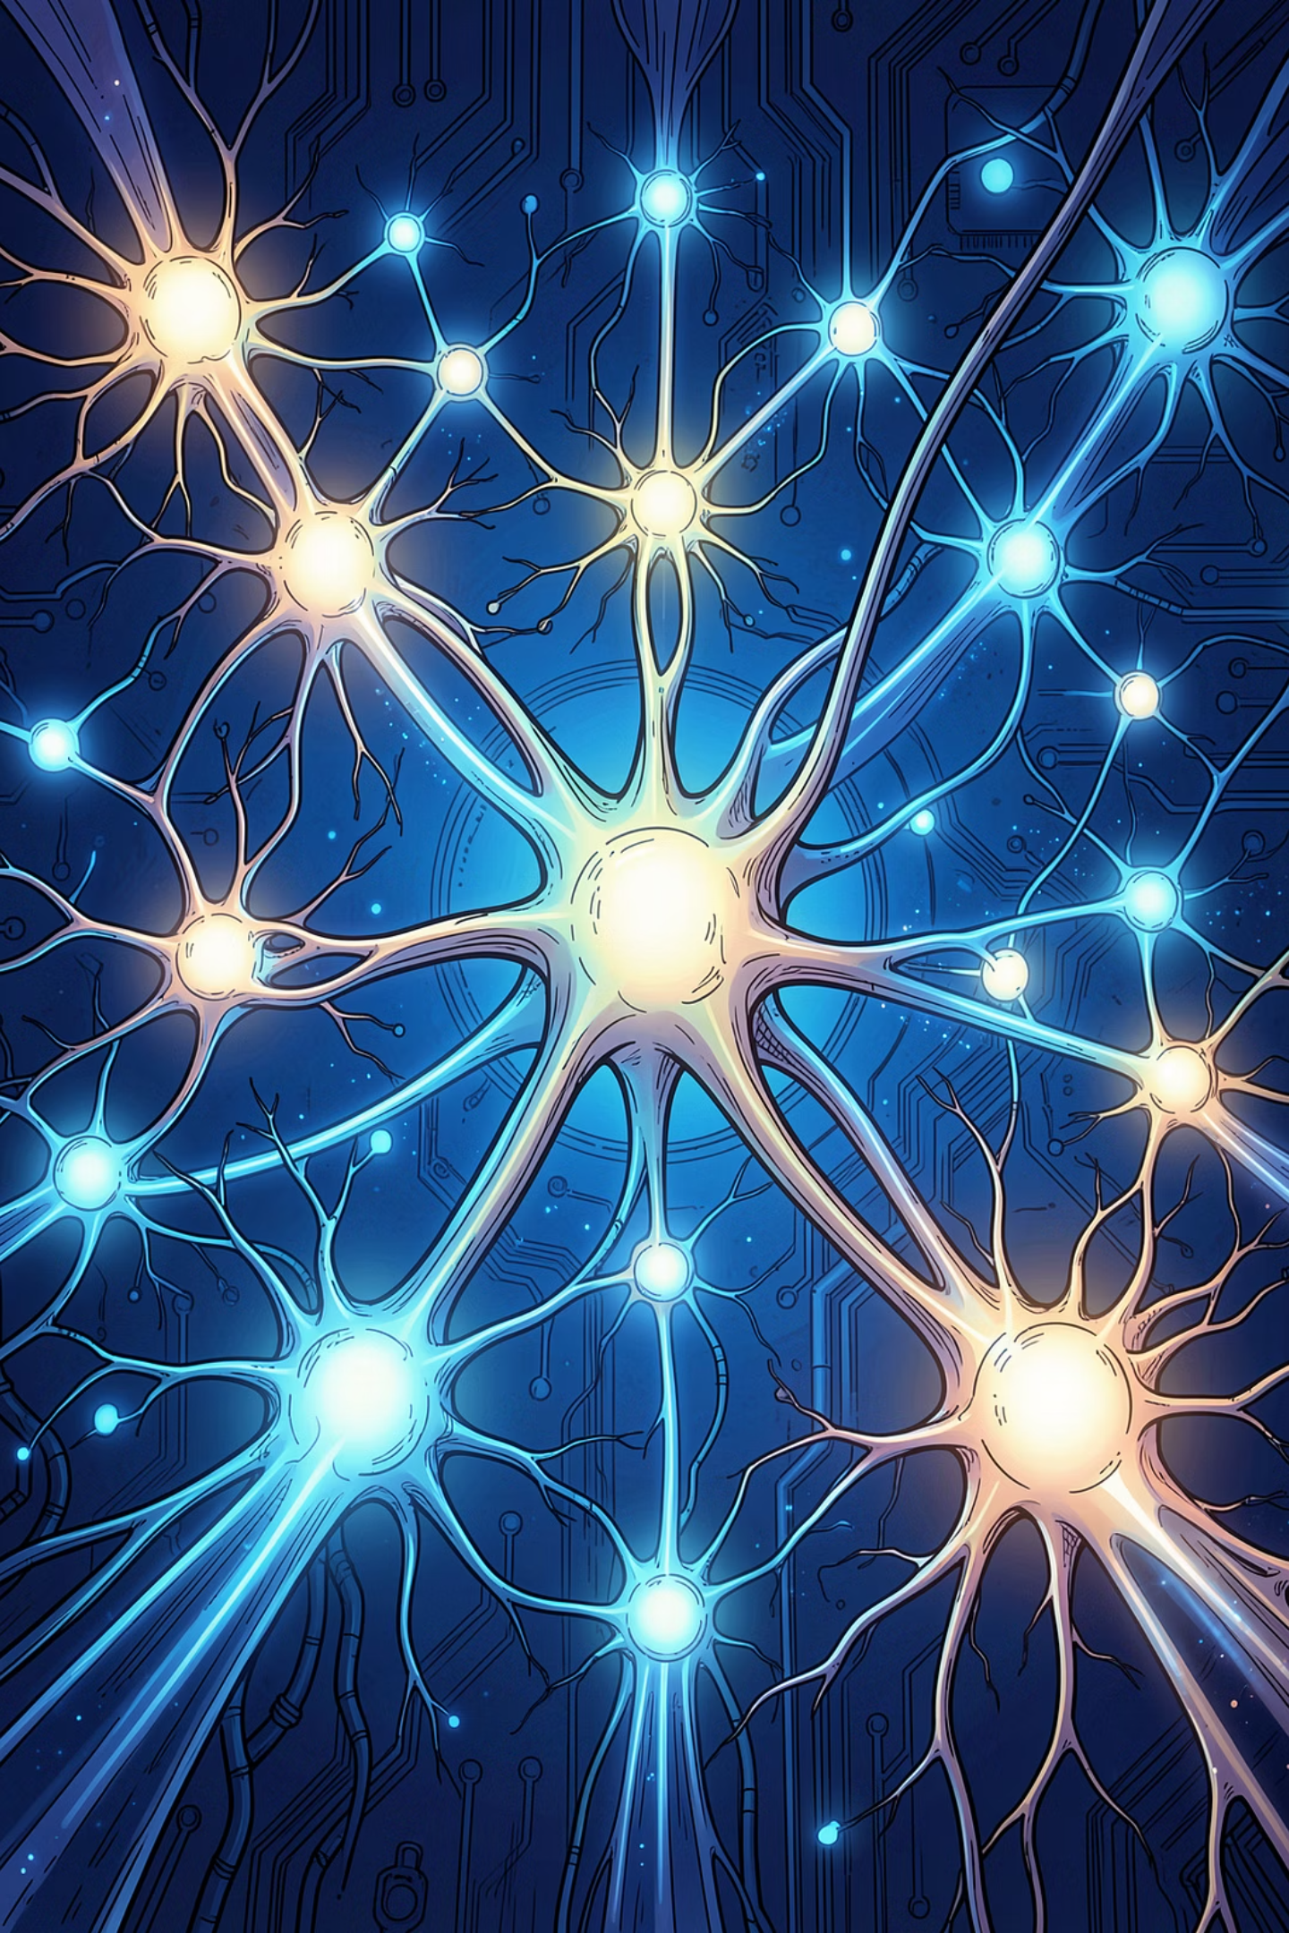

Basic Fine-Tuning Concepts
A practical guide to understanding how pre-trained language models are adapted for specific tasks — from data to methods to decisions.

Slide 2

The Core Idea
Fine-tuning takes a pre-trained model and retrains it on new, task-specific data to improve performance. Done right, it unlocks powerful specialization. Done wrong, it can degrade the model's general capabilities.
Start With
Apply
A pre-trained model with broad language understanding
Task-specific labeled data and supervised training
Result
A specialized model optimized for your use case

Slide 3
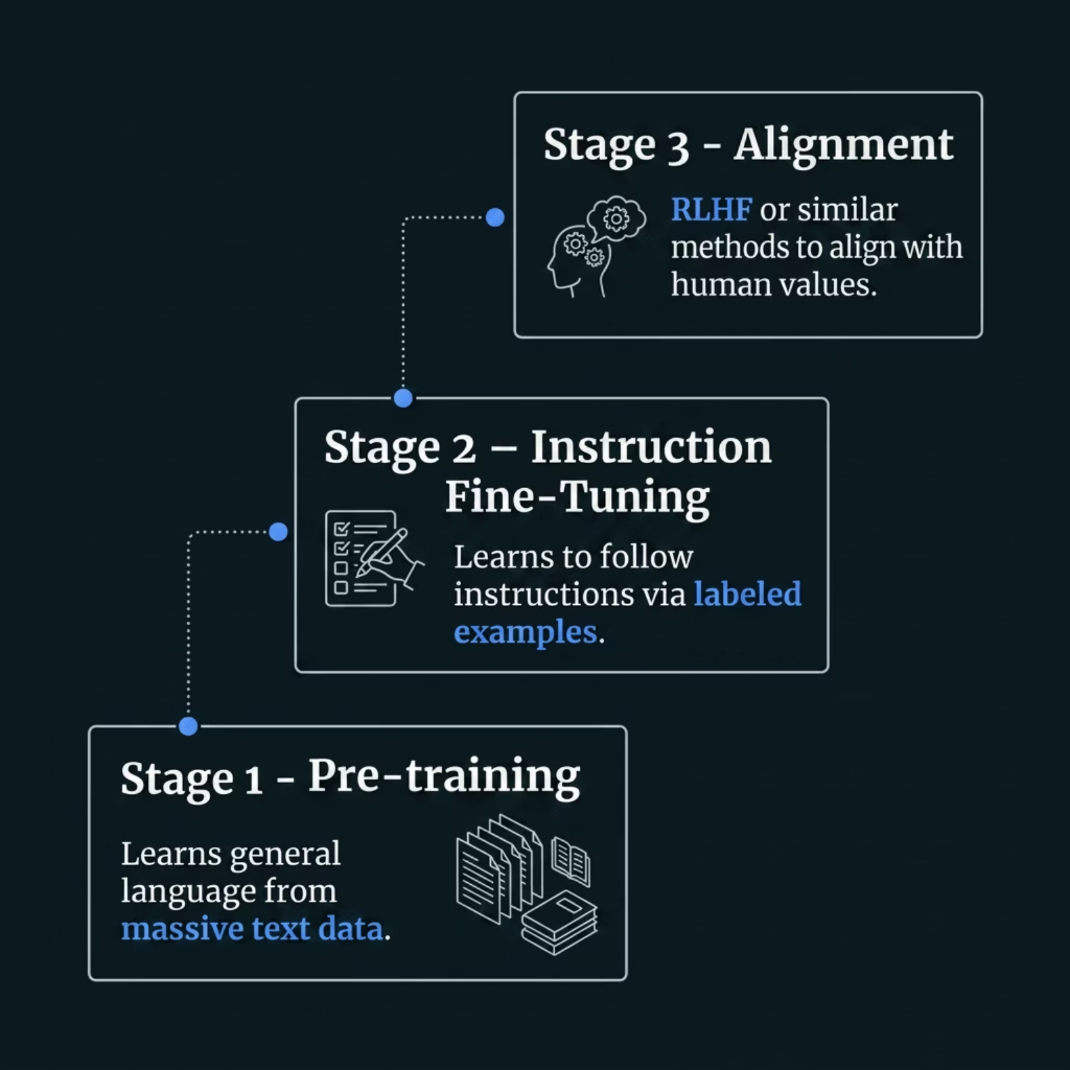


Where Fine-Tuning Fits in LLM Training
Large language models go through a structured training journey. Pre-training builds foundational language understanding from massive text corpora. Instruction fine-tuning teaches the model to respond to prompts correctly. Finally, alignment techniques like RLHF ensure outputs are helpful, honest, and harmless.
Fine-tuning typically happens at Stage 2, though it can be reapplied later for new tasks.

Slide 4

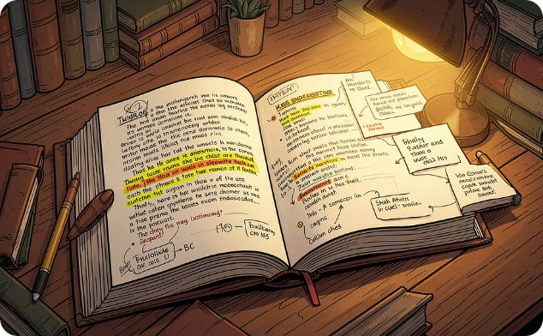
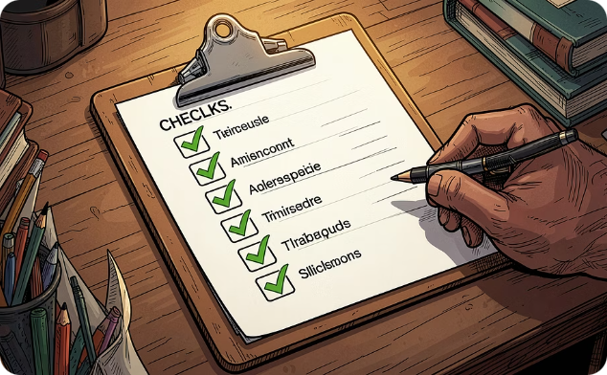
The Data That Drives Fine-Tuning
Quality data is the engine of fine-tuning. Instruction fine-tuning relies on labeled pairs — each example maps an instruction to its desired output, often with supporting context.
Instruction
Context
Desired Output
A clear prompt or command, e.g., "Summarize this article in two sentences."
Optional background information that grounds the response, such as a document or passage.
The ideal response the model should produce — the training target for each example.

Slide 5
Two Main Targets: Instruction vs. Task
Instruction Tuning
Task-Specific Tuning
Teaches the model to follow any instruction across a broad range of prompts and topics. Improves general helpfulness and adaptability.
Specializes the model for a narrow, defined objective like summarization, classification, or translation. Optimizes for one domain.
Wide variety of prompt types
General-purpose capability boost
Often used after pre-training
Focused on a single use case
Higher precision in that domain
Requires domain-specific data

Slide 6
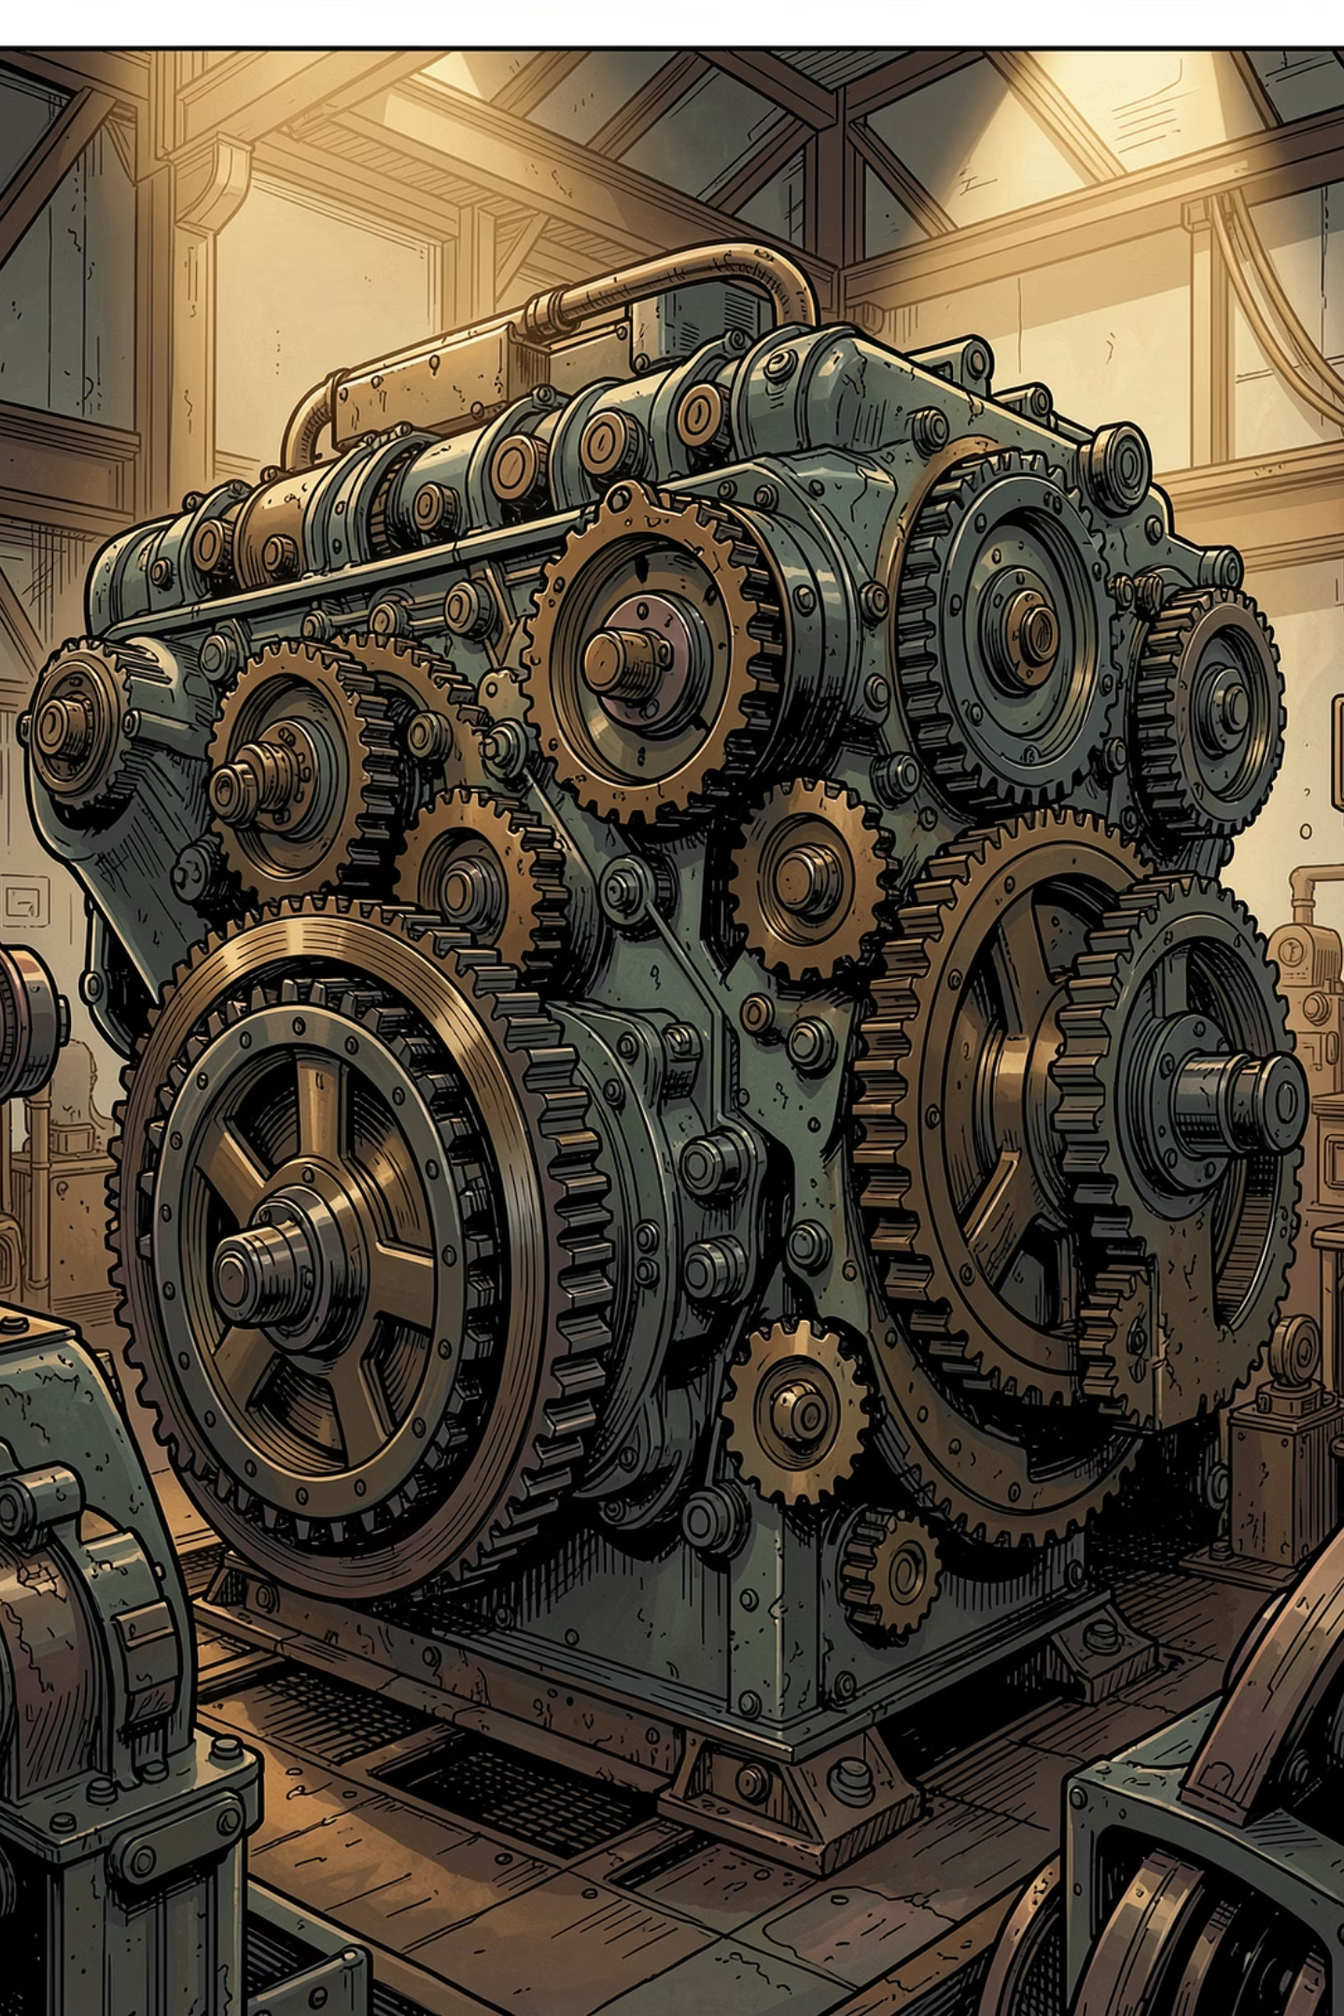
Full Fine-Tuning — The "Brute Force" Option
Full fine-tuning updates every weight in the model. It's the most powerful approach but demands significant compute and careful training discipline.
✅ Strength
Can yield the strongest performance when data and compute are sufficient
⚠️ Risk
Overfitting is a real concern — the model may memorize training data rather than generalize
🛠 Mitigation
Use early stopping, learning rate schedules, and validation sets to control training

Slide 7

PEFT — Tune Less, Learn More
Parameter-Efficient Fine-Tuning (PEFT) freezes the vast majority of the model's weights and updates only a small, targeted subset. The result: dramatic savings in compute and memory with surprisingly strong performance.
Less Compute
Less Memory
Transfer Learning
Fewer parameters to update
Smaller GPU footprint
Builds on pretrained knowledge

Slide 8
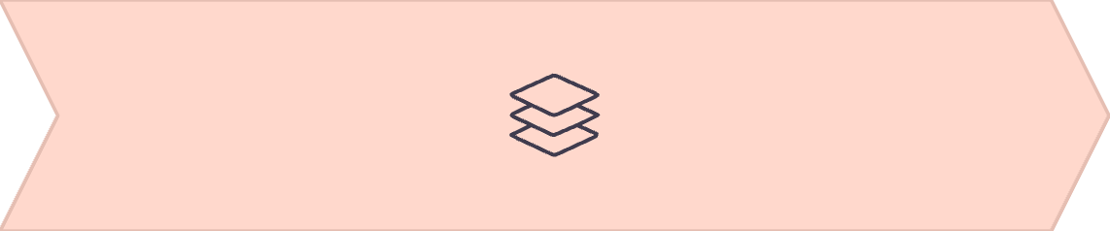
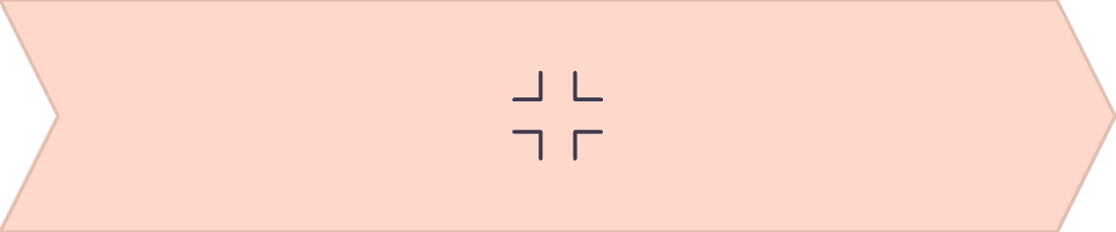
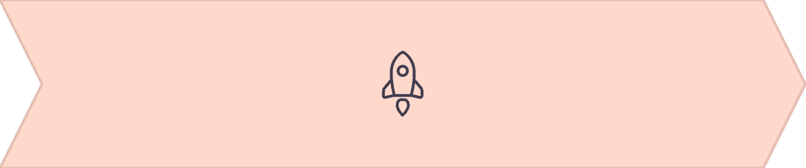
Common PEFT Methods: LoRA & QLoRA
LoRA
QLoRA
Result
Freezes pretrained weights and trains low-rank adapter matrices that capture the delta from the original weights. Lightweight and effective.
Combines quantization (4-bit precision) with LoRA, dramatically reducing memory usage while maintaining fine-tuning quality.
Both methods enable fine-tuning of large models on consumer-grade GPUs — democratizing access to customization.

Slide 9
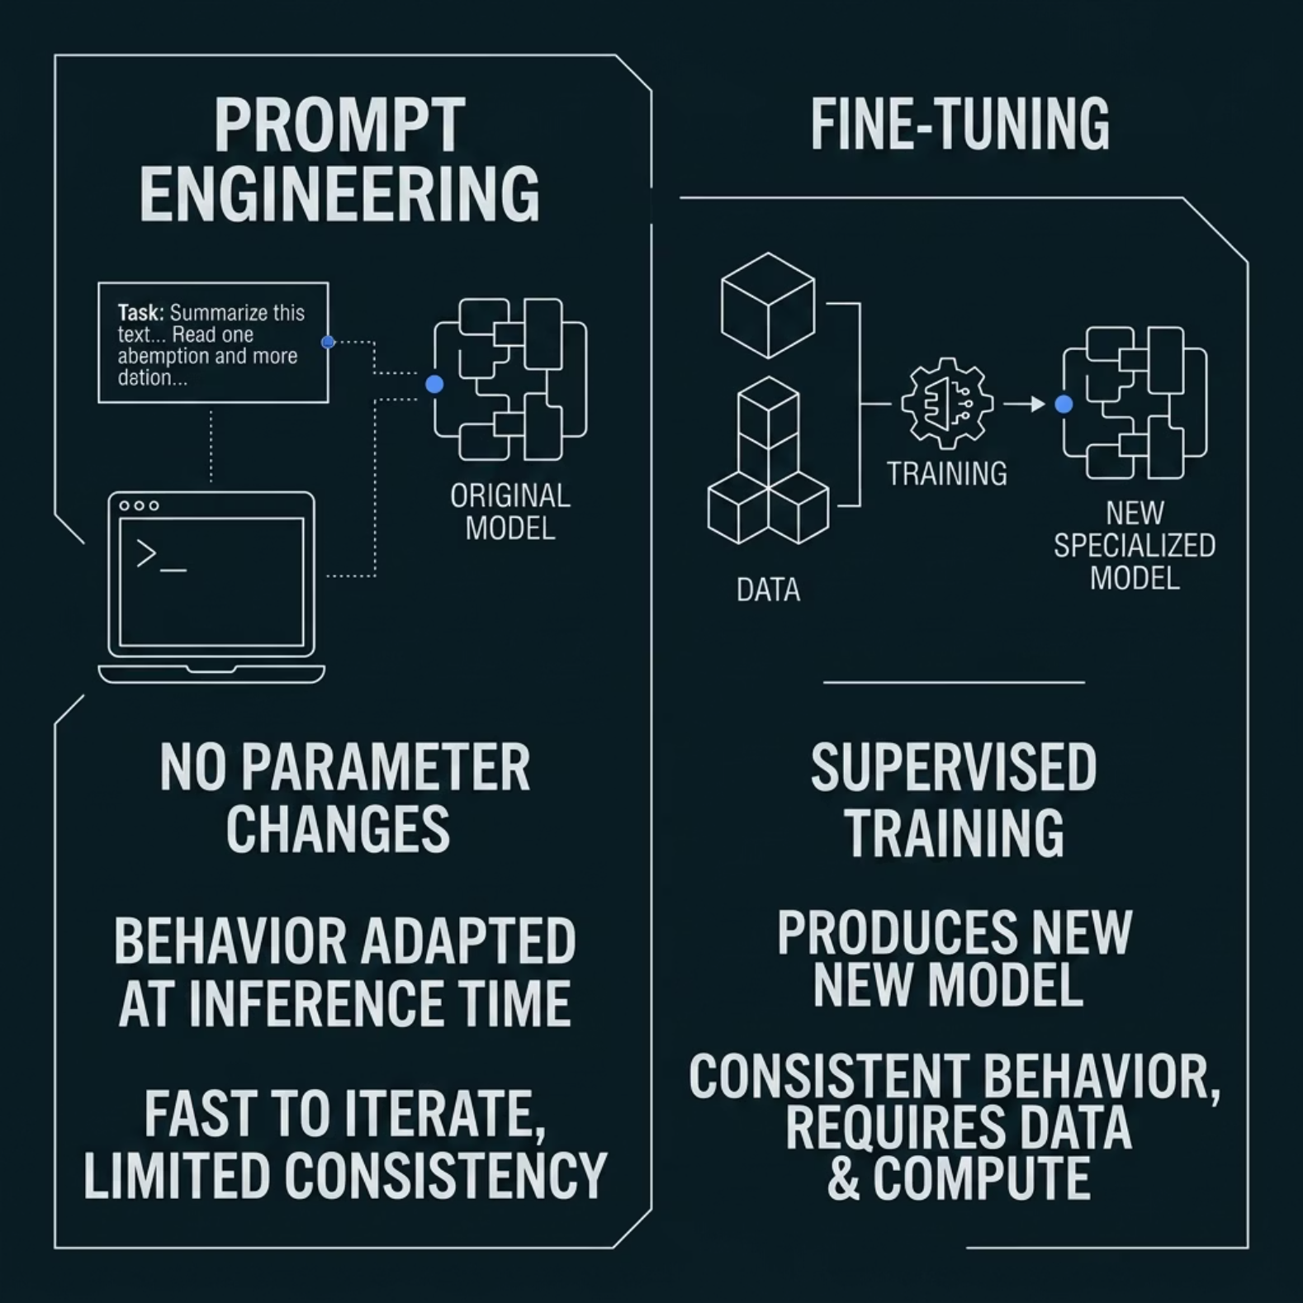

Prompting vs. Fine-Tuning
Both approaches adapt model behavior — but they operate at fundamentally different levels.
Prompt engineering guides behavior at inference time with no parameter changes. Fast to iterate, but limited in consistency.
Fine-tuning is supervised training that produces a new, specialized model with consistent, reliable behavior on your task.
Start with prompting. Move to fine-tuning when prompts alone can't deliver the consistency you need.

Slide 10
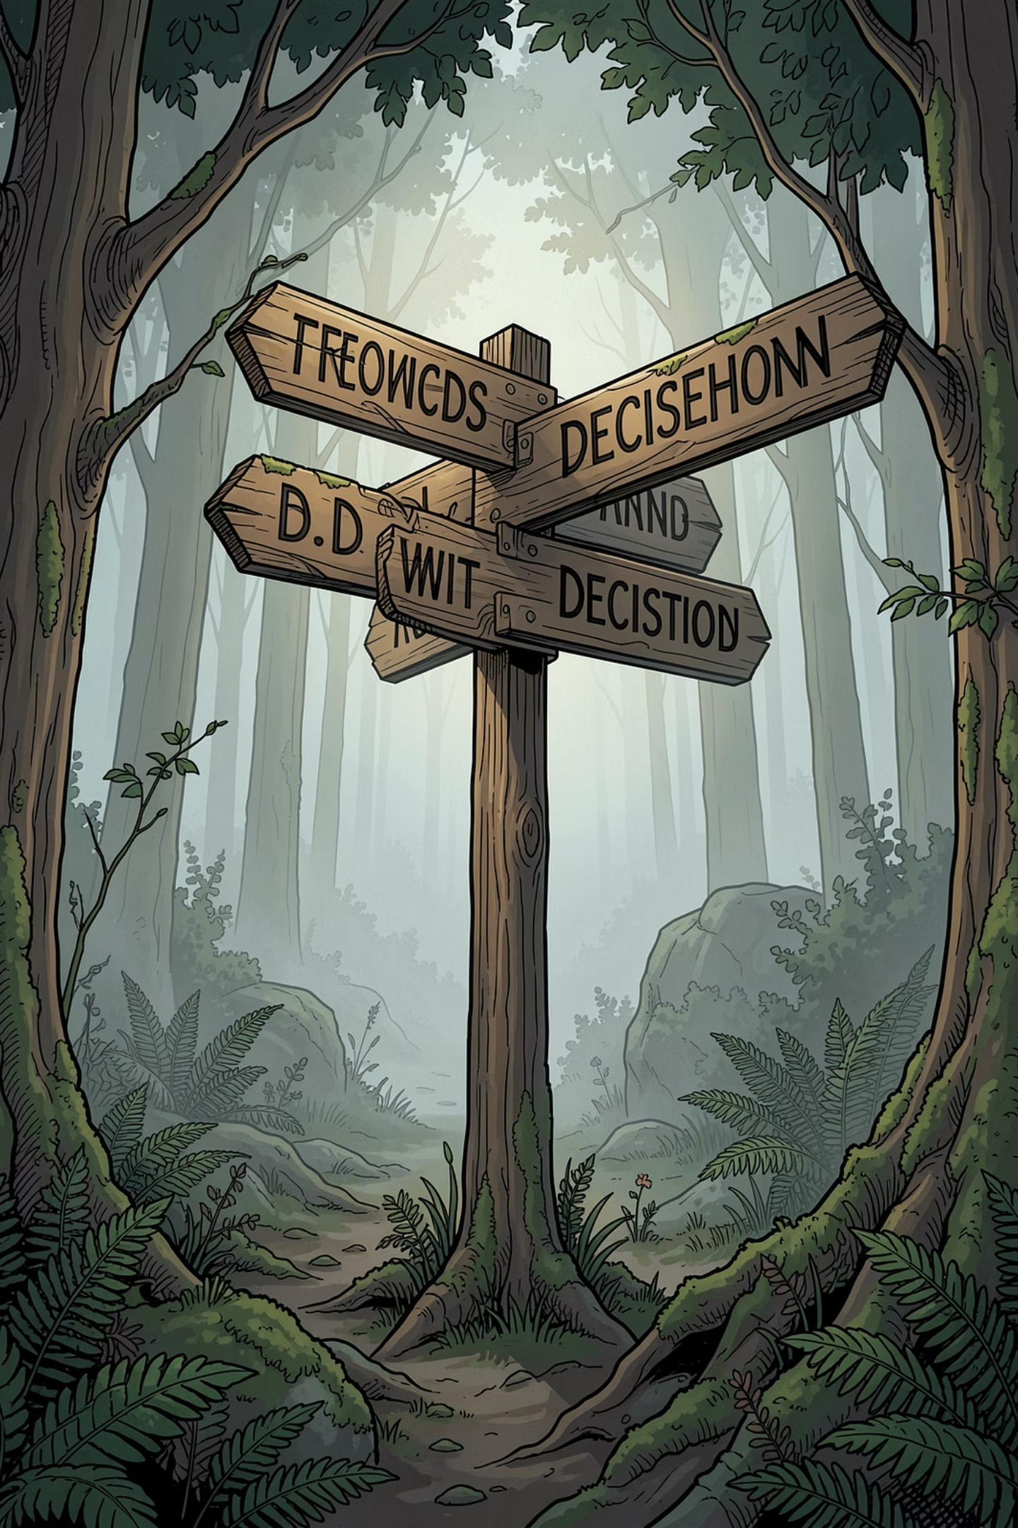
When to Fine-Tune — The Decision Moment
1
You need consistent, repeatable behavior
If prompt engineering gives inconsistent results on your specific task or instruction style, fine-tuning is the answer.
2
You have labeled training data
Fine-tuning requires quality examples. Without them, prompting or in-context learning may be your only option.
3
Compute is limited? Use PEFT
When GPU memory or budget is constrained, prefer LoRA or QLoRA over full fine-tuning for efficient specialization.

