Slide 1


Retrieval-Augmented Generation (RAG)
Turn your data into reliable, grounded answers — combining the power of large language models with your own knowledge base.
AI ARCHITECTURE
KNOWLEDGE SYSTEMS

Slide 2

The Problem: LLMs Can Answer… Without Knowing
Training Data Limits
LLMs generate from static training data — they can't access your private, proprietary, or up-to-date information.
Plausible but Ungrounded
Without real context, models produce confident responses that may be wrong, outdated, or entirely fabricated.
The Hallucination Risk
High-stakes domains like legal, medical, or enterprise require factual grounding that base LLMs can't guarantee.

Slide 3
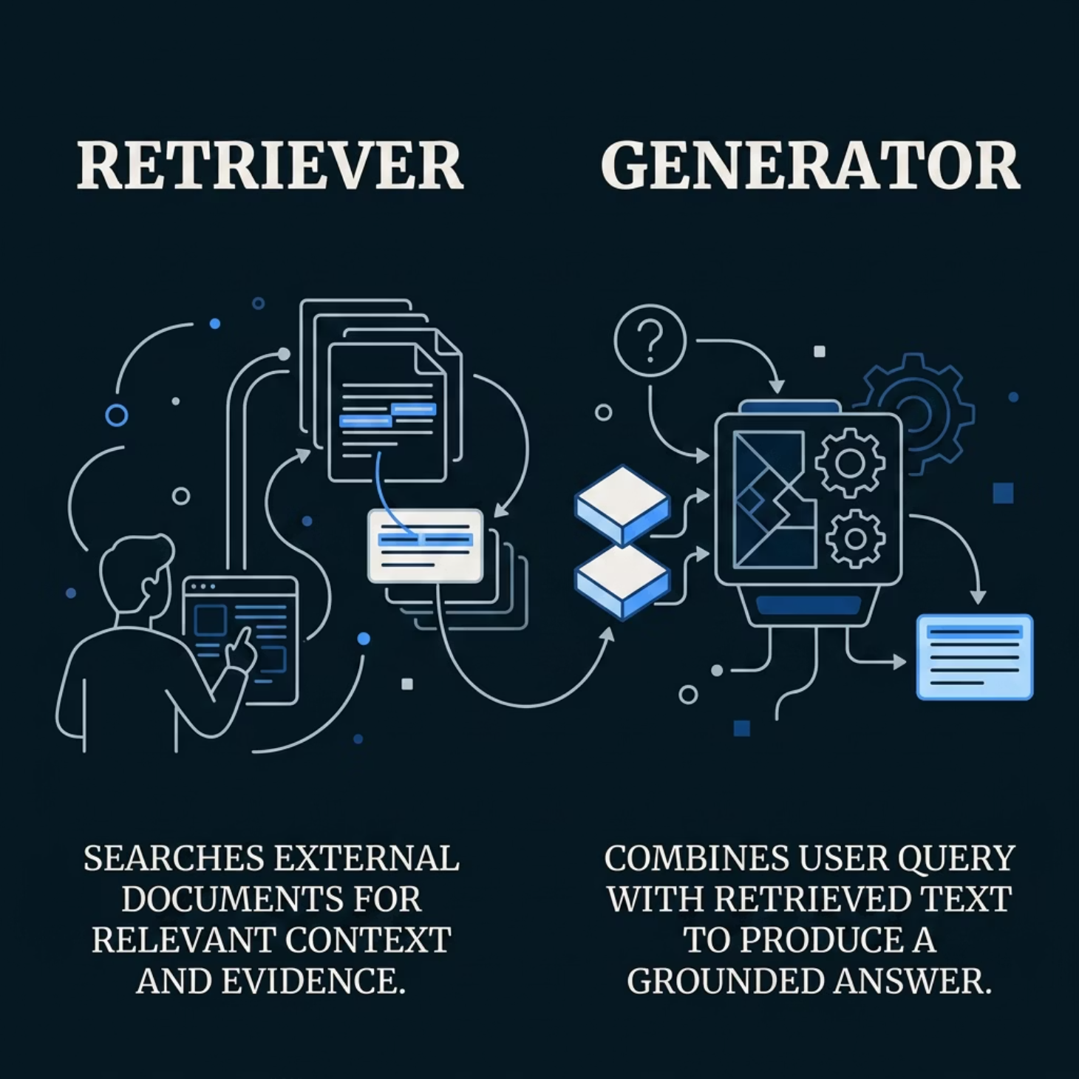


THE SOLUTION
Retrieval-Augmented Generation
RAG bridges the gap between a model's general knowledge and your specific data. A retriever fetches relevant documents, and a generator conditions its answer on that context.
Think of it as giving the LLM an open-book exam — it can look up the right source before answering.

Slide 4

How RAG Works: The Core Pipeline
Retriever Search
Context Assembly
Vector search finds relevant documents.
Combine retrieved context with the query.
User Query
Generator Output
User submits a clear question or prompt.
Produce a grounded, cited answer.
Every step is tunable — from how documents are chunked and embedded, to how the generator weights retrieved context. Pipeline quality depends on each stage working in concert.

Slide 5

Architecture Choices That Matter
Dense Retrieval
Sparse Retrieval
Uses vector embeddings for semantic similarity. Best for meaning-based queries across large corpora.
Keyword and BM25-based matching. Strong for exact-term lookups and structured data.
Hybrid Retrieval
Combines dense + sparse for best-of-both-worlds coverage. Often the production default.
Key principle: Retrieval quality directly controls answer accuracy — a strong generator can't fix bad context.

Slide 6


REAL-WORLD ADVANTAGE
Grounded, Trustworthy Outputs
RAG gives models real-time access to external data instead of relying solely on frozen training memory.
Factual Accuracy
Relevance
User Trust
Answers are anchored to retrieved sources, reducing hallucinations.
Responses reflect your specific domain, not generic training data.
Citable sources make outputs auditable and defensible.

Slide 7



Where RAG Gets Used
Enterprise Q&A
Legal Research
Smart Chatbots
Answer employee questions over internal docs, policies, and product knowledge bases with precision.
Ground responses in case law, statutes, and contracts — reducing risk and improving compliance.
Upgrade generic chatbots with domain-specific knowledge for customer support and sales.

Slide 8

Common Pitfalls — And How They Show Up
1
Chunking Issues
Too large or too small chunks cause retrieval misses, cutting off critical context mid-answer.
2
Weak Retriever Config
Poor embedding models or similarity thresholds return irrelevant docs — garbage in, garbage out.
3
Context Window Overflow
Retrieving too many documents can overwhelm the generator's context limit, degrading quality.

Slide 9



Building for Reliability: Tools & Infrastructure
Retrieval
Query embedding, search, and re-rank
Generation + Eval
Ingestion
LLM answers, grounding checks, feedback loop
Parse, chunk, and embed documents
A production-ready RAG system requires more than a model — it needs a full pipeline with evaluation at every stage.
Privacy & Cost
Evaluation
Design for data governance, PII handling, and token efficiency from day one.
Measure retrieval precision, answer faithfulness, and groundedness — not just fluency.

Slide 10

If the generator is the voice, retrieval is the memory — and memory is what you must design well.
01
02
Start Small
Iterate on Generation
Pick a focused corpus — a single doc set or knowledge base — and validate retrieval quality first.
Once retrieval is solid, tune prompts, temperature, and context window for your use case.
03
Evaluate & Scale
Add evaluation metrics, expand your corpus, and monitor grounding over time.

