Slide 1
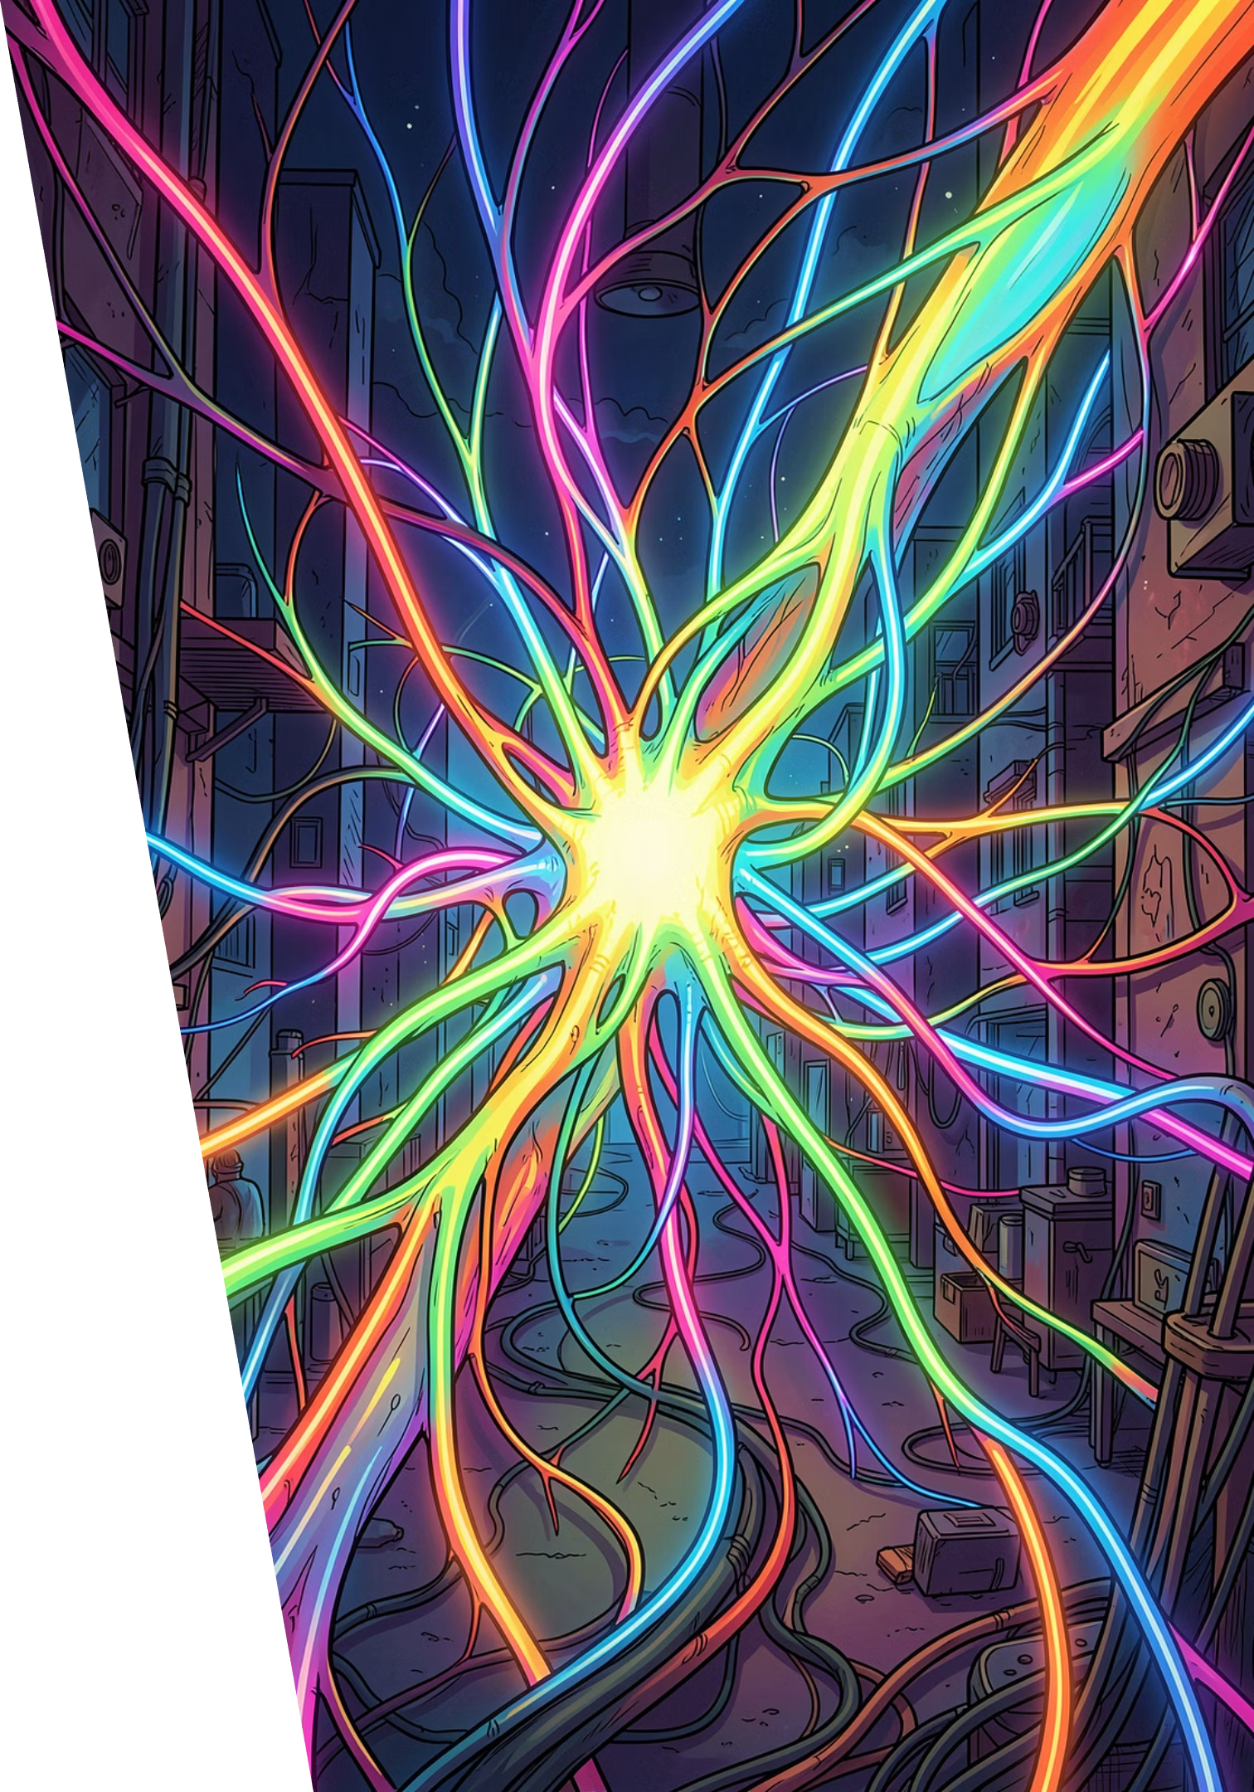

Text-to-Image Generation: Revolutionizing Presentations
How AI is transforming static slides into dynamic, visually compelling stories.

Slide 2

The Challenge: Static Slides in a Dynamic World
Time-Consuming Creation
Traditional presentations rely on stock images or manual design — a slow, often frustrating process.
Poor Visual Alignment
Mismatched visuals and text lead to weak communication and reduced audience engagement.
Tool Limitations
Existing automated tools fall short in formal contexts like business and academic research.

Slide 3
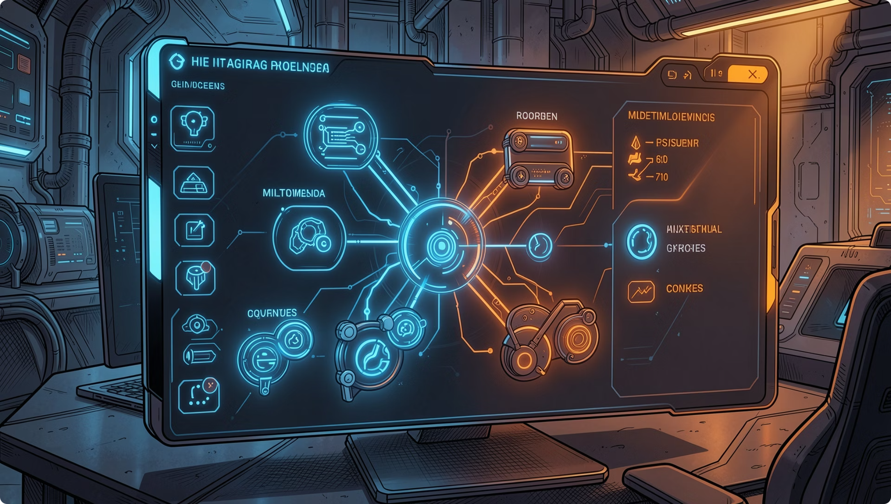
Introducing PreGenie: An Agentic Framework
2025 RESEARCH
What is PreGenie?
PreGenie leverages multimodal large language models (MLLMs) to generate high-quality visual presentations with accurate text summarization and image understanding.
Outperforms existing models in aesthetics and content consistency.
Stage 1
Stage 2
Analysis & Initial Generation
Review & Re-generation

Slide 4

AUTOPRESENT: Designing Structured Visuals from Scratch
CVPR 2025
AUTOPRESENT uses tool-augmented code generation to build complete slide decks from natural language instructions — with precise control over every element.
Code-Driven Design
Natural Language Input
Iterative Refinement
Generates structured layouts through executable code, ensuring pixel-perfect precision.
Users describe their vision in plain text; the system handles the rest.
Explores multi-pass design improvement for progressively higher slide quality.

Slide 5

AI-Powered Presentation Tools: A Growing Ecosystem
Alai Docs
API-first platform for generating presentations from text. Supports PDF/PPT export, custom themes, and slide count configuration. Poll-based result retrieval for async workflows.
Presenton
Open-source AI generator with a desktop app and API. Supports multiple AI model providers and offers self-hosted deployment for full data privacy.

Slide 6
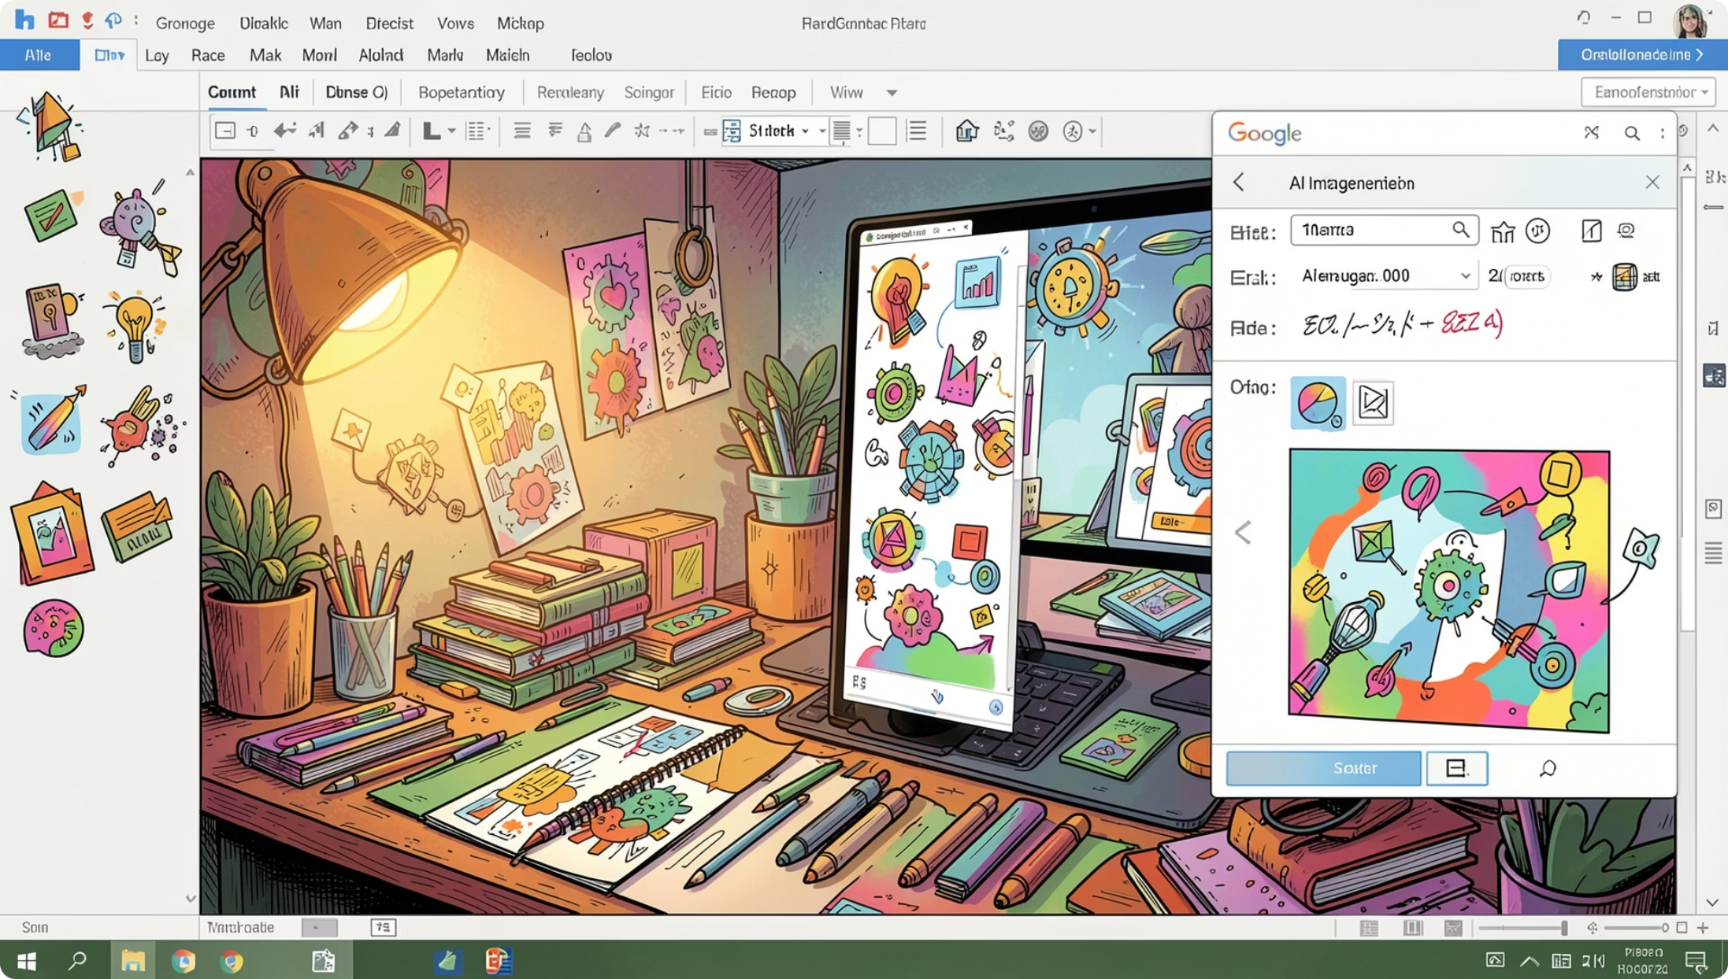

Visualizing Ideas: Google Workspace AI
Gemini in Google Slides
Google's Gemini integration brings text-to-image generation directly inside Slides. The "Help me create an image" feature lets users generate custom visuals from prompts — no design skills required.
Generate images from text prompts in seconds
Tailor visuals to specific presentation needs
Avoid copyright issues with AI-generated originals

Slide 7








The Impact: Enhancing Communication and Creativity
Save Time & Effort
Boost Creativity
Automates image sourcing and creation, freeing creators to focus on content.
Enables exploration of diverse visual styles and concepts at scale.
Improve Relevance
Ensure Originality
Generates images precisely matching the surrounding content and context.
Creates unique visuals, eliminating copyright and licensing concerns.

Slide 8
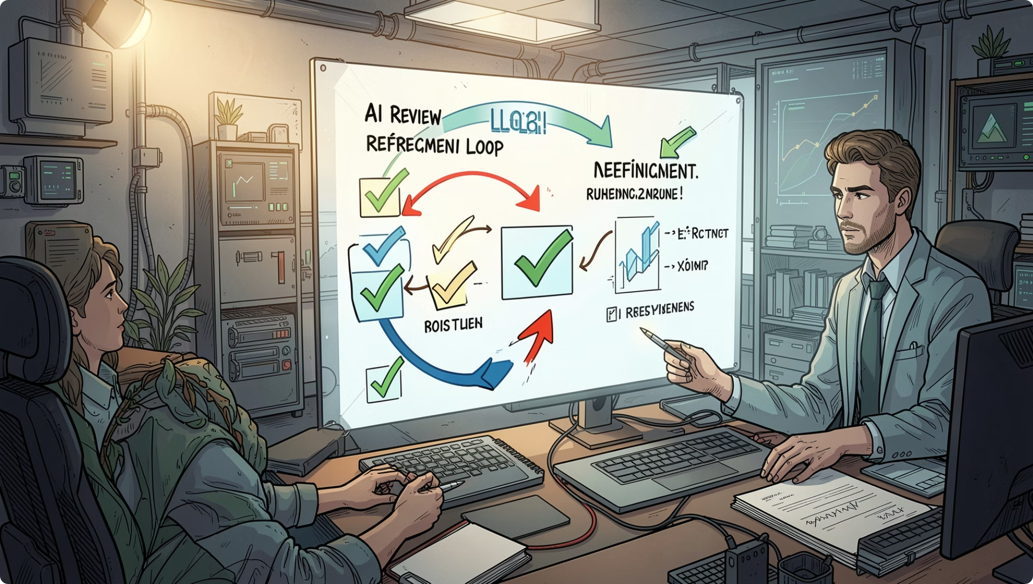
Beyond Basic Generation: Iterative Refinement
ARXIV 2025
Textual-to-Visual Iterative Self-Verification
This framework decomposes slide generation into content and layout, then applies a LLM-based Reviewer + Refiner workflow — mimicking human editorial judgment.
Alignment
Logical Flow
Visual Appeal
Text and visuals stay semantically consistent.
Slide sequences follow coherent narrative structure.
Design quality improves across refinement passes.

Slide 9
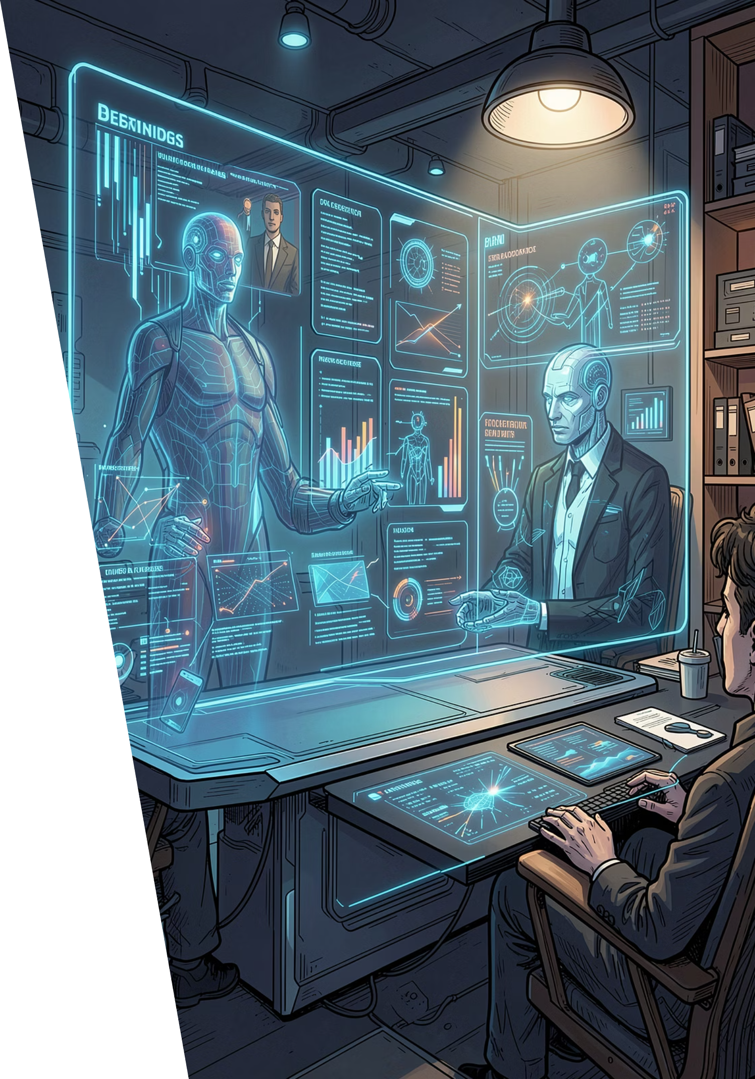
The Future of Presentations: Intelligent and Interactive
1
Now
Text-to-image generation and AI-assisted layout tools are entering mainstream workflows.
2
Near Future
Seamless integration of content summarization, dynamic layouts, and multi-modal generation.
3
Long Term
Fully personalized, adaptive presentations that respond to audience context in real time.

Slide 10
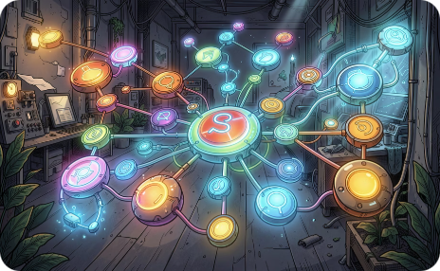
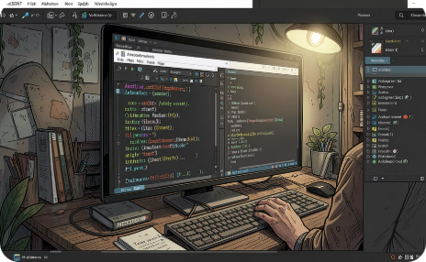
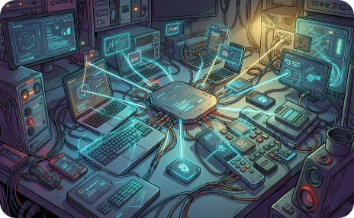
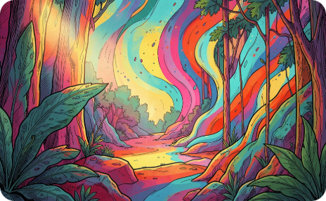
Embrace the AI Revolution in Presentations
The tools are here. The frameworks are proven. The only question is: will you lead or follow?
PreGenie
AUTOPRESENT
Alai & Presenton
Google Gemini
Agentic MLLM framework for iterative, high-quality slide generation.
Code-driven, natural-language slide design from CVPR 2025.
API-first and open-source platforms for flexible, privacy-conscious generation.
Built-in AI image generation inside Google Slides for everyday creators.

