Slide 1
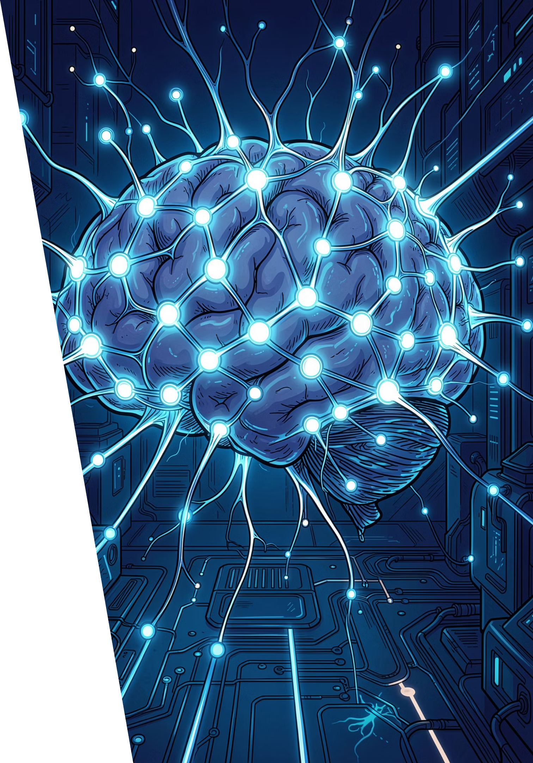

AI Agents: The Future of Work and Innovation
Autonomous intelligence is reshaping how we work, build, and innovate. Welcome to the agentic era.

Slide 2
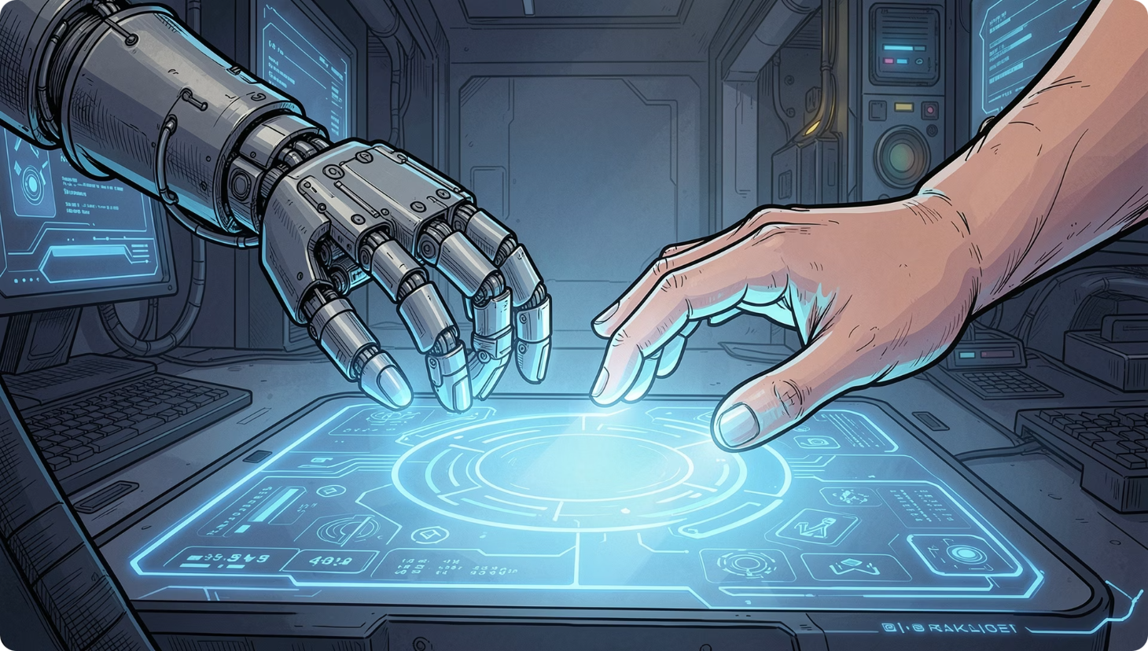
DEFINITION
What is an AI Agent?
An AI agent is an autonomous entity that perceives its environment, makes decisions, and takes actions to achieve specific goals.
Unlike static AI models that simply respond to prompts, agents are adaptive, goal-oriented, and capable of interacting with dynamic environments — learning, planning, and acting on their own.

Slide 3



EVOLUTION
From Simple Assistants to Agentic AI
AI has evolved from rule-based tools to fully autonomous systems with growing business impact.
Generative AI Assistants
Generative AI Agents
Agentic AI Systems
Follow rules, automate repetitive tasks, achieve singular goals
Address broader tasks, automate entire workflows, mimic human logic
Fully autonomous, multi-agent systems with increasing business impact
Source: AWS

Slide 4










ARCHITECTURE
Key Components of an AI Agent
Foundation Models
Orchestrator
Tools
Core intelligence driving reasoning and decision-making
Manages task flow and coordination between components
External APIs, databases, and code to extend capabilities
Knowledge & Memory
Autonomy
Access to information and ability to retain context
Triggers, planning, exception handling, and self-learning

Slide 5
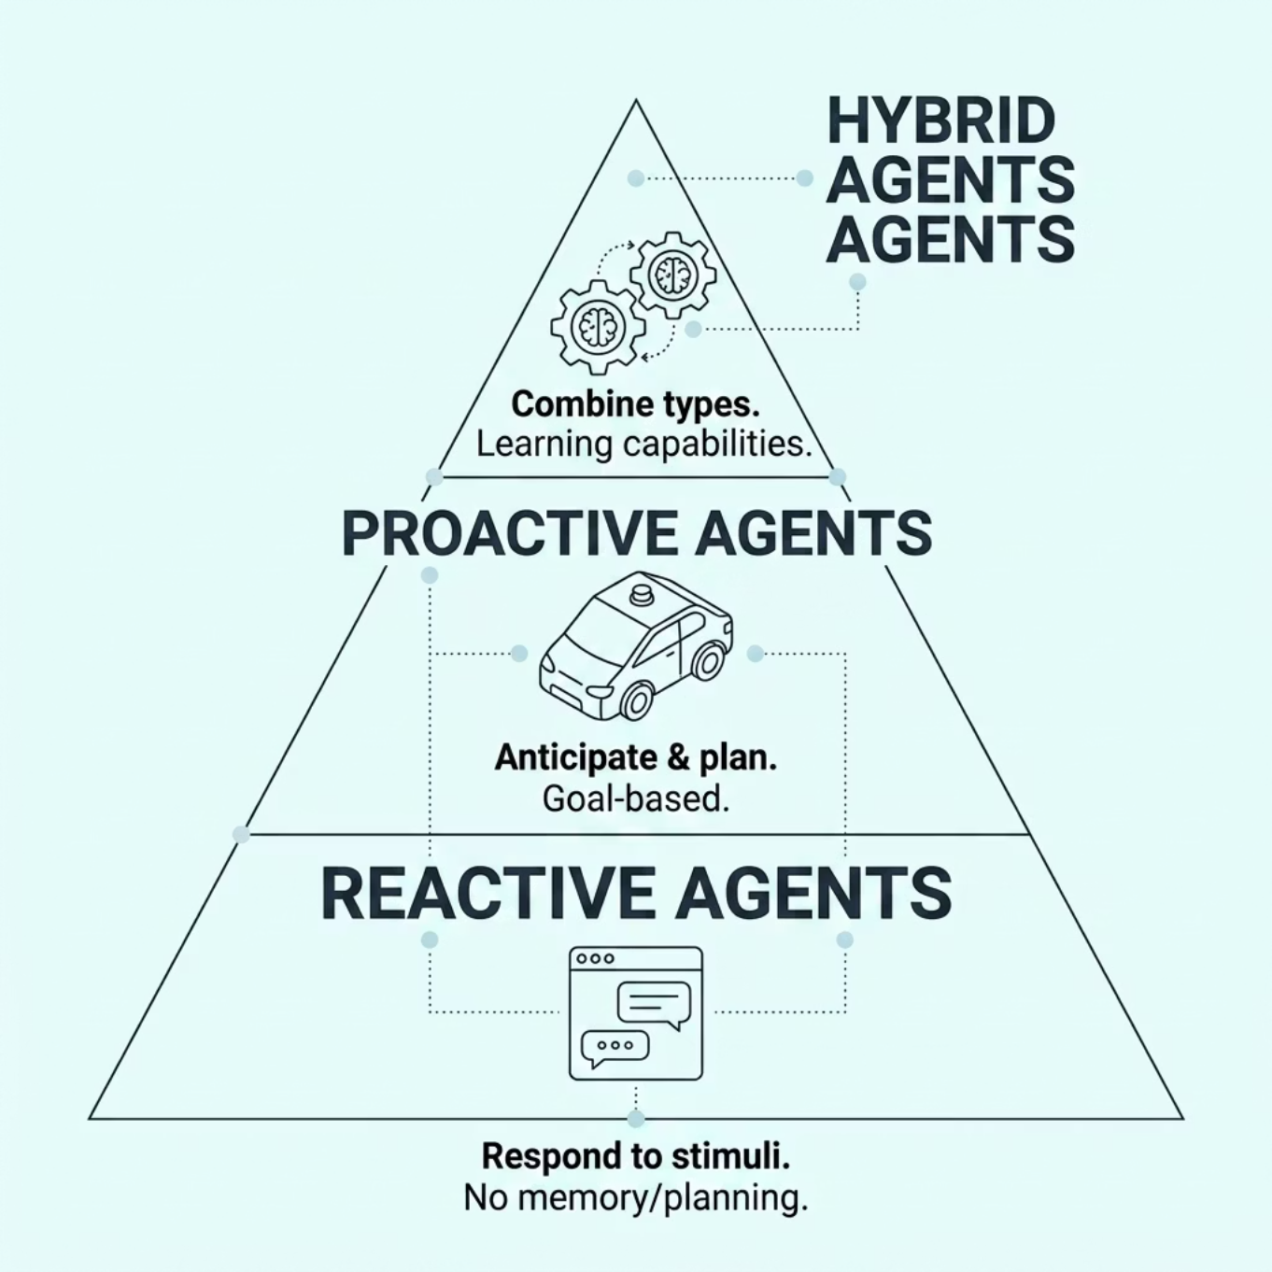

TAXONOMY
Types of AI Agents
AI agents span a spectrum of complexity — from simple stimulus-response systems to sophisticated hybrid agents that learn and plan ahead.
Reactive
Proactive
Hybrid
Instant response, no memory
Goal-driven, predictive
Adaptive, learning-enabled

Slide 6

2025 AND BEYOND
The "Year of Agents"
2025 is being called the "Year of Agents" — a tipping point for agentic AI adoption across industries. (Source: UC Berkeley)
33%
Enterprise Apps by 2028
Gartner predicts one-third of enterprise software will include Agentic AI
Source: AWS

Slide 7




APPLICATIONS
Real-World Applications Across Industries
Customer Service
Software Engineering
Finance
Healthcare
Intelligent contact centers and automated client onboarding at scale
Code generation and AI-powered development — GitHub Copilot, Devin
Investment research assistants and real-time fraud detection
Clinical workflow automation and personalized patient engagement

Slide 8
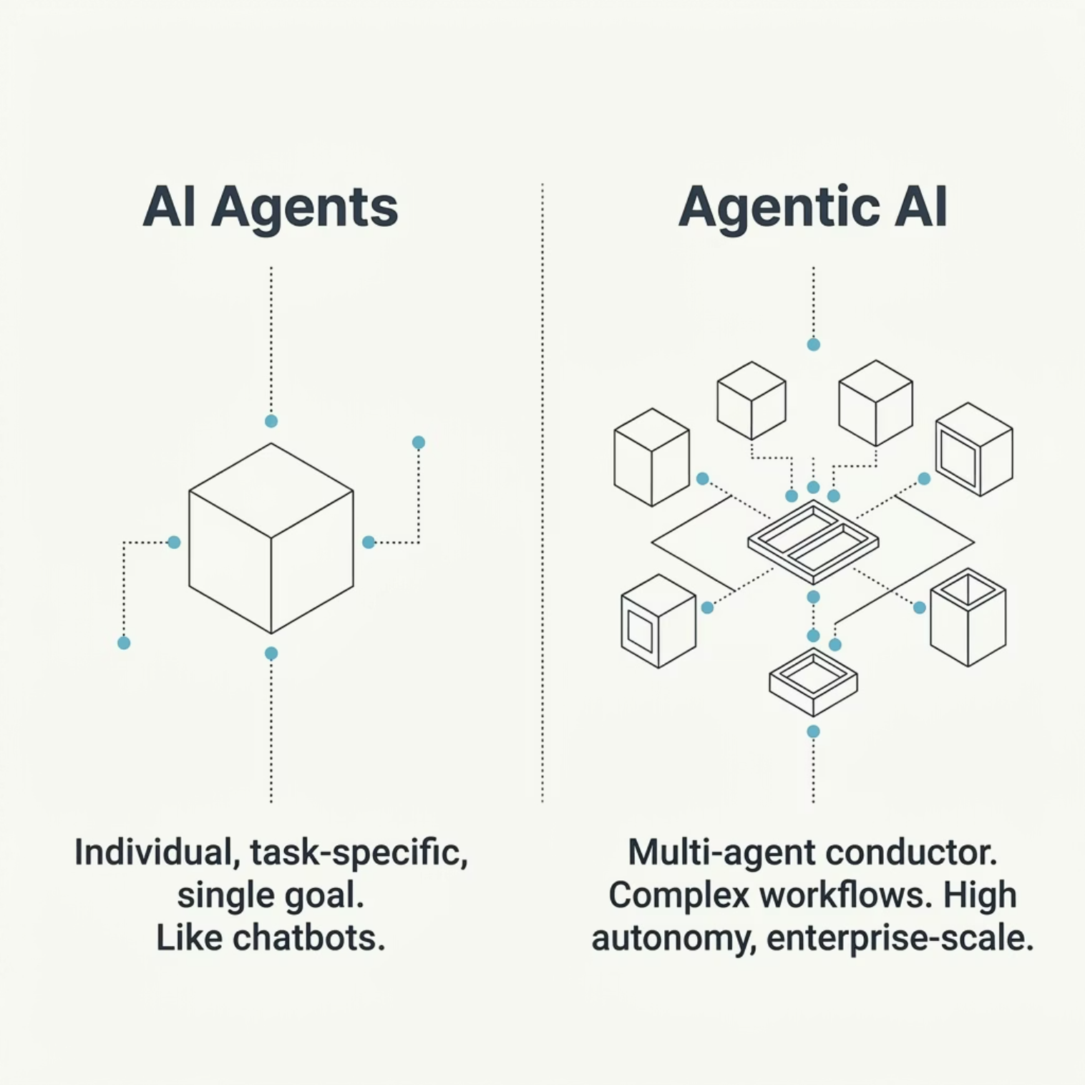

DISTINCTION
AI Agents vs. Agentic AI
AI Agents
Agentic AI
Individual entities designed for specific tasks — like a chatbot handling customer queries. Focused and task-bound.
A "conductor" that integrates multiple agents to orchestrate complex, multi-step processes — offering higher autonomy and scalability.

Slide 9
PATTERNS
Building Effective Agents: Key Patterns
1
2
3
Orchestrator-Workers
Evaluator-Optimizer
Parallelization & Routing
A central orchestrator delegates tasks to specialized worker agents — ideal for complex, multi-step workflows.
Agents that self-reflect and refine their own outputs, continuously improving quality through feedback loops.
Efficiently distributes tasks across agents and routes them to the right specialist for maximum throughput.

Slide 10

The Future is Agentic
AI agents are not just a technological shift — they are a fundamental transformation in how work gets done, how problems are solved, and how organizations innovate.
🤝 Personal Assistants
🏢 Enterprise Solutions
Smarter, context-aware companions for everyday tasks
End-to-end automation across entire business operations
🚀 New Innovation
Unprecedented levels of automation and productivity

