Slide 1
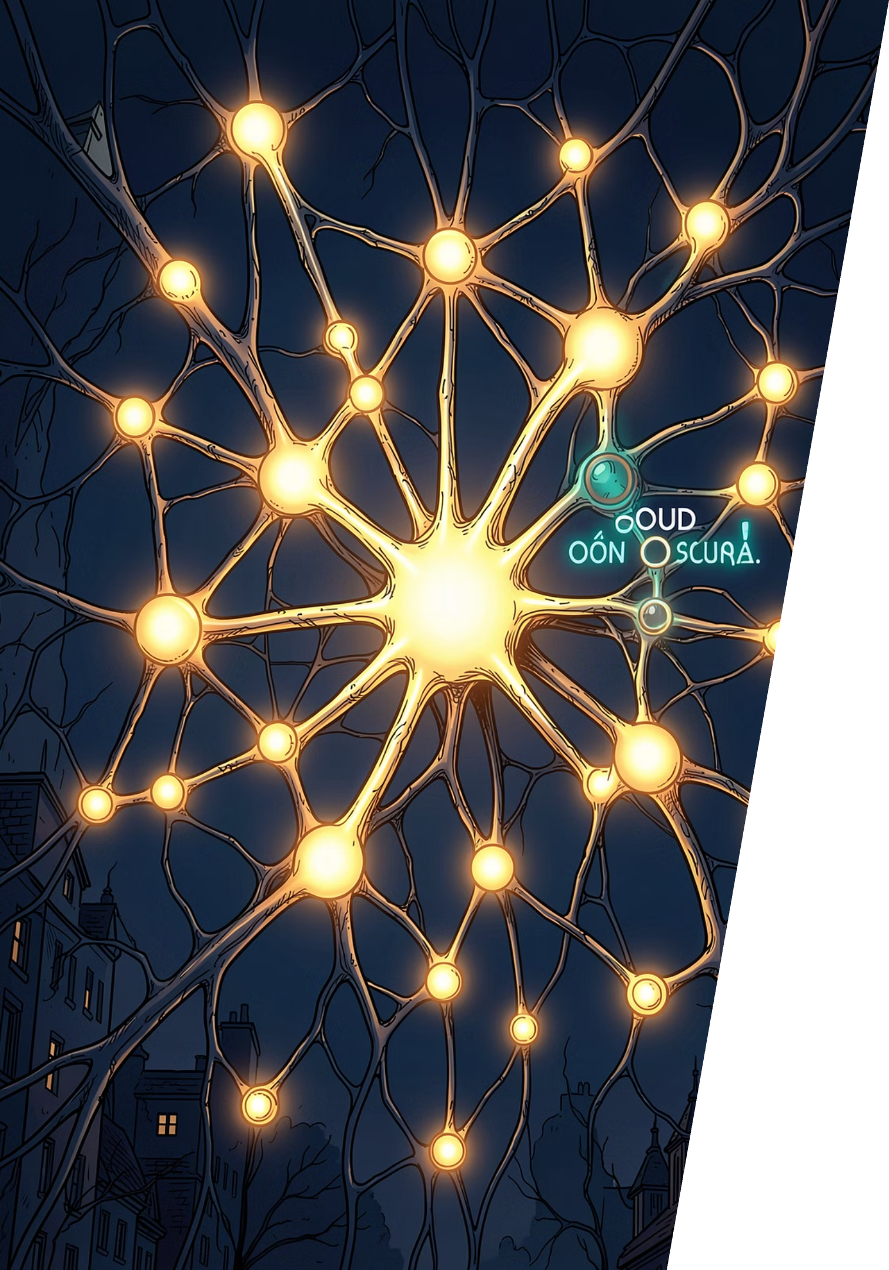

The Dawn of Multimodal AI
Seeing, Hearing, and Understanding
AI is evolving beyond text — learning to perceive the world the way humans do.

Slide 2
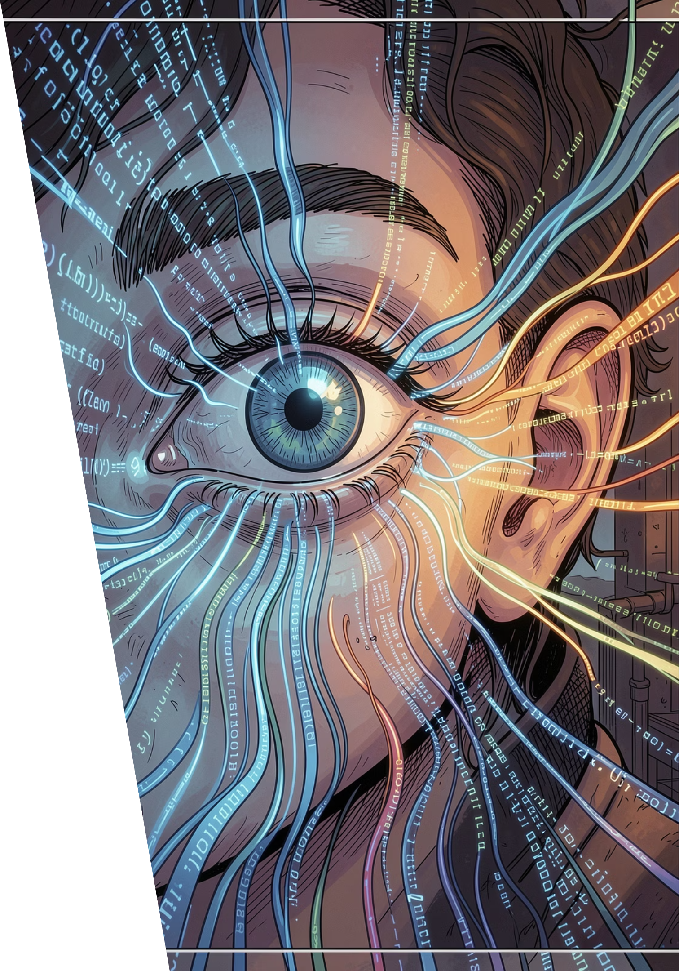
Beyond Text: The Multimodal Revolution
The Limitation
The Breakthrough
Text-only AI misses the richness of images, audio, and video — the primary ways humans communicate.
Multimodal AI combines text, images, audio, and video into a unified understanding.
The Promise
More human-like interaction — AI that sees, hears, and truly comprehends context.

Slide 3
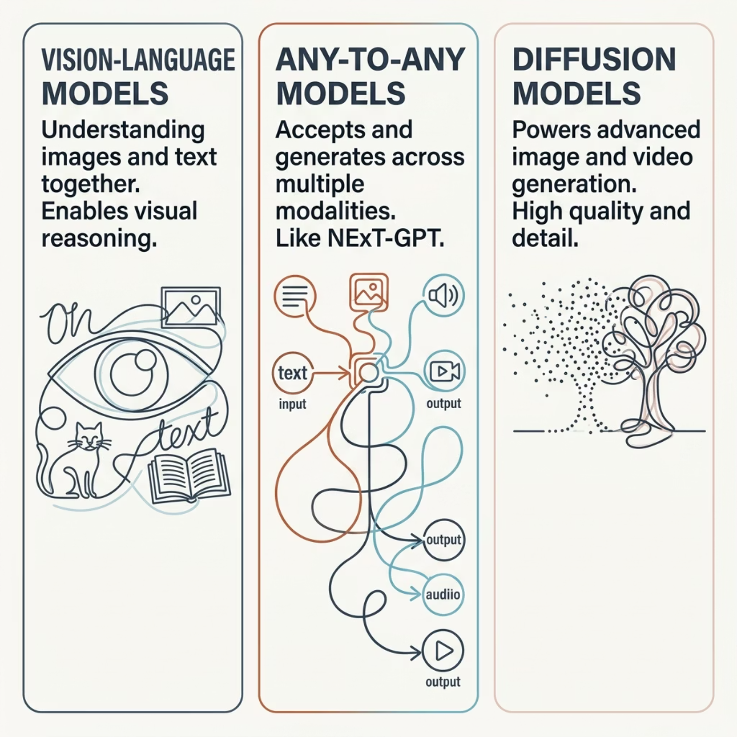

Key Technologies Driving Multimodality
Three breakthrough technologies are converging to make multimodal AI a reality. Each addresses a different layer of the challenge — from understanding visual content, to flexible cross-modal generation, to producing high-quality media outputs.
Vision-Language Models (VLMs) bridge the gap between pixels and meaning
Any-to-Any Models like NExT-GPT enable seamless cross-modal generation
Diffusion Models power photorealistic image and video synthesis

Slide 4
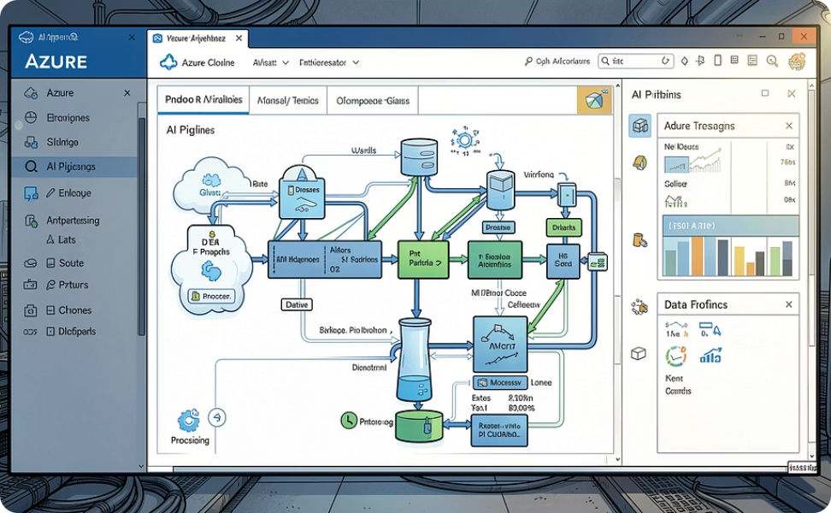
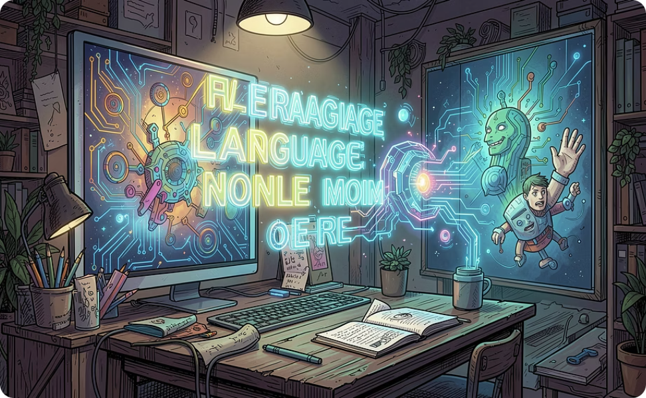
USE CASE 1
Intelligent Content Analysis & Generation
Azure Multimodal AI + LLM Processing Accelerator
GILL — Generating Images with LLMs
Fuses large language models with image generation and retrieval, enabling AI to create and reference visuals contextually within a conversation.
Build production-grade pipelines for summarization, classification, and enrichment — turning raw multimodal data into structured, actionable insight at scale.

Slide 5
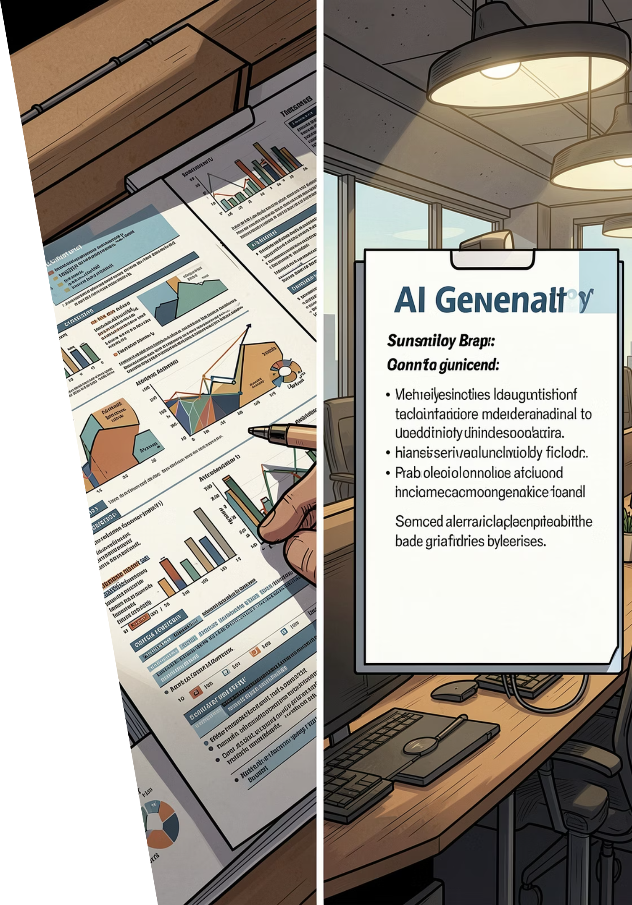
From Data Overload to Insight
Multimodal AI cuts through complexity — extracting meaning from documents, images, and mixed media in seconds.

Slide 6
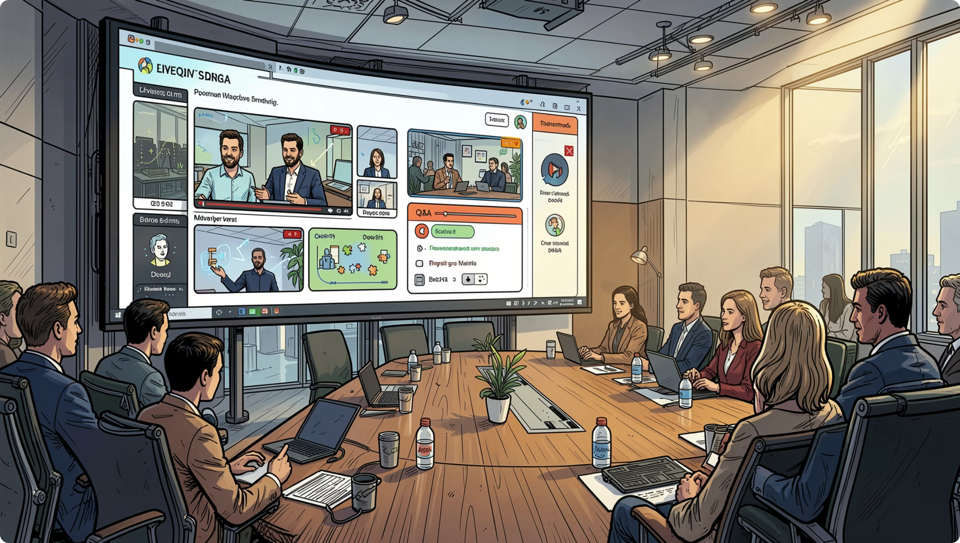
USE CASE 2
Interactive Presentations & Communication
PresentAgent-2
Generates full presentation videos from natural language queries — incorporating research, multimodal media, and interactive Q&A in one seamless workflow.
Multimodal Router
Intelligently routes each request to the best model (VLM or LLM) — optimizing for quality, latency, and cost automatically.

Slide 7
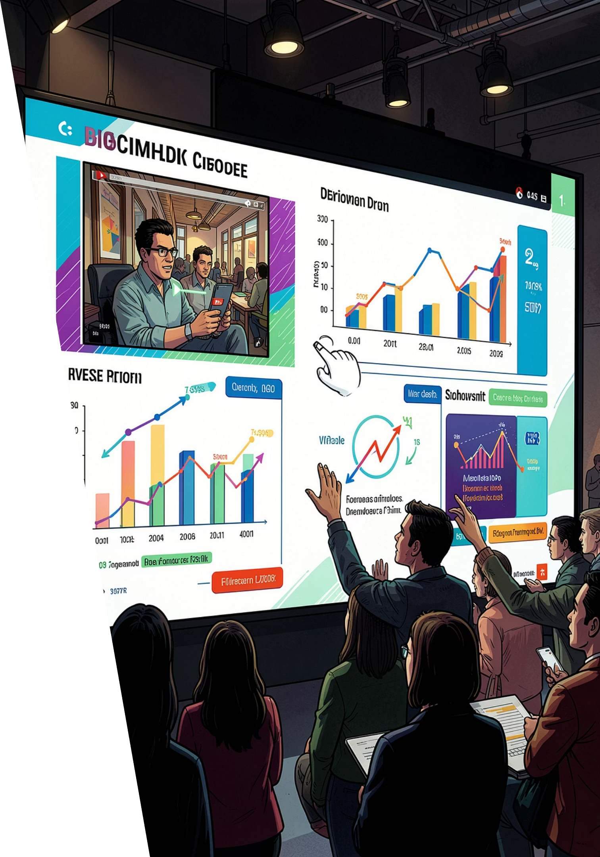
Engage, Inform, Interact
The next generation of communication is multimodal — dynamic, responsive, and deeply personalized.

Slide 8






THE FUTURE IS NOW
Seamless Integration
Transfusion
LlamaIndex
Unified Workflows
A single unified model generating state-of-the-art text and images, handling interleaved multimodal data natively — no separate pipelines needed.
A framework for building LLM-powered agents over your own data, enabling rich multimodal workflows with retrieval, reasoning, and generation.
Together, these tools enable end-to-end multimodal pipelines — from ingestion to insight to output — with minimal friction.

Slide 9
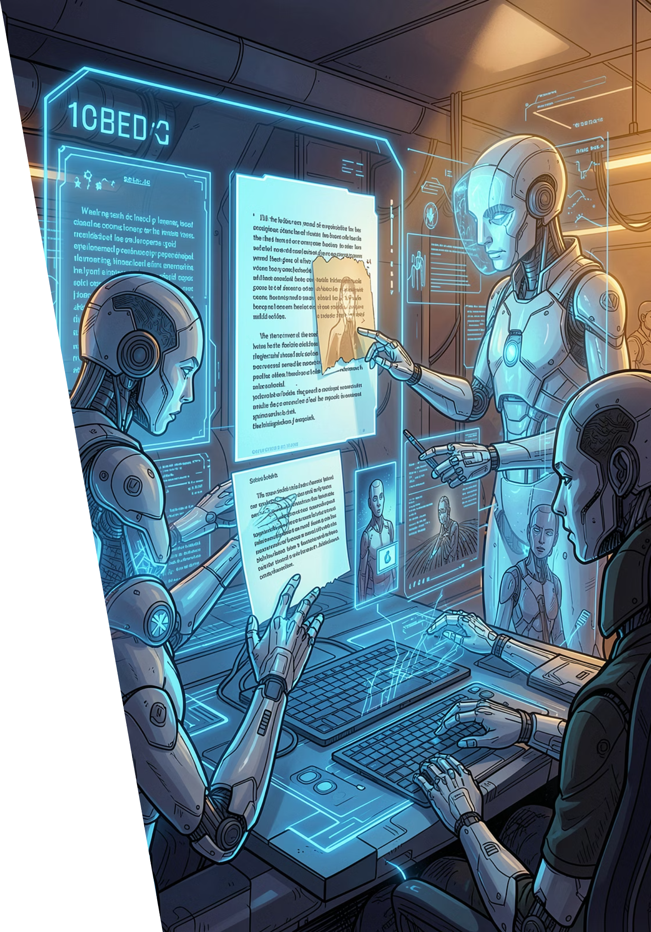
AI That Understands Your World
When AI perceives text, images, and video together, it stops being a tool — and starts being a partner.

Slide 10


Embracing the Multimodal Future
Transforming Interaction
Multimodal AI is reshaping how we communicate with technology — more naturally, more intuitively, and with far greater depth.
Accelerating Progress
The journey from text-only to truly perceptive AI is not a distant vision — it is happening now, at remarkable speed.
Your Opportunity
The question is no longer if multimodal AI will change your field — it's what you will build with it.

