Slide 1


From RAG to Agentic AI
Empowering Enterprise Intelligence
How retrieval-augmented generation evolves into autonomous, decision-making AI systems — and why it matters for your enterprise.

Slide 2

The Challenge: Static Knowledge in a Dynamic World
Frozen at Training Date
LLMs have knowledge cutoffs — they cannot access information published after their training ended.
Hallucinations
Without grounding in real data, LLMs confidently generate incorrect or fabricated answers.
Enterprise Reality
Organizations need AI that reasons over current, private, and proprietary data — not just public training corpora.

Slide 3
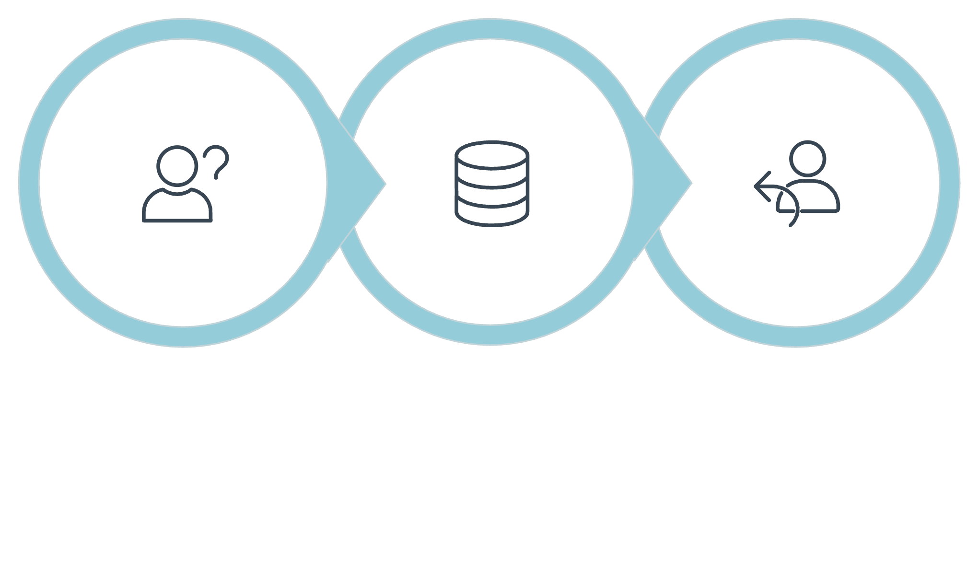

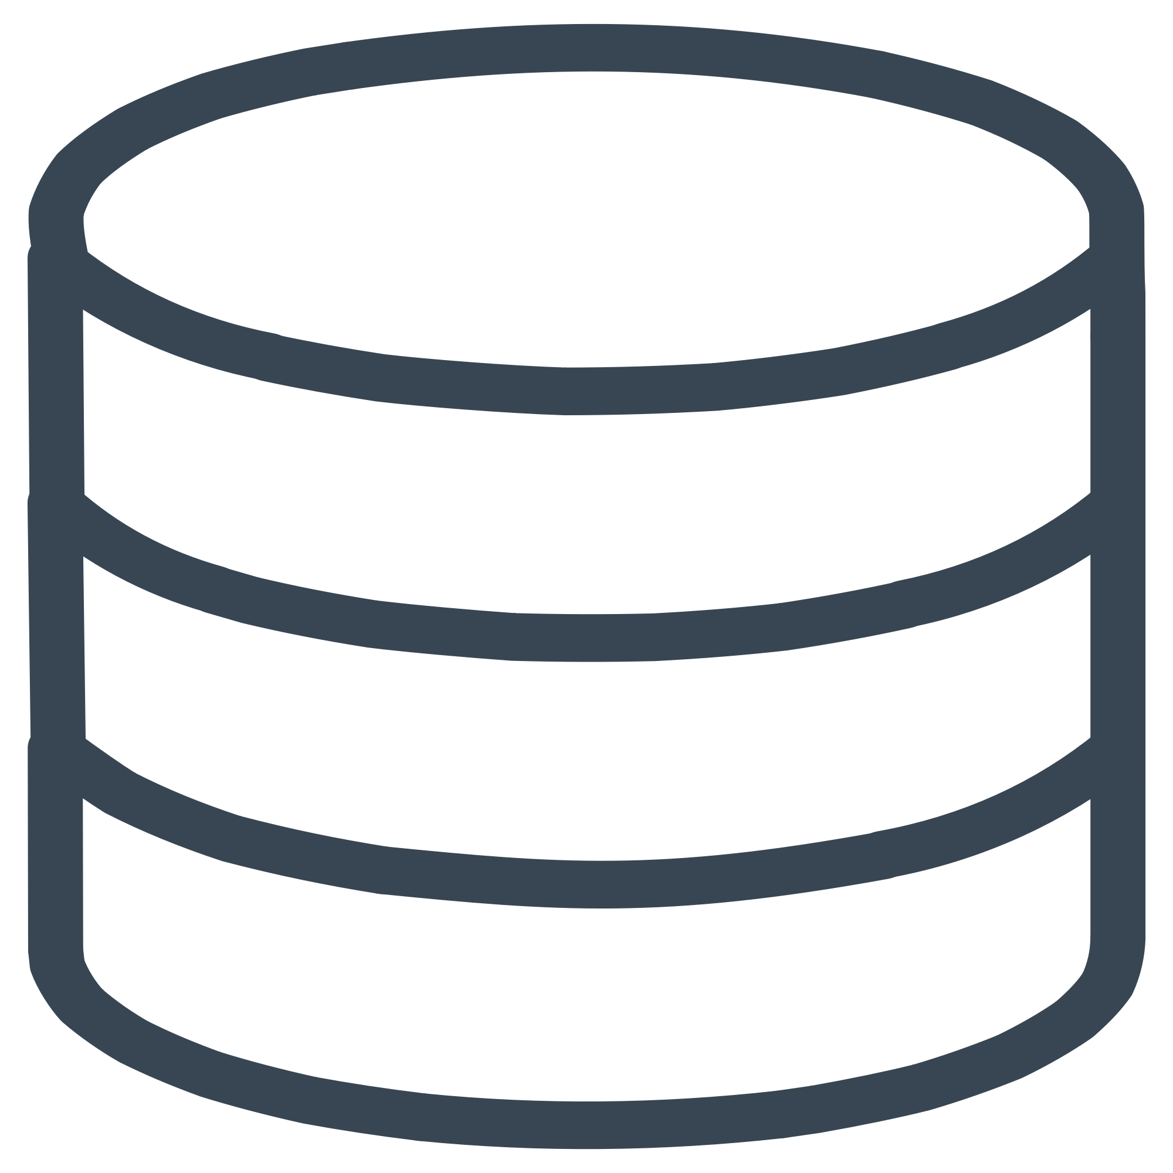

Enter RAG: Bridging the Knowledge Gap
Retrieval-Augmented Generation (RAG) connects LLMs to external knowledge sources in real-time — grounding responses in factual, up-to-date information.
Contextual Answer
User Query
Retrieve Docs
This pipeline ensures every answer is grounded in the most relevant, current information available — dramatically reducing hallucinations and improving factual accuracy.

Slide 4
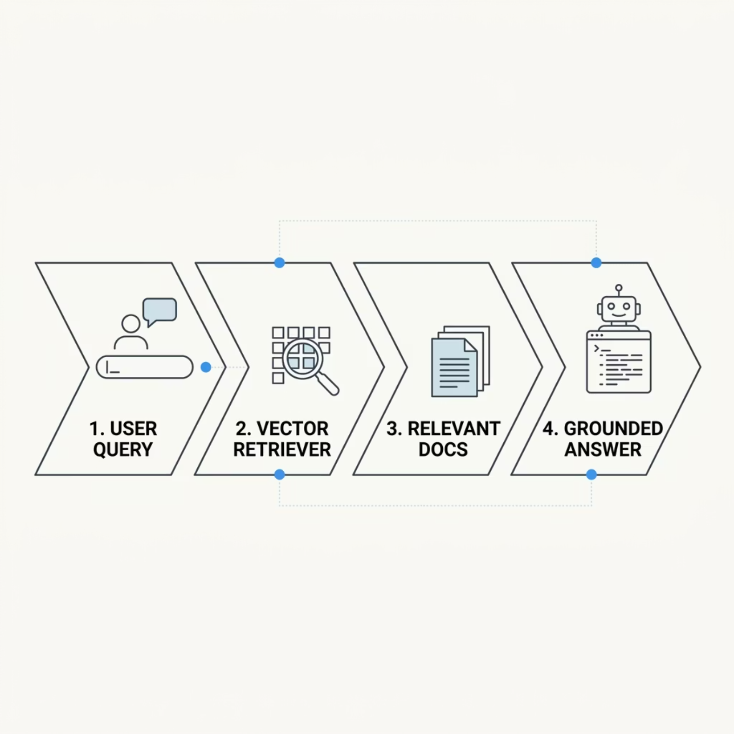


Basic RAG: Search, Then Generate
Why It Works
RAG injects live, relevant context into the LLM's generation window — so the model answers based on your data, not just its training memory.
RAG is the foundational pattern for enterprise AI — but it's only the beginning.

Slide 5
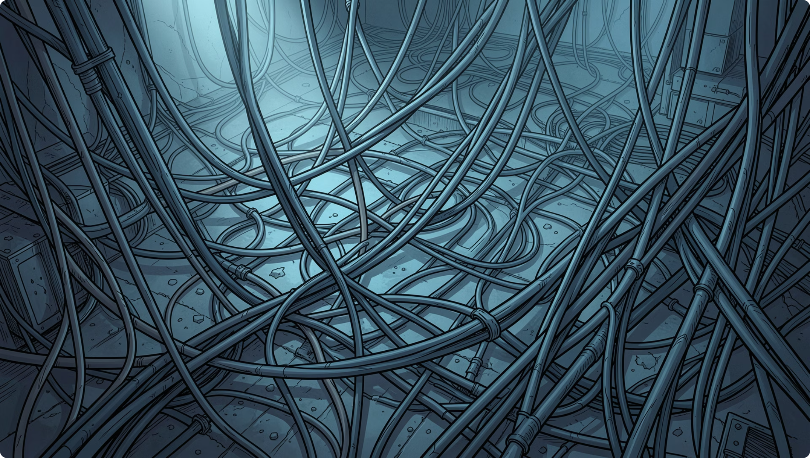

The Limitations of "Naive" RAG
Where Simple RAG Falls Short
Complex, multi-part questions — single retrieval passes can't handle layered reasoning.
Cross-document synthesis — summarizing or comparing across sources requires more than one lookup.
Structured data analysis — databases and spreadsheets need specialized tool access.
Relevance judgment — deciding which information matters and how to use it.

Slide 6
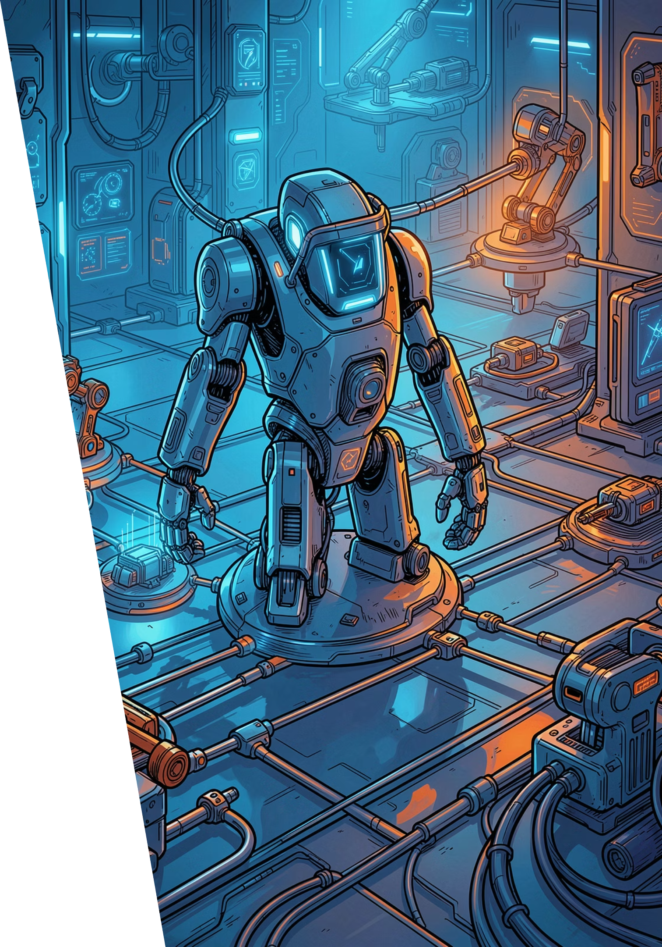

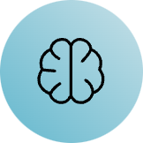




Agentic RAG: The Next Evolution
Agentic behavior empowers LLMs to plan, decide, and act — not just retrieve and respond.
Tool Integration
Reasoning
Agents call external tools — search engines, databases, APIs — dynamically as needed.
Agents break down complex problems, plan steps, and select the right tool for each sub-task.
Workflow Orchestration
Agents chain multiple actions together to achieve multi-step goals autonomously.

Slide 7
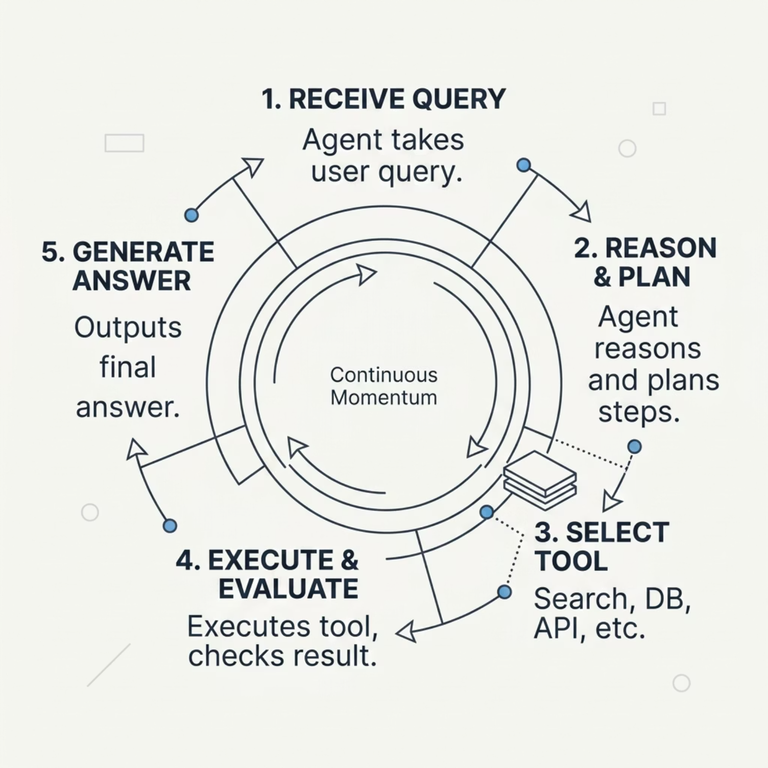

Agentic RAG: Reason, Decide, Act, Generate
A Smarter Loop
Unlike basic RAG's single retrieval pass, agentic systems iterate, evaluate, and adapt — mirroring how a human expert would tackle a complex problem.
Result: More reliable, scalable, and intelligent AI systems that handle real enterprise complexity.

Slide 8
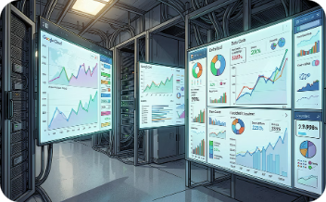
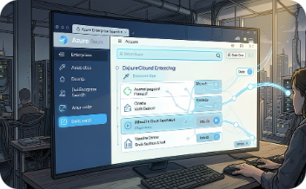
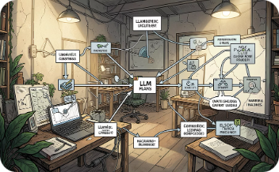
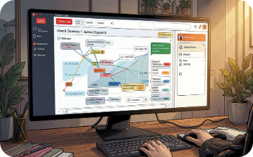
Real-World Applications & Platforms
Google Cloud Vertex AI
Azure AI Search
LlamaIndex
Oracle APEX & Database 23ai
Building financial analysis agents using unstructured SEC filings and structured stock price data.
Moving beyond basic RAG to Agentic Retrieval for scalable enterprise search solutions.
A data framework connecting LLMs to structured and unstructured data with agentic query layers.
Integrating RAG chatbots with native vector search for application-specific enterprise data.

Slide 9
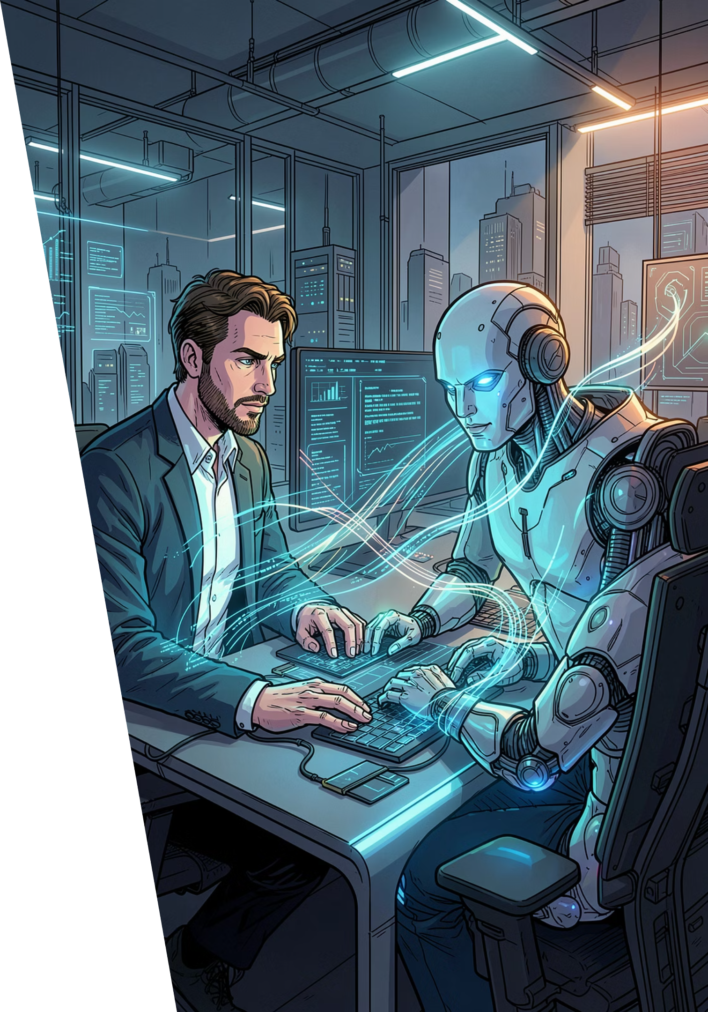
The Future: Intelligent Agents for Enterprise AI
1
Human-Like Problem Solving
Agentic RAG systems search, scan, open full documents, and synthesize findings — just like a skilled analyst.
2
Enhanced Accuracy, Reduced Hallucinations
Grounding every step in verified data sources dramatically improves trust and reliability.
3
Automation of Complex Tasks
From research to reporting, agentic AI handles multi-step workflows that were previously manual.

Slide 10

Empower Your Enterprise with Agentic AI
Take Action
The Vision
Explore Azure AI Search, Google Vertex AI, and LlamaIndex
Start with a high-value use case: research, compliance, or customer support
Build agents that access, reason over, and act on your enterprise data
The journey from RAG to agentic AI is not just a technical upgrade — it's a strategic transformation.
Organizations that embrace agentic AI will deploy smarter, more responsive, and more powerful solutions — turning data into decisive action.
The future of enterprise AI is autonomous, grounded, and actionable.

