Slide 1

Department of Computer Science and Engineering
23CSB201 – OBJECT ORIENTED PROGRAMMING
I B.Tech. AIML-B / II SEMESTER
UNIT - 5
Introduction to IO Streams in Java
SNS COLLEGE OF TECHNOLOGY
An Autonomous Institution
Coimbatore-35
09/01/2026 23CSB201 | IO STREAMS AND JAVASCRIPT | Object Oriented Programming | Ms Kirupa SNSCT
01/10

Slide 2
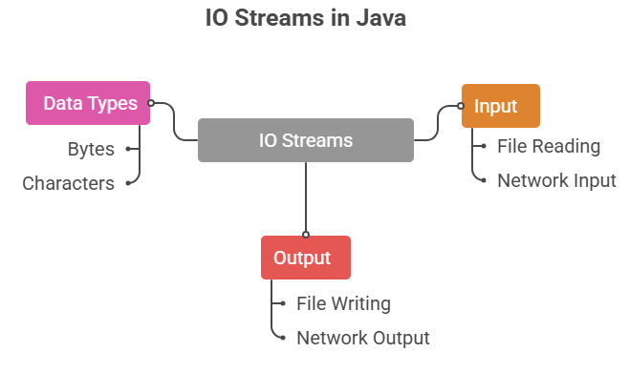
Introduction to IO Streams in Java
IO Streams are used to read and write data
IO stands for Input and Output
Streams represent a flow of data
Data can be bytes or characters
09/01/2026 23CSB201 | IO STREAMS AND JAVASCRIPT | Object Oriented Programming | Ms Kirupa SNSCT
02/10

Slide 3
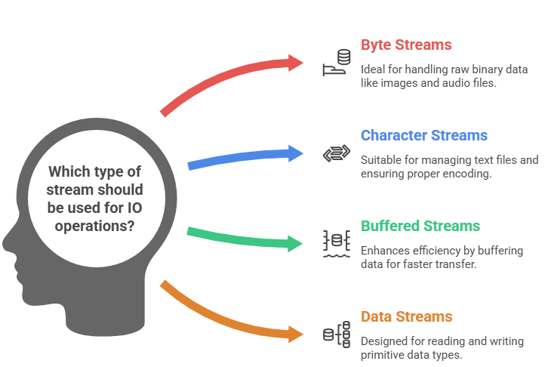
Types of Streams in Java
09/01/2026 23CSB201 | IO STREAMS AND JAVASCRIPT | Object Oriented Programming | Ms Kirupa SNSCT
03/10

Slide 4
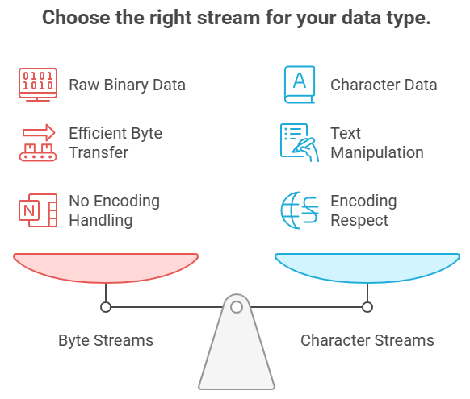
Byte Streams and Character Streams
09/01/2026 23CSB201 | IO STREAMS AND JAVASCRIPT | Object Oriented Programming | Ms Kirupa SNSCT
04/10

Slide 5
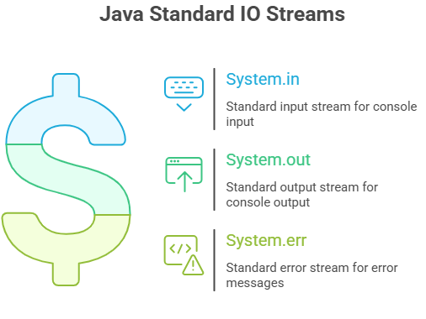
Standard IO Streams
Java provides three standard I/O streams accessible via the java.lang.System class:
System.in
System.out
System.err
09/01/2026 23CSB201 | IO STREAMS AND JAVASCRIPT | Object Oriented Programming | Ms Kirupa SNSCT
05/10

Slide 6
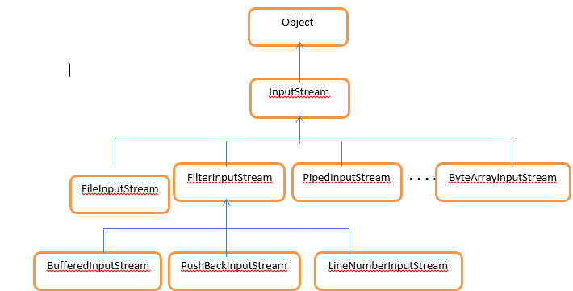
IO Streams Hierarchy Diagram
06/10
09/01/2026 23CSB201 | IO STREAMS AND JAVASCRIPT | Object Oriented Programming | Ms Kirupa SNSCT

Slide 7
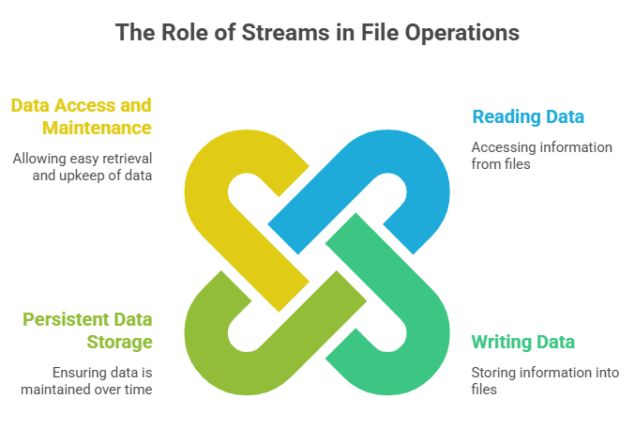
File Handling using IO Streams
File handling using I/O streams involves treating a file as a continuous sequence of data (a stream) that can be read from or written to by a program.
09/01/2026 23CSB201 | IO STREAMS AND JAVASCRIPT | Object Oriented Programming | Ms Kirupa SNSCT
07/10

Slide 8
Questions to Solve
Explain the need for IO Streams in a Java application that processes large amounts of data from external sources.
  Differentiate between byte streams and character streams with examples.
  Draw and label the basic hierarchy of InputStream and OutputStream classes.
A multimedia application needs to handle both text configuration files and binary image data.
  Which type of streams would you choose for each, and why?
  How does buffering improve performance in such scenarios?
09/01/2026 23CSB201 | IO STREAMS AND JAVASCRIPT | Object Oriented Programming | Ms Kirupa SNSCT
08/10

Slide 9
Summary:
IO Streams manage input and output operations
  Java provides byte and character streams
  Used widely for file and console operations
  Essential concept in Java programming
09/01/2026 23CSB201 | IO STREAMS AND JAVASCRIPT | Object Oriented Programming | Ms Kirupa SNSCT
09/10

Slide 10
REFERENCE
https://www.geeksforgeeks.org/java/java-io-input-output-in-java-with-examples/
https://www.tutorialspoint.com/java/java_files_io.htm
https://www.geeksforgeeks.org/java/file-handling-in-java/
https://www.w3schools.com/java/java_io_streams.asp
09/01/2026 23CSB201 | IO STREAMS AND JAVASCRIPT | Object Oriented Programming | Ms Kirupa SNSCT
10/10

Slide 11

09/01/2026 23CSB201 | IO STREAMS AND JAVASCRIPT | Object Oriented Programming | Ms Kirupa SNSCT

