Slide 1

Department of Computer Science and Engineering
23CSB201 – OBJECT ORIENTED PROGRAMMING
I B.E. AIML-B / II SEMESTER
UNIT - 5
Console Operation
SNS COLLEGE OF TECHNOLOGY
An Autonomous Institution
Coimbatore-35
12/01/2026 23CSB201 | Console Operation | Object Oriented Programming | Ms Kirupa AP/CSE / SNSCT
01/10

Slide 2
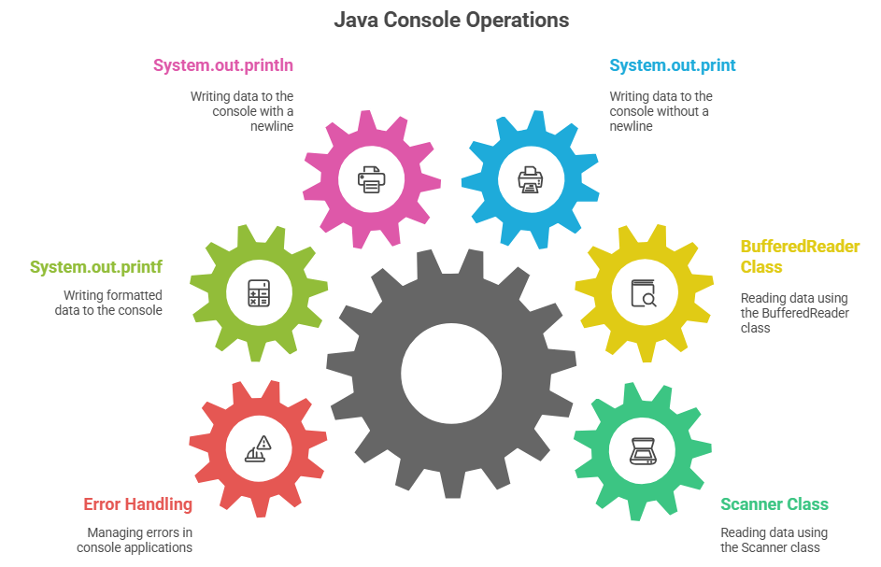
Introduction
Console operations primarily involve reading input from the user and writing output to the screen. The main methods utilize the System.out and System.in streams, the Scanner class, and the Console class.
12/01/2026 23CSB201 | Console Operation | Object Oriented Programming | Ms Kirupa AP/CSE / SNSCT
02/10

Slide 3
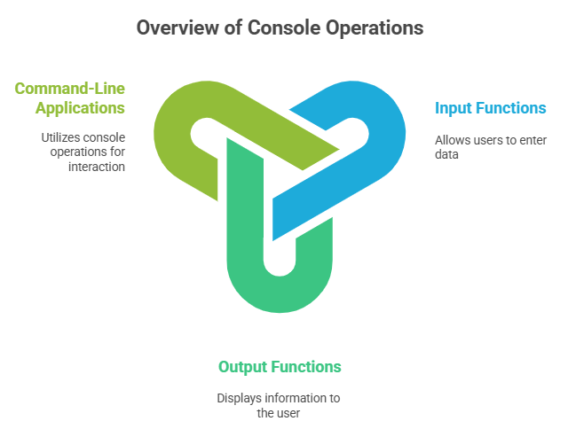
What is Console Operation?
Console operations include:
- Taking input from the user
- Displaying output on the screen
Commonly used in command-line applications.
12/01/2026 23CSB201 | Console Operation | Object Oriented Programming | Ms Kirupa AP/CSE / SNSCT
03/10

Slide 4
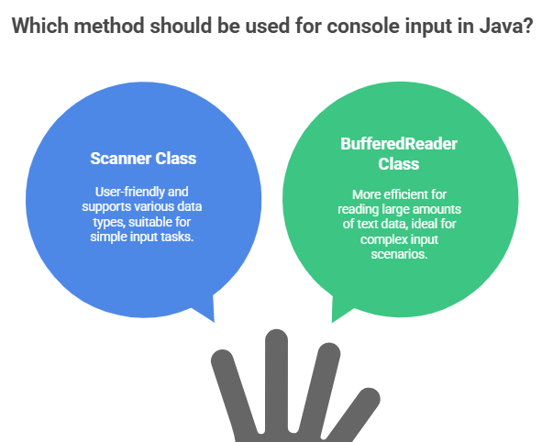
Console Input in OOP
Using the `Scanner` Class
The Scanner class, part of the java.util package, offers a simple and convenient way to parse primitive types and strings from an input stream, such as the console.
04/10
12/01/2026 23CSB201 | Console Operation | Object Oriented Programming | Ms Kirupa AP/CSE / SNSCT

Slide 5
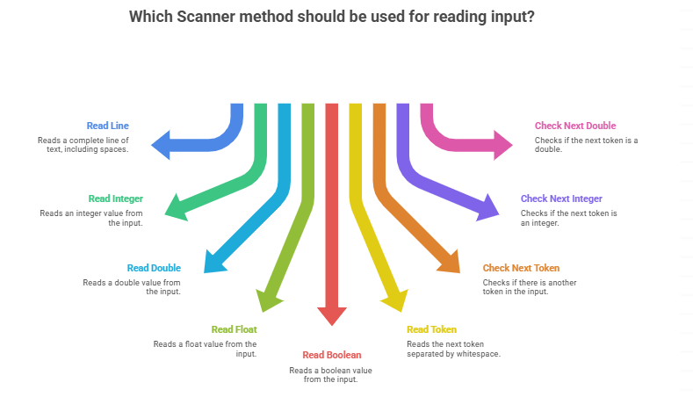
Common Scanner Methods:
12/01/2026 23CSB201 | Console Operation | Object Oriented Programming | Ms Kirupa AP/CSE / SNSCT
05/10

Slide 6
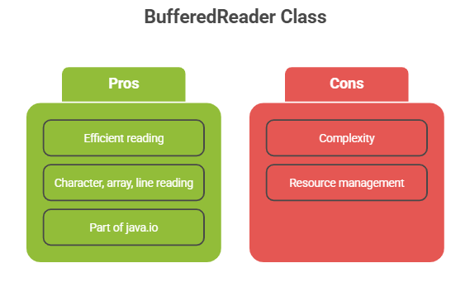
Using the `BufferedReader` Class
The BufferedReader class, part of the java.io package, provides a more efficient way to read large amounts of text from an input stream.
12/01/2026 23CSB201 | Console Operation | Object Oriented Programming | Ms Kirupa AP/CSE / SNSCT
06/10

Slide 7
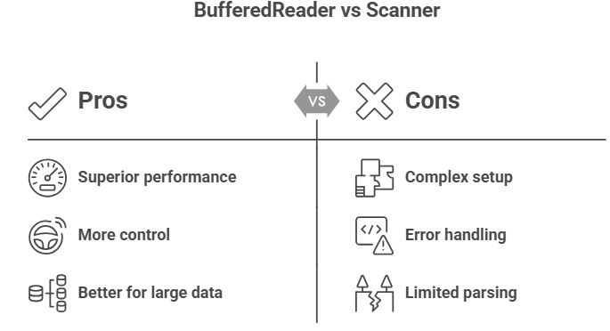
Advantages of BufferedReader over Scanner
12/01/2026 23CSB201 | Console Operation | Object Oriented Programming | Ms Kirupa AP/CSE / SNSCT
07/10

Slide 8
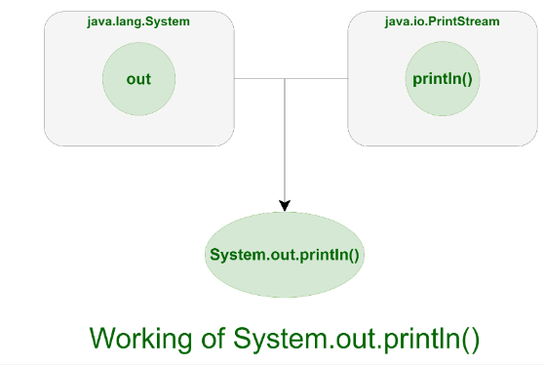
System.out.println in Java
12/01/2026 23CSB201 | Console Operation | Object Oriented Programming | Ms Kirupa AP/CSE / SNSCT
08/10

Slide 9
Summary:
The Java Console provides information about the Java version, user home directory, and any error message that occurs while running an applet or application.
12/01/2026 23CSB201 | Console Operation | Object Oriented Programming | Ms Kirupa AP/CSE / SNSCT
09/10

Slide 10
REFERENCE
https://www.w3schools.com/java/java_output.asp
https://www.tutorialspoint.com/java/io/java_io_console.htm
https://www.geeksforgeeks.org/java/system-out-println-in-java/
12/01/2026 23CSB201 | Console Operation | Object Oriented Programming | Ms Kirupa AP/CSE / SNSCT
10/10

Slide 11

12/01/2026 23CSB201 | Console Operation | Object Oriented Programming | Ms Kirupa AP/CSE / SNSCT

