Slide 1

Department of Computer Science and Engineering
23CSB201 – OBJECT ORIENTED PROGRAMMING
I B.E. AIML-B / II SEMESTER
UNIT - 5
File Operation
SNS COLLEGE OF TECHNOLOGY
An Autonomous Institution
Coimbatore-35
19/01/2026 23CSB201 | File Operation | Object Oriented Programming | Ms Kirupa AP/CSE / SNSCT
01/10

Slide 2
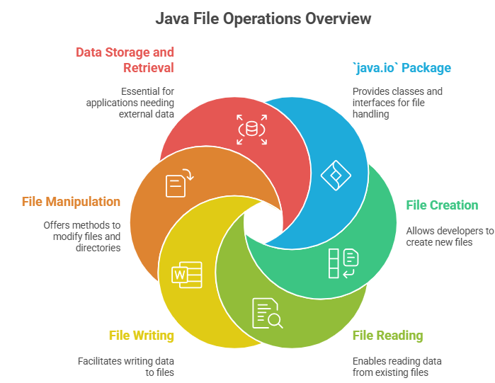
Introduction
19/01/2026 23CSB201 | File Operation | Object Oriented Programming | Ms Kirupa AP/CSE / SNSCT
02/10

Slide 3
19/01/2026 23CSB201 | File Operation | Object Oriented Programming | Ms Kirupa AP/CSE / SNSCT
03/10

Slide 4
19/01/2026 23CSB201 | File Operation | Object Oriented Programming | Ms Kirupa AP/CSE / SNSCT
04/10

Slide 5
19/01/2026 23CSB201 | File Operation | Object Oriented Programming | Ms Kirupa AP/CSE / SNSCT
05/10

Slide 6
19/01/2026 23CSB201 | File Operation | Object Oriented Programming | Ms Kirupa AP/CSE / SNSCT
06/10

Slide 7
19/01/2026 23CSB201 | File Operation | Object Oriented Programming | Ms Kirupa AP/CSE / SNSCT
07/10

Slide 8
19/01/2026 23CSB201 | File Operation | Object Oriented Programming | Ms Kirupa AP/CSE / SNSCT
08/10

Slide 9
19/01/2026 23CSB201 | File Operation | Object Oriented Programming | Ms Kirupa AP/CSE / SNSCT
09/10

Slide 10
REFERENCE
19/01/2026 23CSB201 | File Operation | Object Oriented Programming | Ms Kirupa AP/CSE / SNSCT
10/10

Slide 11

19/01/2026 23CSB201 | File Operation | Object Oriented Programming | Ms Kirupa AP/CSE / SNSCT

