Slide 1

Dr. SNS RAJALAKSHMI COLLEGE OF ARTS AND SCIENCE
(AUTONOMOUS)
Department of Mathematics
DISCRETE MATHEMATICS WITH PROBABILITY AND HYPOTHESIS TESTING
Unit IV
Topic: Test of Hypothesis
Dr. K.Sasikala
Assistant Professor
Dept. of Mathematics
Dr. SNSRCAS

Slide 2
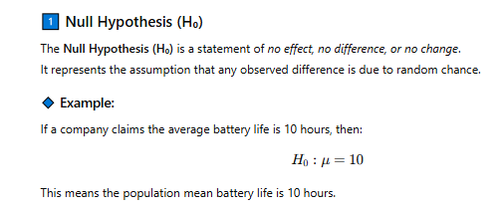
1.Define Null Hypothesis with Example.
2.What is alternate hypothesis? Give an example.
3.State the meaning of degrees of freedom in hypothesis testing.
4.Explain level of significance (α) in large sample tests.
4.Define Type I error with its probability notation.
5.What is Type II error? Provide its formula.

Slide 3
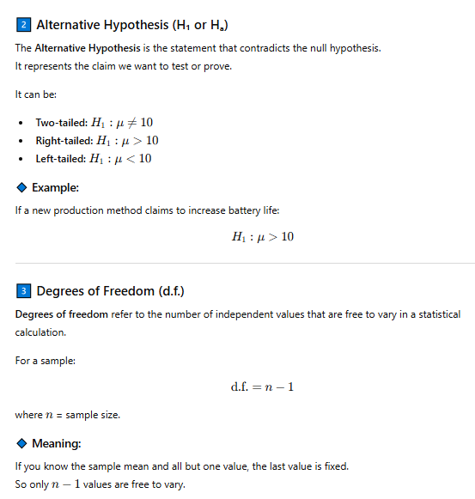

Slide 4
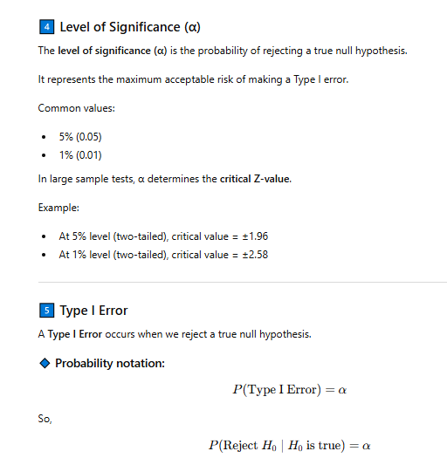

Slide 5
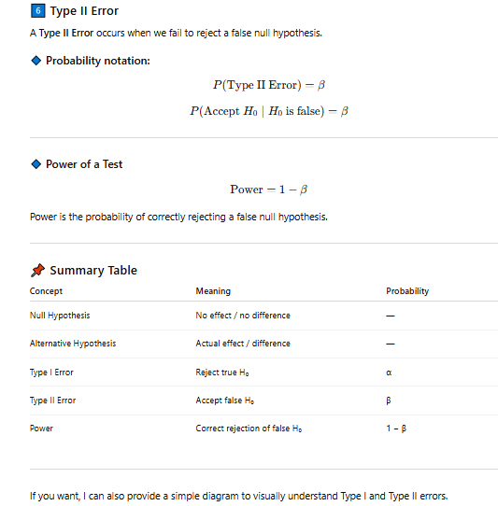

Slide 6
Thank You

